Slide 1


Covid Recovery Insight Project: Cash-First Approaches

Slide 2
Definition: Cash-First Approaches
Cash-First approaches mean providing people with money, rather than emergency food or in-kind support, making them an effective and dignified form of support to people facing hardship locally. They can have an immediate impact on people’s lives*.
There are different ways to embed Cash-First information and resources into partners’ work supporting low income and vulnerable communities across communities. A Cash-First approach focuses on the rationale that maximising income is effective in aiding lower-income residents facing food insecurity.
In a major study**of approaches to tackle food vulnerability during the pandemic the authors explain how ‘cash first’ or ‘income-based’ work encompassed a range of responses including:
  schemes designed to refer or support people to access and maximise their entitlements to the social security system (e.g. signposting or advice services)
  as well as the provision of additional cash support on top of access to basic entitlements through crisis emergency payments (e.g. emergency finance schemes).
Notes:
*Edinburgh Community Food and the Cash First Approach
**Local responses to household food insecurity across the UK during COVID-19 (September 2020 – September 2021). An analysis of experiences from 14 local areas from around the UK and recommendations for future policy and practice appendix (2021)

Slide 3
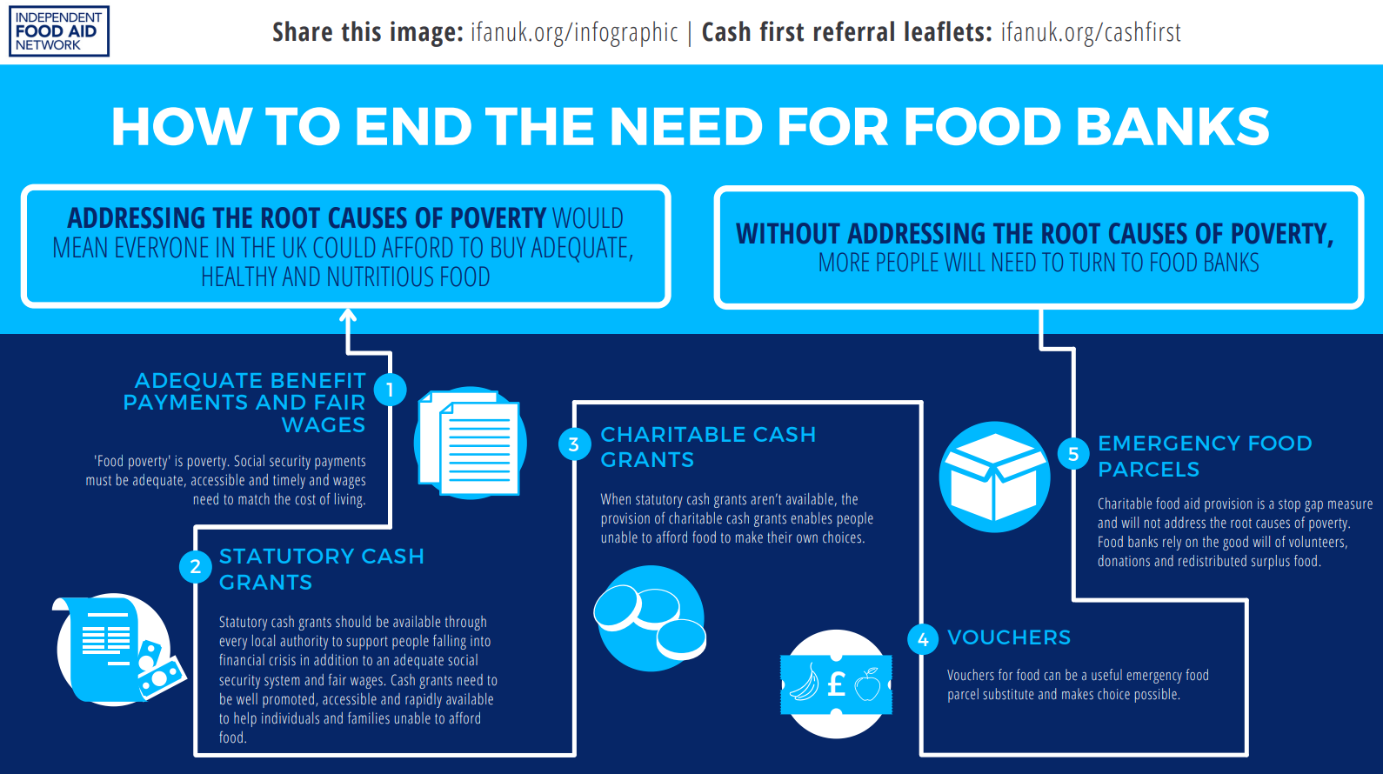
Notes:
IFAN’s ‘Worrying About Money?’ project aims to reduce the need for charitable food aid by helping people access any existing financial entitlements and advice on income maximisation as a cash first approach to food insecurity. Find out more here.

Slide 4
Evidence
A strong review in 2018 of interventions to address household food insecurity in high-income countries supported cash-first approaches above alternatives and concluded that research on social protection interventions suggests both cash transfers and food subsidies (e.g. the US Supplement Nutrition and Assistance Programme in the USA) reduce household food insecurity | A more recent longitudinal review of local responses to the pandemic in 14 local authority areas of the UK found positive, but different, outcomes associated with income maximisation interventions, compared to cash grants and vouchers. See concluding remark below:
“These practical examples of a ‘cash first approach’, both support for income maximisation and discretionary cash grants were underpinned by a general consensus across the study’s research workshops that ‘cash based’ interventions are the most appropriate because they were seen to provide recipients with choice and dignity. However, similar to earlier findings from these authors, it was acknowledged that there is no ‘one size fits’ all solution with some noting the need for tailoring depending on particular circumstances, for example in rural areas where the cost of living is more expensive or when, despite maximised income, households still experience poverty due to the inadequacy of the welfare support they receive
Notes:
Sources
1:
Interventions to address household food insecurity in high-income countries (2018)
2:
Local responses to household food insecurity across the UK during COVID-19 (September 2020 – September 2021). An analysis of experiences from 14 local areas from around the UK and recommendations for future policy and practice appendix (2021)

Slide 5
Evidence – Scotland’s policies working?
The Trussell Trust statistics going back to 2014/15 showed that in every region and country of the UK the figures had risen year on year – with one exception. In Scotland, in 2021, there had been a fall. Then, on 24 November 2021, the Trust published more recent statistics, up to September and the trend had continued. “Different policy interventions in Scotland to boost the income of people in receipt of social security may have impacted on the levels of need for food banks in this period.” (Trussell Trust Data Briefing 2021)
“Significant evidence exists to show that increasing the value of benefits reduces overall levels of need for food banks. Statistical modelling carried out as part of the State of Hunger (2021) research found that an increase of £1 in the value of all main income replacement benefits was associated with a decrease of 2.6 per cent in the number of parcels given out in a typical local authority.”
Notes:
Sources
1:
Microsoft Word - Mid-year stats briefing 2021_V3_Final (trusselltrust.org)
2:
Local responses to household food insecurity across the UK during COVID-19 (September 2020 – September 2021). An analysis of experiences from 14 local areas from around the UK and recommendations for future policy and practice appendix (2021)

Slide 6
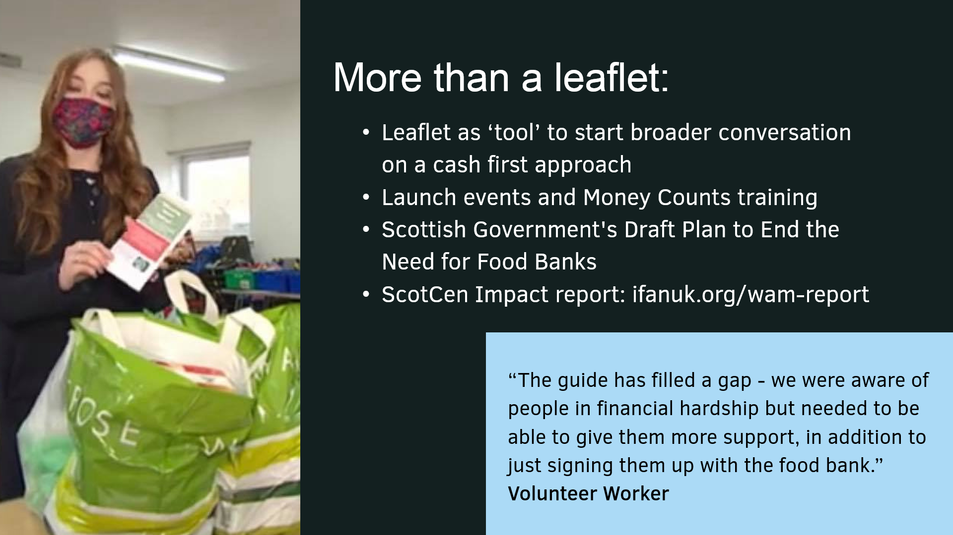
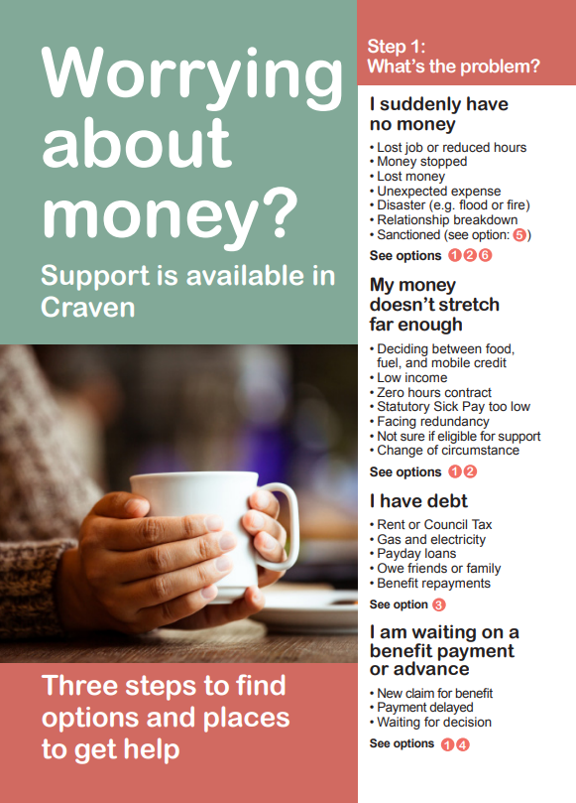
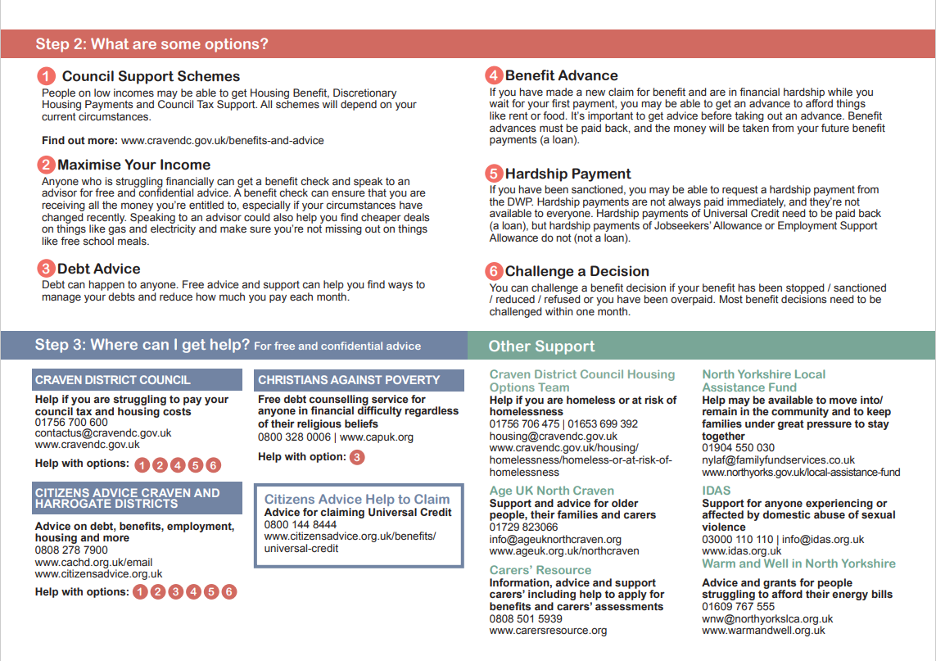
IFAN Worrying about Money Cash Referral Leaflet evaluation (2021)
Overall, the leaflet has been viewed very positively by participants.
It has been recognised as a useful tool which can help support income maximisation and poverty reduction work at a service, organisational and local authority level.
The main impact reported by participants is that the leaflet has helped raise awareness amongst staff, volunteers and people experiencing financial challenges, which organisations can provide financial support and how they can be accessed.
Staff and volunteers also reported that the leaflet had given them confidence to discuss money with people experiencing financial challenges and signpost or refer them to staff.
While it has been challenging to capture the impact the leaflet has had on individuals experiencing financial difficulties, participants were able to give examples of incomes of those experiencing financial hardship being increased as a result of referrals.

Slide 7
Outcomes associated with Cash-First approaches
Outcomes for individuals
More dignity compared to alternatives
More choice compared to alternatives
More flexibility for households to address their most pressing financial issues
Greater confidence amongst staff and volunteers to discuss money with people experiencing financial challenges and signpost or refer them to staff
Increased incomes for those experiencing financial hardship
Healthier behaviours (and with more income, life expectancy*)
Outcomes for organisations
Support income maximisation work by organisations
Support food insecurity and poverty reduction work by organisations
Raised awareness amongst staff, volunteers and people experiencing financial challenges which organisations can provide financial support and how they can be accessed
Tools (e.g. cash-first leaflet) easy to replicate and roll out in different places affordable
Outcomes for communities / system
Injecting funds into the local economy
Referral pathways into support are strengthened
Notes:
Sources
Local responses to household food insecurity across the UK during COVID-19 (September 2020 – September 2021). An analysis of experiences from 14 local areas from around the UK and recommendations for future policy and practice appendix (2021)
Interventions to address household food insecurity in high-income countries (2018)
IFAN Worrying about Money Cash Referral Leaflet evaluation (2021)
Sustain: Cash-first approaches to addressing food poverty (2022)
Trussell Trust data briefing on mid-year statistics relating to use of food banks: April 2021 –September 2021
Trussell Trust, Cash first literature review (2022)
An evaluation of the Leeds City Council Cash Grant Pilot Programme (2022)
Five lessons – Learnings from Leeds Cash first evaluation (2022)
* Relationship between income and healthy life expectancy by local authority, Health Foundation (2021)

Slide 8
Outcomes associated with food voucher schemes
Credit for analysis below: Dr Megan Blake, University of Sheffield (2022)
Access to food/amount of food: The voucher schemes reviewed provide access to only fruits and vegetables to the recipients and in low-income families and areas where access to fruits and vegetables is limited.
Outcomes for individuals
Improves food and nutrition security
Behaviour changes and healthy eating outcomes
Improves Wellbeing Improves household financial wellbeing
Outcomes for communities
Community resilience and social infrastructure. Buying from community markets and stalls increase social cohesion in neighbourhood and provides meeting place for diverse community members for connections and conversations. Place-based voucher schemes have the potential to increase social interaction.
Investments in local economy. Vouchers are mostly redeemed at the local fruits and vegetable markets/stalls - increasing customers for participating stalls, co-operatives and FV producers and increase spending in local market and have the potential to increase footfall in local markets.
Connecting with community services /strengthening communities. Place-based voucher scheme is likely to received greater level of support from local stakeholders and leaders and therefore have maximum impact. And the Rose VS are delivered in partnership with existing local organisations and existing activities focused on health and wellbeing to support families in their local area therefore increase community resilience and social interactions.
Notes:
Sources
Local responses to household food insecurity across the UK during COVID-19 (September 2020 – September 2021). An analysis of experiences from 14 local areas from around the UK and recommendations for future policy and practice appendix (2021)
Interventions to address household food insecurity in high-income countries (2018)
IFAN Worrying about Money Cash Referral Leaflet evaluation (2021)
Sustain: Cash-first approaches to addressing food poverty (2022)
Trussell Trust data briefing on mid-year statistics relating to use of food banks: April 2021 –September 2021
Trussell Trust, Cash first literature review (2022)
An evaluation of the Leeds City Council Cash Grant Pilot Programme (2022)
Five lessons – Learnings from Leeds Cash first evaluation (2022)
* Relationship between income and healthy life expectancy by local authority, Health Foundation (2021)

Slide 9
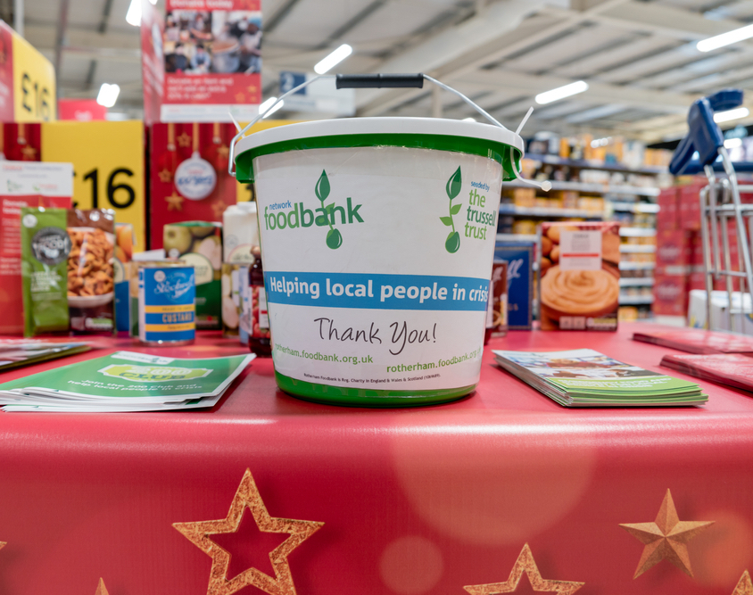
Leeds Cash-First Pilot Evaluation
The pilot scheme provided cash grants to people in financial hardship in Leeds, running from 1 October 2021 to 1 April 2022, and distributed £45,450 between 187 grants, supporting 283 individuals rather than emergency food aid (parcels).
The pilot scheme aimed to impact four areas for grant recipients:
To increase their emotional wellbeing
To negate the need for further food bank use within 12 months
To enable them to be better able to afford the essentials
To enable them to be better able to manage their financial situation
Notes:
1. Cash grants have an immediate impact on a person’s financial situation and can prevent them from needing to turn to a food bank for support.
2. Cash grants are a more dignified form of support when people face financial hardship - people overwhelmingly prefer receiving a cash grant than an emergency food parcel from a food bank.
3. People use cash to buy the essential items, particularly food, gas, and electricity. This strongly supports existing international and UK evidence that cash transfers do not lead to ‘misuse’.
4. Cash grants can also unlock benefits beyond purchasing the essentials, including paying down debt or reducing the impact of larger one-off costs such as paying for a car’s MOT to be able to get to work. This can be vital in putting people on a financially secure foundation for the long-term.
5. Cash grants should be an option when providing support to people facing financial hardship locally, but alone can only provide short-term respite. They should be situated within a wider local ecosystem of support available to people, alongside a national social security system which provides people with enough income to afford the essentials.

Slide 10
Leeds Cash-First Pilot Evaluation: 5 learning lessons
1: Cash grants have an immediate impact on a person’s financial situation and can prevent them from needing to turn to a food bank for support.
2: Cash grants are a more dignified form of support when people face financial hardship - people overwhelmingly prefer receiving a cash grant than an emergency food parcel from a food bank.
3: People use cash to buy the essential items, particularly food, gas, and electricity. This strongly supports existing international and UK evidence that cash transfers do not lead to ‘misuse’.
4: Cash grants can also unlock benefits beyond purchasing the essentials, including paying down debt or reducing the impact of larger one-off costs such as paying for a car’s MOT to be able to get to work. This can be vital in putting people on a financially secure foundation for the long-term.
5: Cash grants should be an option when providing support to people facing financial hardship locally, but alone can only provide short-term respite. They should be situated within a wider local ecosystem of support available to people, alongside a national social security system which provides people with enough income to afford the essentials.
Longer-term impacts of the scheme included the ability to accumulate small amounts of savings, increased confidence in financial management, debt repayment, and purchase of durable household items.
The cost of living crisis, other personal issues and the design and delivery of Universal Credit all negatively affected the longer term impact of the scheme.

Slide 11
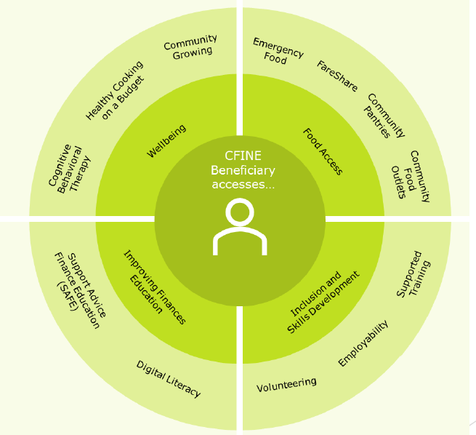
Community Food Initiatives North East (CFINE)
Learning lessons from their cash-first approaches
Emergency food does not solve the problem; it creates dependency, erodes dignity, does not change status quo, However, essential if no other way of accessing essential support e.g., food.
Food is more than often, the “vehicle” to other essential support services available
‘Cash first’ as a standalone approach simply does not work. Beneficiaries need access to a range of wrap-around services to tackle underlying issues/causes.
Poverty is often complex and for this reason, requires holistic and person-centred responses. (see diagram overleaf).

Slide 12
CFINE cash-first approaches (income maximisation examples)
Income Maximisation example: Support, Advice, Finance, Education (SAFE)
Financial capability/inclusion team based ‘on the ground’ at CFINE
Welfare/benefits support and advice (including supporting benefit applications, appeals, tribunals)
Budgeting advice
Wraparound support including accessing additional services e.g., Pantries, Volunteering, Employability, Cooking
2021-22 secured £1,586,372 in financial gain for beneficiaries
Income Maximisation example: Employability & Skills Development
Introductory & Warehouse Skills Development Programmes
Stage 1-4 of Employability Pipeline delivered in-house
Work experience and training
Accredited training (e.g., food safety, forklift accreditation)
Employability support (CV’s, interview prep, job search)
Cooking on a budget, 1 to 1 SAFE and wraparound support
62% success rate of participants gaining employment within 6 months

Slide 13
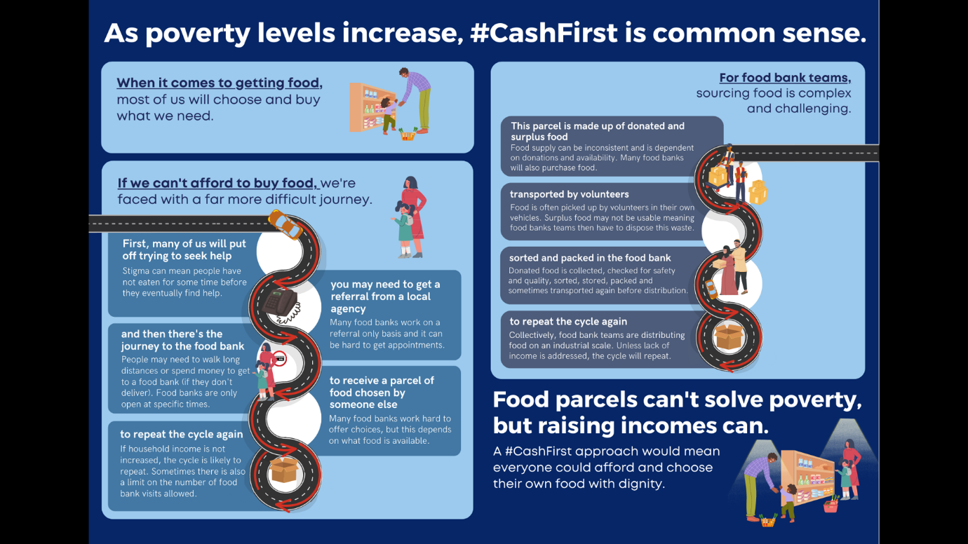
Notes:
Please see these links for further arguments linked to this topic
Why Cash First? - Independent Food Aid Network UK
The case for cash first - moving on from vouchers and food parcels as a response to food insecurity | November 2021 | READ HERE
Webinar: Cash-first approaches to addressing food poverty | Sustain | February 2021 | READ HERE
The growing need for charitable food aid and a cash first approach to food insecurity | Isle of Wight Food Waste and Food Poverty Conference | November 2022

Slide 14
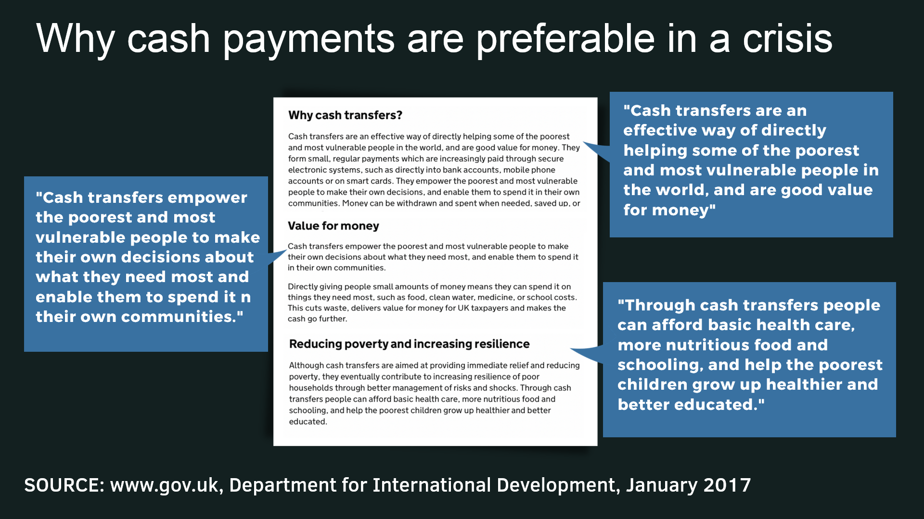
Notes:
Please see these links for further arguments linked to this topic
Why Cash First? - Independent Food Aid Network UK
The case for cash first - moving on from vouchers and food parcels as a response to food insecurity | November 2021 | READ HERE
Webinar: Cash-first approaches to addressing food poverty | Sustain | February 2021 | READ HERE
The growing need for charitable food aid and a cash first approach to food insecurity | Isle of Wight Food Waste and Food Poverty Conference | November 2022

Slide 15
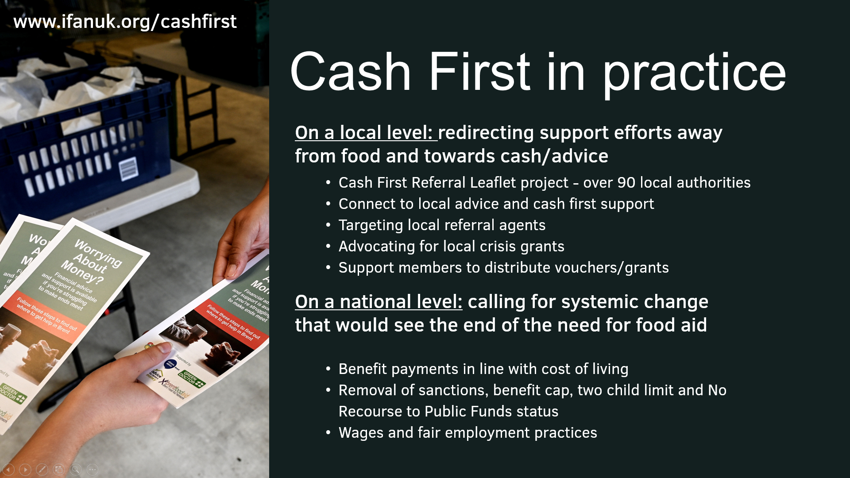
Notes:
Please see these links for further arguments linked to this topic
Why Cash First? - Independent Food Aid Network UK
The case for cash first - moving on from vouchers and food parcels as a response to food insecurity | November 2021 | READ HERE
Webinar: Cash-first approaches to addressing food poverty | Sustain | February 2021 | READ HERE
The growing need for charitable food aid and a cash first approach to food insecurity | Isle of Wight Food Waste and Food Poverty Conference | November 2022

Slide 16
Questions arising
How can local authorities address increased financial hardship and food insecurity in an efficient and just way?
What work are local authorities and others doing to ensure that money gets directly to those who need it the most?
How can Cash-First responses work most effectively alongside models of wrap-around support?
Under what conditions would local authorities consider Cash-First rather than alternative forms of support that might unintentionally create dependency?
Do the examples in the main report help us visualise further ways in which community cafes could play a part in actively promoting and participating in Cash-First approaches e.g. like the Edinburgh Take 5 Access arrangements? (see slide notes for details)
Would any change to the existing welfare assistance schemes enhance the positive outcomes for people in hardship feeling dignity, choice and control?
Notes:
Edinburgh Community Food has shared learning about its Cash-First approaches at a November 2022 conference. Take 5 Access is a partnership supporting Edinburgh's Community Cafés post COVID with objectives to support individual with healthier food to eat socially, healthier food to take home, resources and skills to use healthier food, have access to Cash-First support and resources and connecting communities through the Community Café network. It aims to reduce the risk of food insecurity, increase opportunities for healthier food; and enhance the provision of skills, resources and supported signposting. Community cafes received fresh produce and recipes for three months, free meals for children, fuel payments for those in need, fruit/meal kits to take home, online cooking groups, Ask and Act: CHAI/GIC, tablets and training for staff/volunteers. Impact: Café staff: ‘The [Ask & Act] stalls were a huge hit and we are arranging for more. We have thoroughly enjoyed taking part in this project. It has engaged us with our community in a fun, caring, supportive and educational way. The elderly in our cafe seemed most to appreciate this. We have a lot of people come to eat so they don't have to, can't or don't know how to cook at home.’ REHIS Training: ‘Excellent…..good mix of facts, visuals, discussion & real life examples / I will be able to introduce what I’ve learned over the last two days in our kitchen.’ Eat Well Age Well training: ‘It has given me the means to enter into the conversation with customers and to access ways to help.’
Challenges
Understanding ECF has a role to play around cash first when capacity already pushed
ECF must support and enable cafes and communities to improve health and wellbeing
Complexity of benefits/welfare systems
Benefits training from CHAI: highlighted importance of expert partnerships
Catering staff/volunteer capacity
Adapting project delivery to assist café capacity
Legacy
ECF staff: increased understanding and embedding in delivery e.g. Best Start/Pension Credits/£25 Scottish Child Payment uplift
ECF developed partnerships, have become a bigger part of a wider solution
ECF focused on impact of policy on our communities, voice for community to government
Involved in End Hunger Edinburgh, Ending the Need for Food Banks, members of Poverty Alliance
Cash First Edinburgh and Cash First (edinburghcommunityfood.org.uk)

