Slide 1
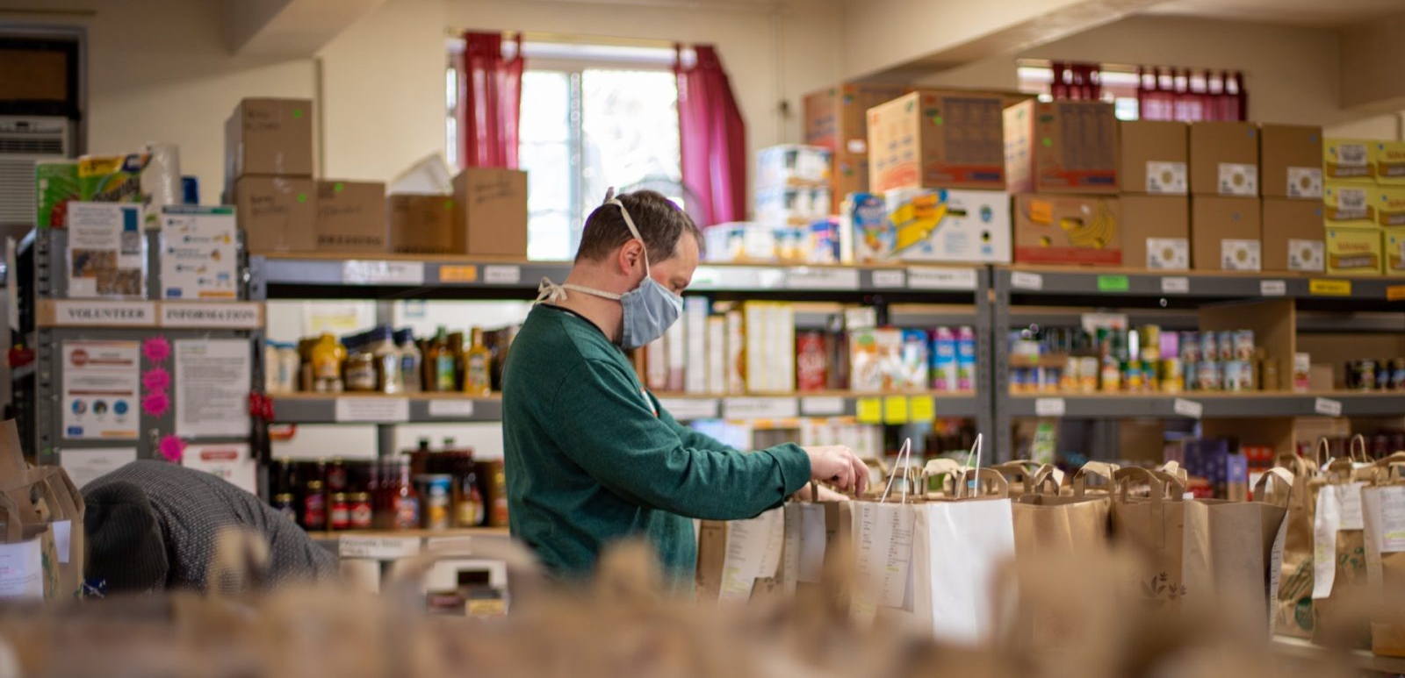

Collaborative Models
Food Partnerships, Networks, Alliances, Taskforces
Covid Recovery Insight Project: Food Insecurity
Notes:
Image from: https://speri.dept.shef.ac.uk/2022/02/10/new-report-local-responses-to-household-food-insecurity-across-the-uk-during-the-covid-19-pandemic/
This presentation draws on the finding from 10 of the most relevant studies identified in the literature review.
Local responses to household food insecurity across the UK during COVID-19 (September 2020 to September 2021). An analysis of experiences from 14 local areas from around the UK and recommendations for future policy and practice.
Food Power, Final Evaluation Report (2021)
Working in collaboration - Leeds Food Insecurity Taskforce (2022)
Food Insecurity: Understanding local delivery, impact and innovation in the North East Riding (2021)
The Value of Local Food Partnerships: UK Sustainable Food Places Evaluation Report (2022)
Household Food Security in the UK: A Review of Food Aid Final Report (2014)
Food Poverty Alliances (2019)
Ways to care: Forms and possibilities of compassion within UK food banks (2021)
East Riding Food Poverty Alliance End of project feedback for lottery (2021)
Seeking Justice. How to understand and end food poverty in York (2019)

Slide 2
Definitions and Characteristics
Local Food Partnerships (LFPs) are cross-sector bodies that own and drive forward agendas on their local food system. Sub regional partners may also play a part.
Local Food Partnerships involve local authorities and other public bodies, working together with third sector, faith groups, business, and academic organisations with the goals of promoting public health and wellbeing; fostering community connection and resilience; building prosperous and diverse local food economies; and helping to tackle the sustainability issues of waste and the climate and nature emergency.
Food Poverty Alliances (FPAs) can take different forms. Some are sub-groups of pre-existing local food partnerships whilst others have recently emerged from coordinating responses to Covid-19.
Alliances share responsibility for their sustainability, funding, reaching out to organisations that might be harder to engage and maintaining momentum, even during periods of lower funding. Evaluations of LFPs and FPAs were found in the evidence review, whilst food insecurity alliances or taskforces appear to be a more recent development and nomenclature with fewer published evaluations of their effects to date.
The activities delivered by different collaborative models include but are not limited to:
Supporting food access: - low cost community food retail e.g. social supermarkets, pantries (membership / nominal payment)
Wrap around support e.g. money advice services, signposting, apps
Cash based responses e.g. income maximisation, cash grants and vouchers
Resources for food response
Direct food provision (to people’s homes and out of home)
Notes:
Evaluations of LFPs and FPAs were found in the evidence review, whilst ‘food insecurity alliances’ or ‘taskforces’ appear to be a more recent development and nomenclature with fewer published evaluations of their effects to date.

Slide 3
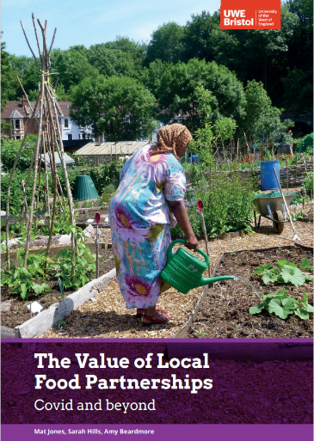
Local Food Partnerships
Local Food Partnerships (LFPs) have been uniquely placed to provide systems leadership and practical solutions through the strategic direction and support of the UK-wide Sustainable Food Places (SFP) programme, established a decade prior to the pandemic.
LFPs have been able to pivot to respond with agility to an extended period of national crisis and have moved forward to offer a coherent framework for the transition of local food system.
The four dimensions of 'effectiveness', 'efficiency', 'engagement', and 'equity' highlight the value of LFPs to fill the leadership gap on local food issues.
LFPs are positively name-checked in the Government’s response to the National Food Strategy
Many learning resources are available to help Food Partnerships establish themselves and / or improve from Sustain
Notes:
Outcomes drawn primarily from Food Power, Final Evaluation Report, 2021
Quote: The Value of Local Food Partnerships: UK Sustainable Food Places Evaluation Report. 2022
‘Local Food Partnerships have already brought together councils and partners from the public sector, voluntary and community groups, and businesses to reduce diet-related ill health and inequality, while supporting a prosperous local food economy. We will learn from their approaches and work to understand and identify best practice in addressing food affordability and accessibility to healthy food. As part of our levelling up mission to narrow the gap in healthy life expectancy, government will identify the areas most in need of this insight, and Defra will work with local authorities and food charities in these priority areas

Slide 4
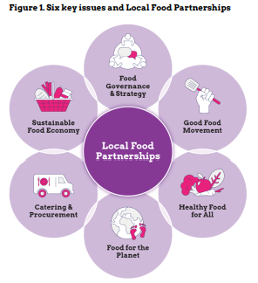
Local Food Partnerships Evaluation Conclusions
In terms of effectiveness, LFPs tackle the fragmented and siloed operations of the local food systems. Working across complex and cross-boundary environments, LFPs are a unique type of partnership that help coordinate action on dysfunctions and opportunities for change in local food systems.
Regarding efficiency, LFPs encourage public, private and third sector agencies to collaborate and share resources. Examples from SFP member areas show how this partnership model provided a powerful way to create efficiencies, eliminate duplication and create innovative solutions.
From the standpoint of engagement, LFPs are designed to focus action on the interests of people and environment, ahead of the convenience of providers. This requires having mechanisms for consultation and co-production. LFPs are configured to engage lived experiences and to find shared visions for change.
Finally, in terms of equity, LFPs respond to the moral and legal case for promoting equality, diversity and inclusion through their open networks, outreach, and democratic structure. In embracing multiple voices, LFPs act as collectives working for food system leadership at the local level.
Notes:
The Value of Local Food Partnerships. - Urban Agriculture Consortium
UK Sustainable Food Places Evaluation Report
March 2022
Introducing Local Food Partnerships and the Sustainable Food Places programme
Local Food Partnerships (LFPs) are cross-sector bodies that own and drive forward agendas on their local food system.
These partnerships involve local authorities and other public bodies working together with third sector, business, and academic organisations with the goals of promoting public health and wellbeing; fostering community connection and resilience; building prosperous and diverse local food economies; and helping to tackle the sustainability issues of waste and the climate and nature emergency.
Currently, 69 Local Food Partnerships are members of Sustainable Food Places (SFP), a UK programme led by three national sustainable food organisations – the Soil Association, Sustain and Food Matters.
The aim of SFP has been to bring about a fundamental change in the food system. SFP has sought to catalyse, inspire, and support multi-sector, local food partnerships to take a strategic and holistic approach to the sustainable food agenda.
Alongside funding, specialist resources, networking, campaigns, advocacy and tailored support, SFP provide an awards-based framework of six issues for member local food partnerships to help shape and benchmark their work (Figure 1). The six issues framework has been adapted and refined to reflect the insights of member places as they feed practical learning through the SFP member network. The first two phases of the UK programme were funded between 2012–2016 and 2016–2019 by the Esmée Fairbairn Foundation. In late 2019, the Esmée Fairbairn Foundation (EFF) and the National Lottery Community Fund (TNLCF) provided funding for a five-year phase 3 of the programme. This was accompanied with a rebranding from “Sustainable Food Cities” to “Sustainable Food Places” to reflect work with both cities and a broader range of localities. By the end of Phases 1 and 2 of the programme in 2019, research2 found that SFC had evolved into a mature and increasingly stable network of active member cities and other geographical areas. Local food partnerships were represented in local authority areas that covered a total UK population of 20.4 million people. SFC had a diverse membership including some of the UK’s most economically deprived urban areas

Slide 5
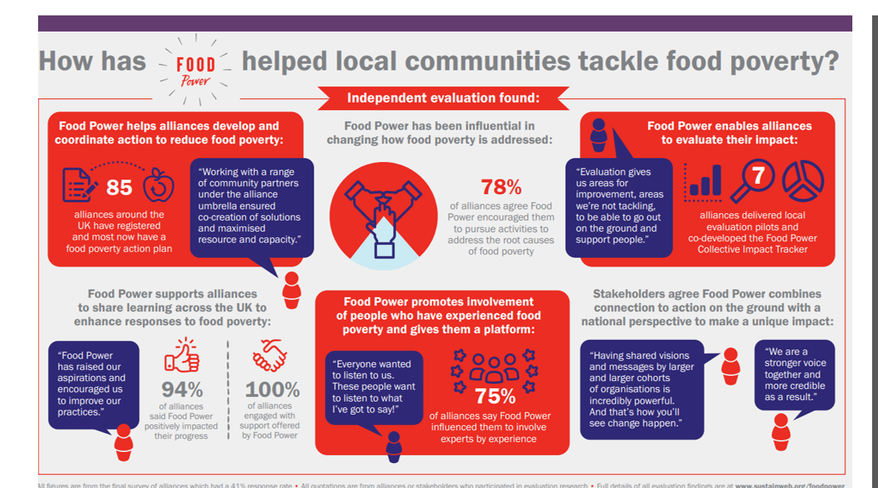
Food Power Evaluation (food poverty alliance focus)
“Research into complex challenges like food poverty suggests that progress is most likely when actors come together to seek collective impact.”
FPA action plans are available to review
A collective impact tracker tool is available
Evidence reviewed finds that food poverty alliances, whilst variable in model created a range of benefits despite their variable models and local contexts. ‘‘Despite the challenges around demonstrating an impact on the most fundamental need - levels of food poverty there is reason to be confident that Food Power has contributed positively to this. Research into complex challenges like food poverty suggests that progress is most likely when actors come together to seek collective impact.’ 9Food Power Evaluation 2017-2021)
Notes:
Source: Food Power: Final evaluation report | Sustain (sustainweb.org)

Slide 6
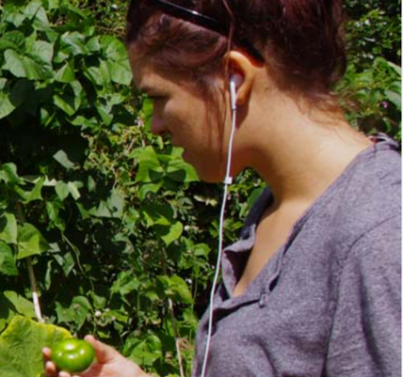
Example outcomes for Individuals from collaborative food models
Personal development for experts by experience
Increased awareness and understanding of food poverty/insecurity by all involved
Relief from / reduction in food insecurity
Empowerment through involvement in designing local action plan e.g., 76% of food poverty alliances reported that they had been influenced by Food Power to consider how to involve experts by experience
Skills development – how to co-operate, collaborate and work in partnership
Accessing new opportunities
Improved diet / access to nutritional quality of food provision
Notes:
Outcomes drawn primarily from Food Power, Final Evaluation Report, 2021
Quote: The Value of Local Food Partnerships: UK Sustainable Food Places Evaluation Report. 2022

Slide 7
Outcomes for communities / localities
Systems leadership on food issues
Improved levels of partnership working, co-ordination & collaboration
Conditions are created to find shared visions for change / common purpose
Emergence of a strategic direction and practical action / solutions
Creation of efficiencies and reduced duplication of effort locally
Improved local food systems
The assets of multiple / cross-sector partners / organisations leveraged
Increased skills and capacity compared to food aid / support models working in isolation
Development of food poverty action plans
Creation of an agenda for ‘good food’
Help tackle rural challenges which can be disproportionate to urban contexts
Organise local provisions in an agile way to meet changing needs.
Shared learning
Shared resources
Sharing good practice to improve delivery to meet local needs
Means to showcase specific interventions
New partnerships or newly constituted partnerships to meet current need
Improved monitoring, evaluation and learning of local action in an agreed / consistent way across multiple food aid / support providers
Better opportunity for demonstrating collective impact to stakeholders / communities
Raise direct funds and / or re-direct funding to align with agreed priorities
Approach and action plans influenced / prioritised by / with experts by experience
Promotion of food citizenship
Reduced food waste across the network
Promotion of equality, diversity and inclusion principles meaning that local action can be tailored to meet people with highest / different needs.
Notes:
Outcomes drawn primarily from Food Power, Final Evaluation Report, 2021
Quote: The Value of Local Food Partnerships: UK Sustainable Food Places Evaluation Report. 2022

Slide 8
Enablers and challenges of partnership working during the pandemic and more generally for food response
“….across the (14 local authority) case study areas, participants saw partnership working, coordination and collaboration as key to the success of local responses during March to August 2020. The partnership working may have been through food partnerships, food poverty alliances or other arrangements. The areas which had existing strong and active food poverty alliances or food partnerships considered this a significant enabler for a timely and coordinated response. In other areas, newly established partnerships, both formal and more informal, were warmly received and positively reflected upon.’
Enablers of partnership working during the pandemic
Recognition of the need for a joined up approach and support, no one could do it alone.
Getting the right people ‘round the table’.
Having a lead organisation that can enable collaboration.
Having established partnerships and networks in place.
Goodwill and willingness to support the response.
Learning from what was happening in other areas.
More general enablers of collaborative working for food response
A range of actors driving for comprehensive approaches and system-wide strategies
Recognising the role of third sector organisations and the limitations of food aid capacity and food supply
Increasing the reach of community food projects and other services
Cash first approaches
Peer mentoring offers a space for like-minded people to share alternative approaches to common challenge and brings structure and greater visibility to existing networks.
As specific groups have been disproportionately affected by the pandemic and its aftermath, we consider that targeting and tailoring of support warrants particular attention from practitioners and policymakers.
Notes:
Sources:
Lambie-Mumford, H., Gordon, K., Loopstra, R. and Shaw, S. (2021) ‘Comparing local responses to household food insecurity during COVID-19 across the UK (March – August 2020), published July 2021, available online http://speri.dept.shef.ac.uk/food-vulnerability-during-covid-19
Local responses to household food insecurity across the UK during COVID-19 (September 2020 September 2021). An analysis of experiences from 14 local areas from around the UK and recommendations for future policy and practice.
Food Poverty Alliances. 2019. Evaluation by Dr Spud Knowles, Dr Poppy Nicol & Dr Hannah Pitt Sustainable Places Research Institute, Cardiff University; Barbora Adlerová & Dr Andrew Williams School of Geography and Planning, Cardiff University

Slide 9
Enablers and challenges of partnership working during the pandemic and more generally for food response
“We had a lot of self-appointed people who were very busy telling everybody else, including established charities, what to do…It's a bit galling when you’ve been doing the same job for 17 years. Maybe we’ve been doing it badly for 17 years and people who've been doing it for 5 minutes know better.’”(Charitable food aid workshop, West Berkshire)
Challenges of partnership working during the pandemic
Different agendas of the actors competing with each other.
Initially, getting the right people ‘round the table’.
Lack of co-ordination.
Increase in inexperienced food aid providers.
Continually changing provision made it difficult to communicate what was available.
Accommodating an increase in inexperienced food aid providers.
Continually changing provision made it difficult to communicate what was available.
More general challenges of collaborative working for food response
Maintaining longer term relationships with experts by experience.
Sustainability challenges owing to funding are commonly reported across the literature.
The time to set up bulk buy processes.
Obtaining referrals from health professionals.
Bidding as a collective rather than individually as food providers.
Ability to demonstrate impact of the model on the most fundamental need - levels of food poverty in the UK.
‘Sticking plaster’ support does not address the underlying issues behind poverty.
Potential to create dependency rather than resilience depending on focus.
Notes:
Sources:
Lambie-Mumford, H., Gordon, K., Loopstra, R. and Shaw, S. (2021) ‘Comparing local responses to household food insecurity during COVID-19 across the UK (March – August 2020), published July 2021, available online http://speri.dept.shef.ac.uk/food-vulnerability-during-covid-19
Local responses to household food insecurity across the UK during COVID-19 (September 2020 September 2021). An analysis of experiences from 14 local areas from around the UK and recommendations for future policy and practice.
Food Poverty Alliances. 2019. Evaluation by Dr Spud Knowles, Dr Poppy Nicol & Dr Hannah Pitt Sustainable Places Research Institute, Cardiff University; Barbora Adlerová & Dr Andrew Williams School of Geography and Planning, Cardiff University

Slide 10
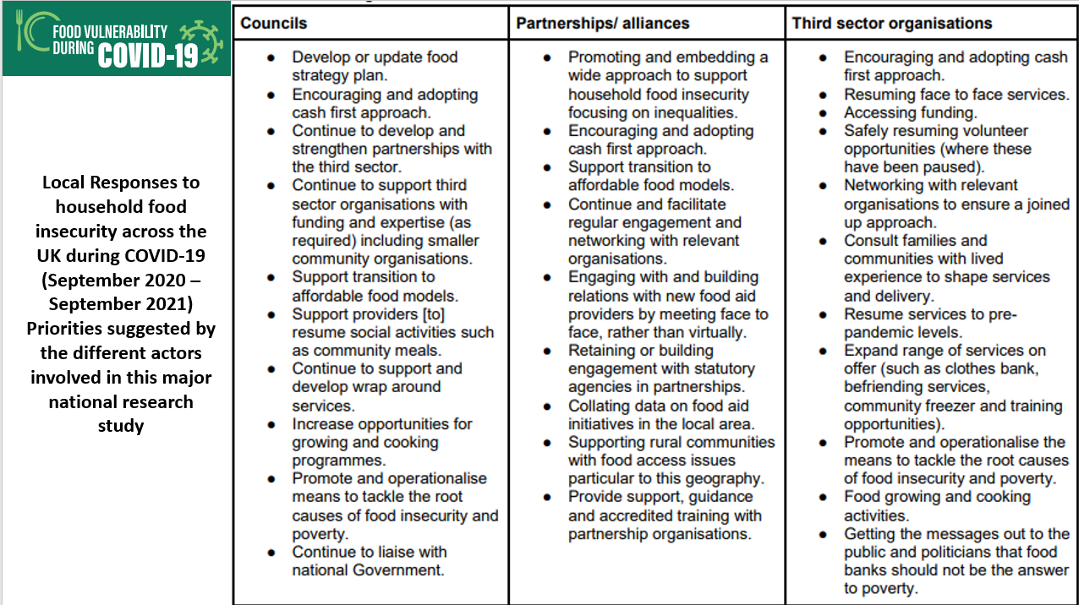
Evidence: Recommendations for Local Authorities
Notes:
Source: p61 http://speri.dept.shef.ac.uk/wp-content/uploads/2022/02/Local-responses-to-food-insecurity-Sept-20-21-Full-Report.pdf

Slide 11
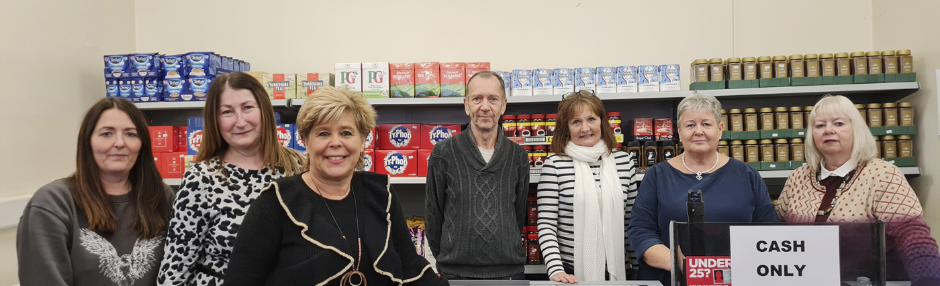
Their vision ‘to achieve food security for all individuals across the East Riding of Yorkshire’.
Nearly 12,000 food parcels were distributed to almost 40,000 people. There are 127 volunteers.
Key to the partnership was a Development Officer role (subsequently extended) to support the food banks and also to develop systems and processes and explore progression beyond food bank provision.
Strategic development is an aim of the Alliance; to meet, share ideas, support each other, share distribution of food, share supplier information
A monitoring tool has been developed to provide a consistent measurement.
This model successfully leveraged over £220k from other sources.
To support volunteers further training was developed around the National Occupational Standards for food bank, food pantry and social supermarket volunteers, and there is a training log and record book, with plans to develop these into a ‘volunteer passport’.
The East Riding Food Poverty Alliance
Notes:
Source: https://www.gooletimes.info/News/article/New%20social%20supermarket%20opens

Slide 12
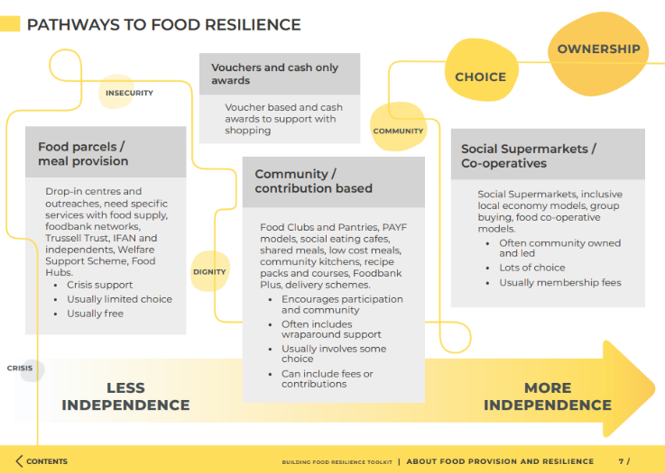
Leeds Food Insecurity Taskforce
The Leeds Food Aid Network exists to bring together a range of food aid providers, agency workers, the Council and members of the wider public, to tackle food poverty.
Partners agreed on a common vision for their work.
“Leeds has a vibrant food economy where everyone is able to access local healthy and affordable food, produced in a way which improves our natural environment and embraces innovation.”
The infrastructure has evolved to enable a broader focus. Most recently, a Food Resilience Toolkit was produced.
Key enabling factors were:
Making Every Contact Counts
Greater choice and ownership
Appropriate signposting and support
Co-locating support
Working collaboratively
Securing opportunities to benefit the system
Notes:
Leeds Food Insecurity Taskforce brought together Leeds City Council including Financial Inclusion Team, Catering Leeds, Children & Families and Adults and Health. Food Partnerships and wider food systems representatives such as Leeds Food Aid Network, Fareshare Yorkshire, Rethink Food, Trussell Trust, Foodwise, Foodcycle. Academic partners including University of Leeds Voluntary and community sector organisations including Voluntary Action Leeds.
Image: Page 7 of the Food Resilience Toolkit
https://foodwiseleeds.org/project/food-resilience/

Slide 13
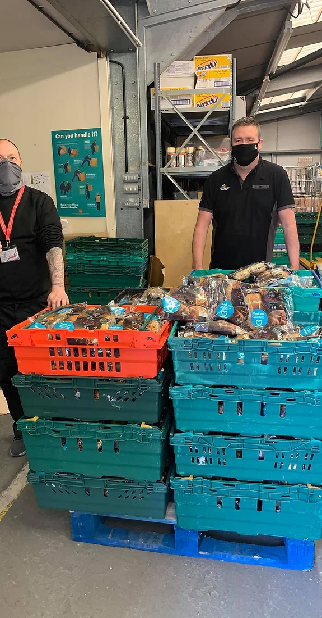
Cheshire East and Warrington Food Networks – developing a sub regional response
"Investment is needed to enable community-led change - compelling evidence of success of community projects, yet there is instability in short-term project funding and an over reliance on volunteers and small VCSE organisations that struggle to access appropriate support when required.”
Created as part of the pandemic response in June 2020. Whist there is a clear need and desire for the Cheshire East Food Network, it was the prospect of financial support that was the catalyst that brought it together.
The Cheshire Food Hub is facilitated by CVS, and without this facilitation is unlikely to come together.
Building relationships across the area was important. Food groups have been able to swap or sell food to each other, distribute surplus fresh food quickly, and share plans and ambitions to support people to move out of food poverty.
Participants identified the following success factors: * Supportive local community; * Passionate and committed volunteers * Strong local partnerships and positive working relationships with stakeholders; * Sharing data and best practice with others; * Building on local assets and taking a co-production approach to project design and delivery; * Communication - with beneficiaries, partners and wider stakeholders.
Notes:
Image: https://www.changing-lives-together.org.uk/cheshire-food-hub
Source: https://selbydistrictavs.org.uk/wp-content/uploads/2021/10/Food-insecurity-understanding-local-delivery-impact-and-innovation-in-the-North_compressed.pdf

Slide 14
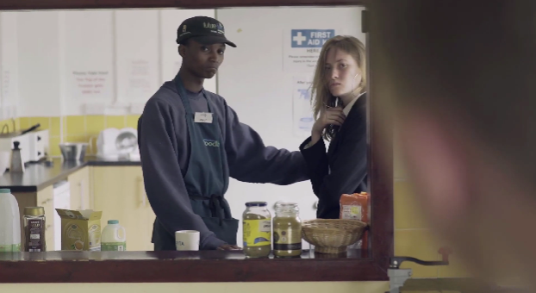
Blackburn with Darwen Food Resilience Alliance
‘We aim to achieve cohesion, increased collaboration by sharing expertise and resources to grow, provide, cook and eat food to improve the health and wellbeing of the borough’s residents across our diverse community.’
Their youth empowerment exchanges, where young people lead conversations with other young people developed into dynamic forums, changed perceptions and responses to the impact of food poverty. A small group of young people were ambassadors and champions in the borough and beyond for Blackburn with Darwen Food Alliance and their school.
As a result, the partnership has raised the issue of food poverty in a community of young people. They have provided life changing experiences for four young people to act as ambassadors on a bigger stage– their school is so proud of what they have achieved. Longer term, the partnership will encourage all schools to be part of the youth empowerment forums and poverty proof schools.
The partnership co-produced a film with young people ‘Edgelands’ and a campaign ‘’#DarwenGetsHangry’
Notes:
Image: screenshot from inside a food bank from http://www.church-poverty.org.uk/edgelands/
https://www.sustainweb.org/foodpower/map/blackburn_with_darwen_food_partnership/
Members: Over 40 orgs/depts involved to date, all committed to developing food poverty strategy. Public Health Blackburn with Darwen (BwD) Eat Well Strategy; adopted by Borough Council, CCG, East Lancashire Hospitals Trust. Involved VCFS sector - Together Lancashire (supports faith/community groups, experience of networking those responding to food poverty), Healthwatch, Housing Assns, mental health, children and youth support services, growing projects, primary and secondary schools.
Established: 14 September 2017 - although the Eat Well Strategy group had been meeting for over 12 months prior to that.

Slide 15

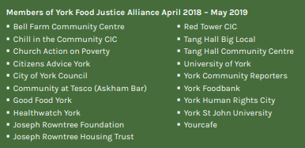
Resources: Food Poverty Alliance Action Plans
56 real examples available around the UK – all linked in the notes for this slide.
Food poverty action plans | Sustain (sustainweb.org)
What can we learn from York’s experience?
Notes:
North West, North East and Yorkshire
Food Poverty in Doncaster: 2019 Action Plan (Doncaster, 2019)
Food insecurity: Understanding local delivery, impact and innovation in the North (East Riding, 2021)
Food Poverty Strategy 2021 (East Riding, 2021)
Food Poverty Action Plan for Greater Manchester (Greater Manchester, 2019)
Lancaster District Food Poverty Alliance: Our Five Year Action Plan (Lancaster, 2021)
Definition of food poverty (Liverpool, 2016)
Good Food Plan (Liverpool, 2021)
VS6 Sustainable and Affordable Food Assembly Report (Liverpool City Region, 2021)
Seeking justice: How to understand and end food poverty in York (York, 2019)
East of England and Midlands
Food insecurity in Birmingham - A city-level response? (Birmingham, 2015)
A collaborative action plan for Cambridge (Cambridge, 2019)
Towards a collaborative food action plan (Cambridge, 2018)
Informing the Hertfordshire Food Poverty Needs Assessment (Hertfordshire, 2021)
Luton Food Poverty Alliance: Action Plan (Luton, 2020)
Food Poverty Network Pilot Project Evaluation (Northamptonshire, 2013)
Food Poverty Action Plan (Norwich, 2019)
Food Power Action Plan (Sandwell, 2019)
Menu for Action (Shropshire, 2018)
London
Food Secure Barnet: Action Plan 2019 - 2021 (Barnet, 2019)
The Use of Food Banks in Brent (Brent, 2017)
The Collaborative Framework for Action 2020 – 2025 (Camden, 2021)
Food poverty in Camden and Islington (Camden & Islington, 2018)
Food Poverty Action Plan (Croydon, 2017)
Good Food in Greenwich Food Poverty Action Plan (Greenwich, 2018)
Food Poverty - summary report (Greenwich, 2017)
Food Poverty Needs Assessment - full report (Greenwich, 2016)
Hackney Food Poverty Action Plan (Hackney, 2020)
Food Poverty Action Plan for Hammersmith & Fulham (Hammersmith & Fulham, 2014)
Islington Food Poverty Action Plan 2019 - 2022 (Islington, 2019)
Cooking Up Ideas (Kensington & Chelsea, 2016)
Food for thought: Food insecurity in 21st century Kingston (Kingston, 2018)
Lambeth Food Poverty and Insecuirty Action Plan 2021-2024 (Lambeth, 2021)
Lambeth Food Insecurity Report (Lambeth, 2017)
Putting Food On The Table (Lewisham, 2014)
London Food Strategy and Implementation Plan (London, 2018)
Beyond the Food Bank: London Food Poverty Profile 2018 (London, 2018)
A Food Poverty Action Plan for Mertion 2018-2020 (Merton, 2018)
We are Food Secure. We are Newham (Newham, 2021 - full document/ online summary)
Redbridge Food Poverty Action Plan (Redbridge, 2017)
A borough-wide action plan to increase household food insecurity (Southwark, 2019, 2021)
Food Poverty Needs Assessment (Sutton, 2015)
Food Poverty Action Plan (Tower Hamlets, 2017)
Food Poverty Action Plan (Waltham Forest, 2019)
South East and South West
Food Strategy Action Plan 2018 - 2023 (Brighton & Hove, 2018)
Food Poverty Action Plan 2015 - 2018: Final progress report (Brighton & Hove, 2018)
Food Poverty Action Plan 2015 - 2018 (Brighton & Hove, 2015)
A Food Strategy for Exeter (Exeter, 2017)
Feeding the Gaps (Oxford, 2014)
Northern Ireland
Enough is Enough: Food poverty scoping exercise (Belfast, 2015)
Scotland
Food poverty/ insecurity in Aberdeen (Aberdeen, 2017)
An Action Plan for Tackling Food Poverty/ Insecurity in Aberdeen (Aberdeen, 2019)
Glasgow, Tackling Food Poverty with a City Plan (Glasgow, 2021)
Fairer Moray Forum Food Poverty Action Plan (Moray, 2019)
Wales
Building resilience: Food Cardiff's five year food security plan (Cardiff, 2018)
Good Food Charter: Good Food for Everyone / Siarter Bwyd Da: Bywd Da I Bawb (North Wales, 2018)
Food Poverty in South Wales: A call to action / Tlodi Bwyd Yn Ne Cymru: Galwad I Weithredu (South Wales, 2019)

Slide 16
Questions Arising
There are a variety of collaborative models across the UK. Food Partnerships command the current weight of evidence around efficacy and value, however, national studies completed during COVID point to other forms being ‘powerful mechanisms’ too such as Food Poverty Alliances and Networks.
York has had a Food Poverty Alliance which evolved into a Food Justice Alliance so its experiences and impact would be useful insight for this study. In North Yorkshire there is the Craven Food Partnership, Whitby Food Alliance, Ryedale Food Network and Selby Anti-Poverty Alliance.
Insights about the effects of these collaborative models would be helpful for this study in order to inform any wider strategic decision to be made about whether and how to encourage more or different collaborative models across York and North Yorkshire where this would lead to the desired outcomes referenced in this report section.

Slide 17
Questions Arising
How could any existing / new collaborative model root the importance of lived experience into its design and production?
How can any collaborative model be viable beyond a time of heightened emergency and secure proportionate, adequate, dedicated co-ordinator resourcing?
How could any investment in new or existing collaborative models link into – indeed be supported by the resourcing - of wider strategies or local cost of living arrangements?
Examples
Food Strategies being developed in York and North Yorkshire by Public Health
The development of Community Networks as part of local government reform in North Yorkshire
Examples around the UK where local authorities are developing collaborative approaches aligned to cost of living responses e.g. the Lewes Food Partnership - see the Cost of Living Hub

Slide 18

How can the principles and practice of dignity be embedded into all approaches by collaborative models (see resources from Nourish Scotland)?

