Slide 1
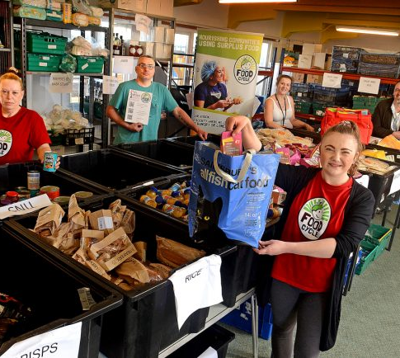

Covid Recovery Insight Project: Food Insecurity
Community Hubs,
Food Hubs and Clubs
Notes:
https://bromsgrovestandard.co.uk/news/longbridge-based-south-community-food-hub-delivers-2000-parcels-during-coronavirus-crisis/
Sources:
‘Meals on wheels for the 21st century’ A report exploring meals on wheels services in London before, during and after Covid-19. Sustain. July 2020.
Lewisham Homes' Community Food Stores Impact Evaluation - January 2022
Releasing social value from surplus food Evaluation Final Report FareShare-British Red Cross. Impact of British Red Cross funding on FareShare to tackle Loneliness and Isolation. February 2020

Slide 2
Definition
‘A community hub is a multipurpose centre, such as a community centre, medical centre or school, that provides a range of high quality and cost effective services to the local community, with the potential to develop new services in response to changing community needs.
Community hubs can provide a means for alternative approaches to service delivery – underpinned by the principles of community involvement and partnership.’
‘Community food hub’ has a specific meaning in some literature as distinct from a community hub that has a food element (please see notes)
Notes:
Using the definition supplied by Locality.
This review is based on 16 of the most relevant studies plus practical examples kindly supplied by City of York Council.
‘Community food hub’ also has a specific meaning in some literature as distinct from a community hub that has a food element. The Food Research Collaboration explains that: ‘Broadly speaking, food hubs are entities that sit between people who produce food and people who eat it, gathering food from growers and distributing it either to commercial customers or directly to consumers. They can fill gaps in local food infrastructure, help consumers find locally sourced produce, support new forms of food retail, incubate food enterprises, or create a space for community education and action. Sustainable food hubs endeavour to apply standards or values supportive of sustainability principles to their sourcing and how they operate. They thus provide an appropriate route to market for agroecological and ethical growers and makers.’

Slide 3
Characteristics: ‘community hubs are…’
Community-led | Multi-purpose | Making use of local assets | Enterprising and resilient
Local people are involved in decision making about how services are run, how buildings are managed Support the delivery through volunteering Typically managed by a community-led organisation, or owned or managed by a public agency e.g. housing association or local authority with substantial community input | Community hubs are multi-purpose, providing and hosting a range of activities and services that are used by lots of different people The range of services reflect local need and may be delivered by local people, other organisations or public agencies – for example: Parent and toddler groups Health and wellbeing activities – exercise classes Employment support Childcare Library services Advice and information. | Community hubs utilise local buildings and land to provide a base for these activities Assets can be acquired through Community Asset Transfer Other hubs are created as a result of new development through community-led building projects. | Community hubs need an income to be sustainable. A range of income sources required to cover the costs of running the building, maintenance, such as: grants; donations; hiring out space; delivering contracts. Make use of good ideas and resources within the community and can adapt to changing circumstances.

Slide 4
Outcomes
Nourished and supported
Involved in decision-making
Valued and able to contribute
Reduced isolation
Social value / social capital
Pride
Self organising capability
Employment
Community resilience (self-organised resilience)
(Contributing to) a reduction in levels of food poverty and malnutrition
Connectedness
Community cohesion
Financial savings and social profit (impacts on the community organisations).
The primary case for intervention is the alleviation of malnutrition and social isolation experienced by many by older adults and disabled adults.
Change attitudes
Improved relationship with food
Inspire change
Improved access to quality food
Improved diet
A sense of control
Able to take part in community life
Less reliant on food banks
Able to afford more than just the essentials.

Slide 5
Success Factors
Success factors
Contextualised
Mix of approaches
Opportunities for reciprocity
Delivered with dignity
A paid for service, different levels of support
Multi support provision through local partnerships
Notes:
Multi support provision through local partnerships, different drivers evolving over time linked to local community need, deriving different effects and benefits
Contextualised – drawing on local ingenuity and creativity
Mix of approaches to meet different needs. Staff able to triage and refer on.
A paid for service, with different levels of support available.
Delivered with dignity at the core, in all the details
Opportunities for reciprocity - people become givers and receivers
Best evidenced through ‘collective impact’ using consistent approaches and measures

Slide 6
Community Benefits
Taken together, community hubs:-
Help build more cohesive and resilient communities
Build better and more integrated services
Transform existing, unused buildings
Provide a focus for community-led regeneration.
However, building capacity requires community assets to be identified, then developed
  “Financial resources health, wellbeing, social connections, peoples' relationships with food, local foodscapes, community cohesiveness and community infrastructures are all assets that support and are needed for community self-organising.”
Notes:
Image option:
https://www.lewishamlocal.com/evelyn-community-store-offering-lewisham-much-more-than-groceries/

Slide 7
York’s Community Hubs
‘Food has been a very important element of the current community hubs and having a food offer requires good basic kitchen facilities and trained volunteers’
A priority for the Council for the past 5 years
The delivery of each hub relied on a partners working together
The community hubs provided a benefit for professionals, practitioners and service providers for their outreach work
Each model is different as they are community led and needs based, but common ingredients linked to: Place, People, Purpose and Connectivity.
A common theme of ALL the community hubs has been a basic food offer on a free or pay-as-you-feel basis i.e., cooked meals eaten in the venues and ‘food shops’.
Benefits
Food helps form part of the welcome offer
They help household finances go further
They are creating a social setting where people can relax, feel supported by peer and the wider community.
Positive outcomes recorded
Personal finance (benefits and budgeting advice)
Increased feelings of connectedness, confidence, wellbeing and giving people something to look forward to each week
Development of friendships
Peer support
Community networks
Greater resilience for individuals
Good practice
By aligning the Citizens Advice York budgeting café initiative with the community hub offer CAY were able to support more than 200 clients with over 380 issues resulting in excess of £210,000 income gain
Training was provided to support volunteering, healthy eating, budgeting and employment readiness
Future?
New types of hub are evolving
Good Place Network could nurture peer support amongst hubs
Notes:
Partners
Community groups managing the community venues, LACs, LAT community and partnership officers, CA York, CYC Benefits Advice, Peasholme Charity – Budgeting Project, Community health champions, Action for Elders, NY Police, York BID, OCAY, Community First Credit Union, CYC Housing Management Officers and Community Involvement Officers
Place – in an area where there is a need for support services and a lack of a focal point for community activity. Community-managed. Accessible, safe space.
People - Partnership of resident volunteers and front line service providers in a community setting offers opportunity to build trust and relationship to facilitate effective engagement reflecting local need. Hubs attract different population segments depending on their orientation – older people, families with young children, ‘all ages’
Purpose - Focal point for community activity – common motivation of connecting people to financial inclusion support and services – clear initial purpose helps to galvanise activity and motivate people to volunteer and engage
Connectivity - Connecting multiple forms of resource – relationships, time, skills, gifts, people= growth in social connections and relationships. Moving away from a deficit model with a narrow focus on finances to creating one of abundance.

Slide 8
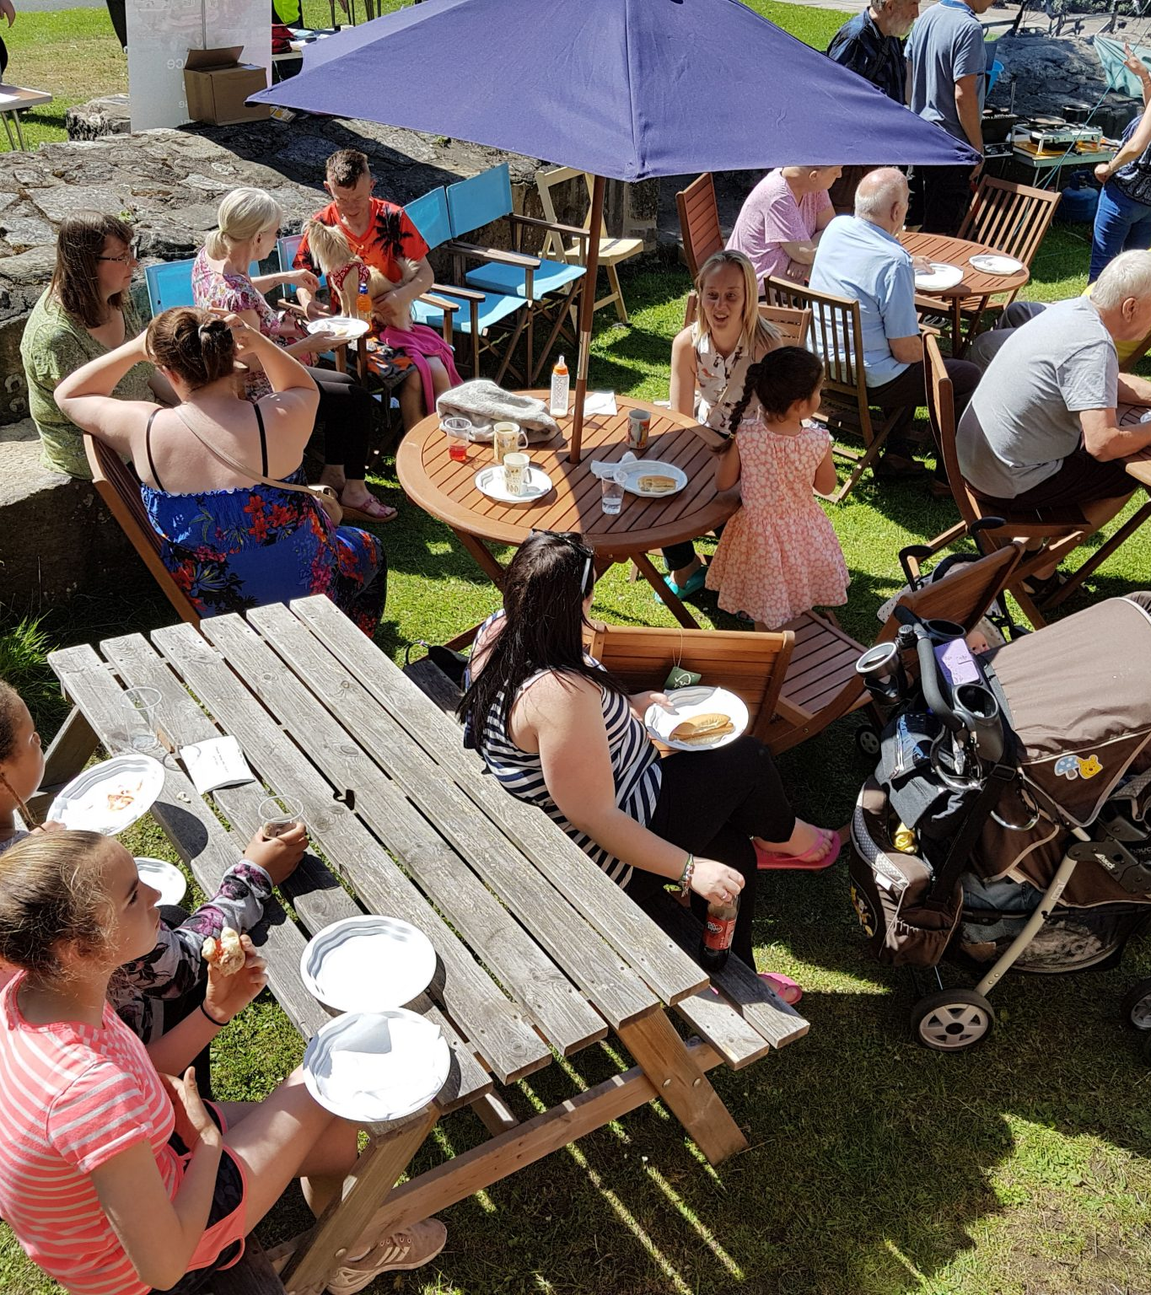
Red Tower CIC, York – the role of a community hub in helping to tackle holiday hunger
The model comprised: 1 project manager with volunteers and a cafe (open every Monday for 7 weeks) with fresh food / lunches for every child and baked goods donated with advice on healthy amounts, plus teas/coffees/juices and a Pay As You feel PAYF signs / donations box (takings used to cover overheads).
There was also a Food 4u Shop operated upstairs (produce that couldn't be made into lunches) for people to take a bag of groceries home (£1 suggested donation per bag)
Research identified these aspects of this holiday support programme to be effective.
Outdoor well-being: The garden was enjoyed by customers young and old every week; children literally dancing in the rain.
Inclusion: Elder neighbours enjoyed a sit-down, neighbours who had not been keen on the project to begin with, came to eat at the cafe by the end; People of minority ethnic origin also came.
Alleviating hunger: There was enough tasty, varied food for everyone, volunteers included, every week.
Zero-Waste: In total approx. 785kg of food was intercepted before being sent to landfill and waste collected for proper disposal by a local compost expert.
Volunteer experience: 1 intern, 1 coordinator, 2 staff from the CIC and 13 other volunteers repeatedly contributed their time, resources and enthusiasm. They appeared to benefit, get along well and enjoy it.
Notes:
Please note, not an impact evaluation per se.
Image : Red Tower York CIC http://redtoweryork.org.uk/the-power-of-food/
Based on sampled feedback from 2,500 users. Source https://static1.squarespace.com/static/5f452e5078bf4f32c97a8045/t/6241963f9ec2b51a579a08b5/1648465485739/TBBT+Impact+Report+2021+FINAL.pdf

Slide 9
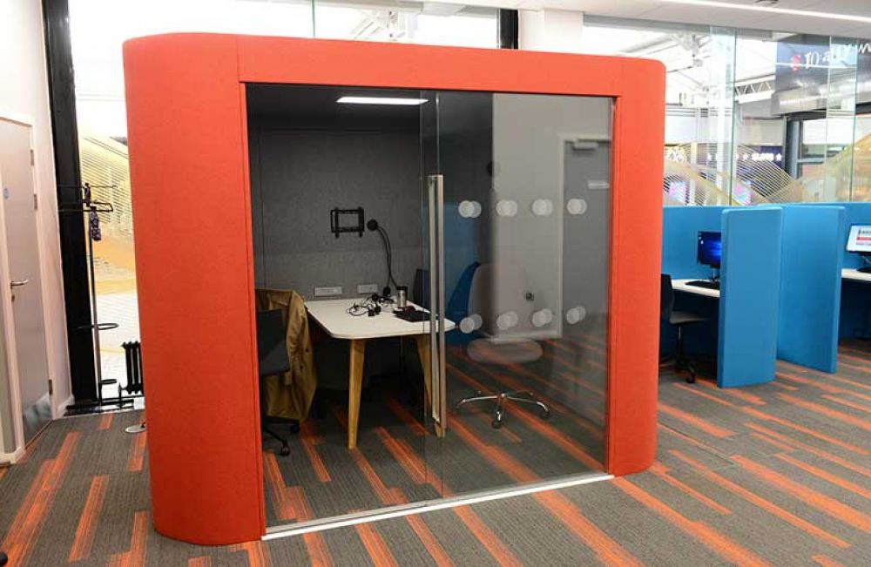
Enfield community hubs with integrated food pantry
The community hubs are designed to allow private conversations, so people feel comfortable to talk about their lives. There are also areas where children can entertain themselves. As part of the council’s, Early help for all strategy, the hubs also help as an access point to then support vulnerable residents with complex needs to find solutions to their problems before they escalate.
The direct services work alongside one another including food pantry and employment and skills support, and referrals to other support as needed, such as welfare and debt advice.
This is an example of a community hub that has an integrated food pantry model which helps residents with accessing healthier foods, such as fresh fruit and vegetables, by offering members heavily discounted shopping.
The pantry also offers support with access to welfare, debt management, and employment and skills training. The aim is to address food poverty and healthy eating issues at a basic level and prevent escalation into more complex needs.
The pantry operates via referrals from the Welfare Advice and Debt Support Team. If residents feel they may be eligible for membership, they are encouraged to visit the community hubs where they can receive support to access the pantry).”
Help with money | Help with jobs and skills | Help with health and wellbeing | Help with housing stability
Notes:
Image: https://www.enfield.gov.uk/services/your-council/community-hubs-and-food-pantry
Based on sampled feedback from 2,500 users. Source https://static1.squarespace.com/static/5f452e5078bf4f32c97a8045/t/6241963f9ec2b51a579a08b5/1648465485739/TBBT+Impact+Report+2021+FINAL.pdf

Slide 10
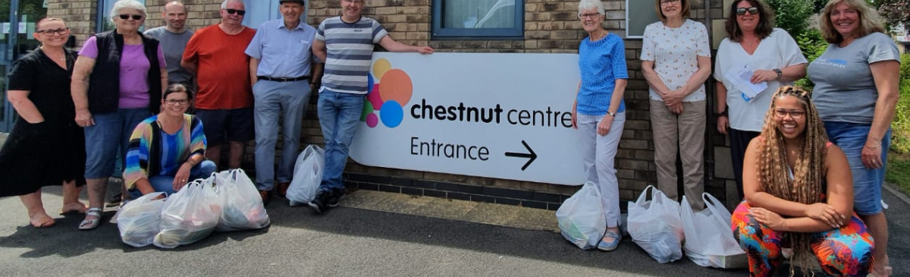
The Bread-and-Butter Thing - a community-led food club and hub network
This approach was selected as has the network of hubs has grown, and independent evaluation evidence points to outcomes beyond supporting those in crisis. TBBT aims to make life more affordable to people. Evaluation estimates that users collectively saved nearly £3m from using the service. Where previously, 86% struggled to access fruit and vegetables locally before programme - 76% are now eating more fruit and vegetables The charity’s impact report includes the following outcomes for TBBT’s users:
77% are cooking more healthily at home and are eating more fruit & veg. Food is the second biggest concern to members after energy bills
22% of members have stopped or reduced using food banks
Two thirds feel less lonely and 76% feel more engaged with the community.
).”
Notes:
https://huddersfieldhub.co.uk/the-bread-and-butter-thing-opens-affordable-food-hub-at-the-chestnut-centre-in-sheepridge/
Based on sampled feedback from 2,500 users. Source https://static1.squarespace.com/static/5f452e5078bf4f32c97a8045/t/6241963f9ec2b51a579a08b5/1648465485739/TBBT+Impact+Report+2021+FINAL.pdf

Slide 11
Merits and drawbacks
Offering a menu of service options around food increases the potential appeal, reduces stigma as it draws in a wider group of people.
Drawbacks identified are that projects / services delivered as part of community hub model can be reliant on grant funding, and while offering a range of support is arguably more valuable than focussing on any single one, one commentator notes that there is often insufficient thought about ‘where next?’ in national strategies (for example on loneliness), and the pathways to build on these positive initial steps enabled through food.
A challenge for multi-faceted approaches is managing growth; achieving a balance between expanding a community hub’s reach and sufficient engagement
Projects not linked to complimentary services were seen as less effective (judged by the number of referrals).

Slide 12
Questions Arising
How is it possible to develop a food offer integral to a community hub model that is relevant to, and ideally owned by / managed by the communities themselves?
How can the co-design of any food hub or club model be co-designed or co-produced within communities?
How can mixed income models be developed so that the sustainability for community food / hubs is less likely to be dependent on public sector grant / voluntary sector goodwill / donations in future?
How can the opportunity to maximise surplus food be realised as part of any community hub model?
What are the ideal conditions for developing / evolving community hubs?
Other examples worth exploring:
Foleshill Community Food Hub, Coventry
Lewisham Food Hub
Notes:
Using the definition supplied by Locality.
This review is based on 16 of the most relevant studies plus practical examples kindly supplied by City of York Council.
‘Community food hub’ also has a specific meaning in some literature as distinct from a community hub that has a food element. The Food Research Collaboration explains that: ‘Broadly speaking, food hubs are entities that sit between people who produce food and people who eat it, gathering food from growers and distributing it either to commercial customers or directly to consumers. They can fill gaps in local food infrastructure, help consumers find locally sourced produce, support new forms of food retail, incubate food enterprises, or create a space for community education and action. Sustainable food hubs endeavour to apply standards or values supportive of sustainability principles to their sourcing and how they operate. They thus provide an appropriate route to market for agroecological and ethical growers and makers.’

