Slide 1
‘Food’ language, definitions and measurement
Alan Graver
Skyblue Research Ltd

Slide 2
Content
Definitions
Measuring Household Food Insecurity
Food poverty
Household food insecurity
ENUF – Evidence and Network on UK Household Food Insecurity
USDA Household Food Security Survey Module
Food and You Survey (UK)
Food Foundation Food Insecurity Tracker
Notes:
ENUF is a hub for research and evidence on household food insecurity in the UK..

Slide 3
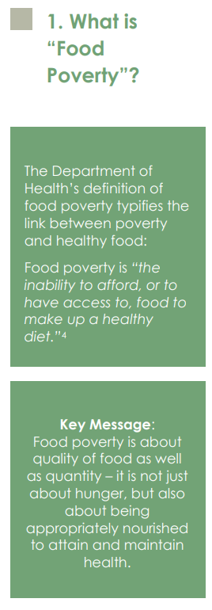
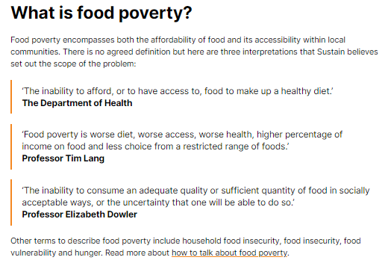
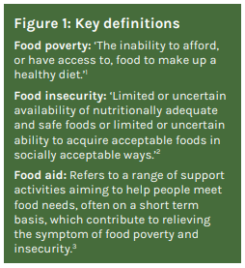
Source : York Food Justice Alliance, June 2019
What is food poverty? | Sustain (sustainweb.org)
Food Poverty: (bristolfoodpolicycouncil.org)
Notes:
What is food poverty? | Sustain (sustainweb.org)
Food Poverty: (bristolfoodpolicycouncil.org)
Source: Seeking justice How to understand and end food poverty in York
York Food Justice Alliance June 2019 page 5

Slide 4
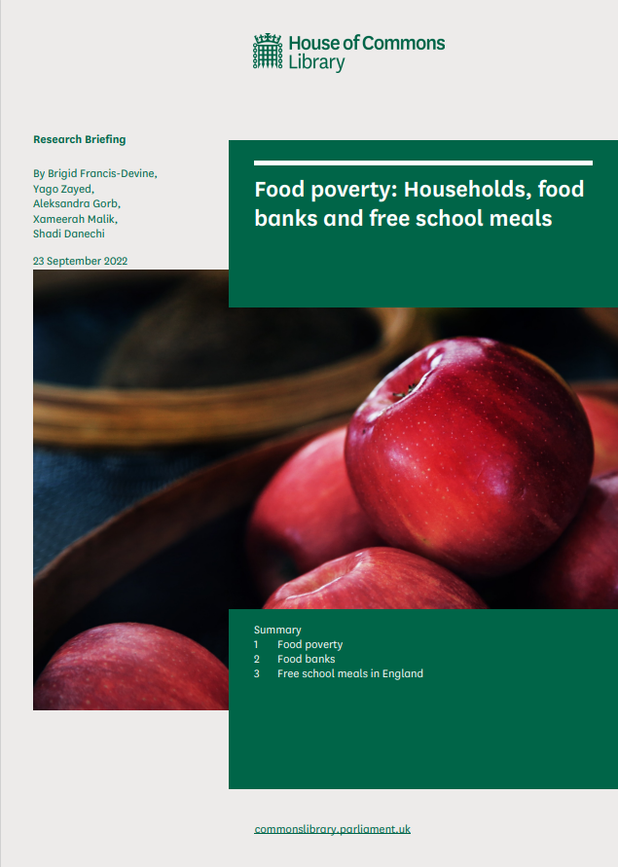
House of Commons, ‘Food Poverty’
There is no widely accepted definition of ‘food poverty’. However, a household can broadly be defined as experiencing food poverty or ‘household food insecurity’ if they cannot (or are uncertain about whether they can) acquire “an adequate quality or sufficient quantity of food in socially acceptable ways”.
The increase in the cost of living has increased household food insecurity.
In June to July 2022, of the 91% of adults in Great Britain who reported an increase in their cost of living, 95% saw the price of their food shopping go up, and 44% had started spending less on essentials including food.
A YouGov survey by the Food Foundation found that in April 2022, 15.5% of all UK households were food insecure (ate less or went a day without eating because they couldn’t access or afford food).
According to the Department for Work and Pensions’ Households Below Average Income survey, in 2020/21, 4.2 million people (6%) were in food insecure households.
Among the 10.5 million people in relative poverty, 16% were in food insecure households, including 17% of children.
People in relative poverty live in a household with income less than 60% of contemporary median income.

Slide 5
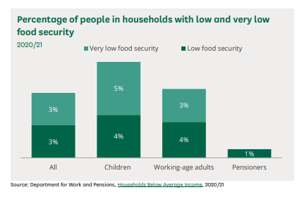
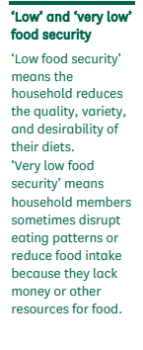
What is food poverty?
There is no widely accepted definition of food poverty, but a household can broadly be defined as experiencing food poverty if they: cannot (or are uncertain about whether they can) acquire “an adequate quality or sufficient quantity of food in socially acceptable ways”. (note 1)
Food poverty is often used as synonymous with household food insecurity. (note 2)
Household food insecurity is defined in broadly the same way across several countries: (note 3)
Households can have low food security even when the UK as a whole has high food security.
Notes:
Food poverty: Households, food banks and free school meals - House of Commons Library (parliament.uk)
See pages 10 and11
Note 1 Child Poverty Action Group, Living Hand to Mouth, 26 March 2019
Note 2 Sustain, What is food poverty?, and Child Poverty Action Group, Living Hand to Mouth, 26 March 2019.
Note 3 This definition is based on the Household Food Security Survey Module, developed by the US Department of Agriculture. Source: US Department of Agriculture, Food Security in the US [Accessed 28 April 2021]

Slide 6
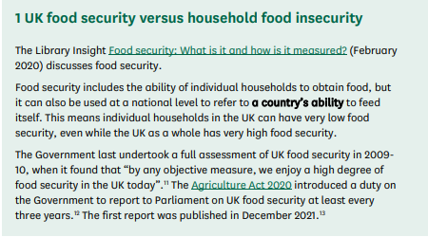
Food insecurity and the cost of living crisis
Rising prices are affecting household budgets, which means more households are experiencing food insecurity.
House of Commons Briefing, September 2022. Food poverty: Households, food banks and free school meal
Page 8
Notes:
Related HoC briefing papers: Rising cost of living in the UK - House of Commons Library (parliament.uk)

Slide 7
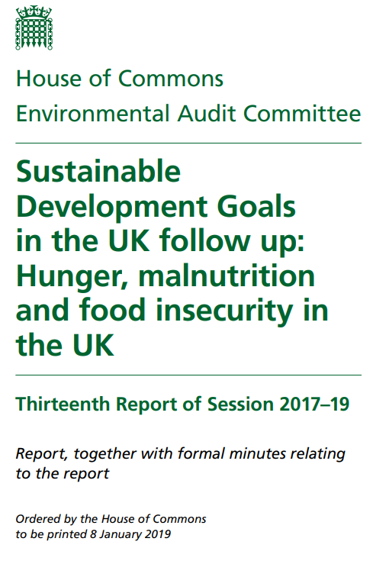
SDG 2: Zero Hunger
“Food insecurity is a significant and growing issue in the UK, with figures from The Food and Agriculture Organisation and The Food Foundation showing that levels are among the worst - if not the worst–in Europe, especially for children.
The issues of food insecurity, hunger, malnutrition and obesity should be considered in parallel in the UK context as they are often co-located and correlated……we are concerned that an item as significant as hunger and food insecurity in the UK has fallen between the cracks. p3
Notes:
SDG = sustainable development goal
SDG2, Zero Hunger, aims to “end hunger, achieve food security and improve
Figure 1: Targets for SDG2: Zero Hunger
2.1 By 2030, end hunger and ensure access by all people, in particular the poor and people in vulnerable situations, including infants, to safe, nutritious and sufficient food all year round
2.2 By 2030, end all forms of malnutrition, including achieving, by 2025, the internationally agreed targets on stunting and wasting in children under 5 years of age, and address the nutritional needs of adolescent girls, pregnant and lactating women and older persons
Sustainable Development Goals in the UK follow up: Hunger, malnutrition and food insecurity in the UK - Environmental Audit Committee - House of Commons (parliament.uk)

Slide 8
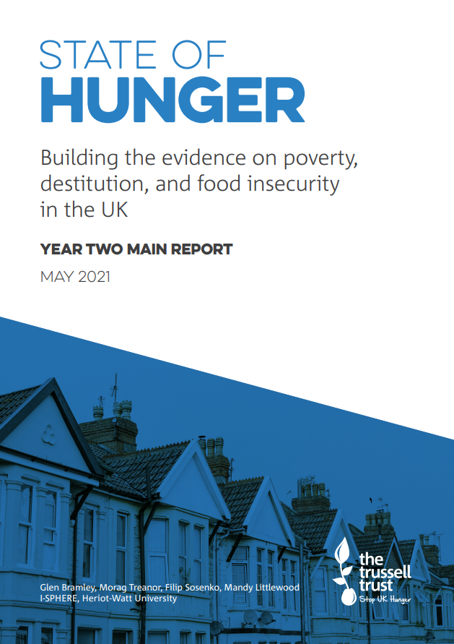
Hunger
There is no single, nationwide Government measure for hunger in the UK. The Committee heard evidence of the high and growing number of people experiencing hunger in the UK.
The Food Foundation estimates 1.97 million people within the UK may be undernourished.
However the British Association for Parenteral and Enteral Nutrition (BAPEN) places the number of malnourished, specifically undernourished, people at 3 million, of which 1.3 million are over 65.
While 93% of undernourished people are living in the community, BAPEN also found issues in social care.
Notes:
House of Commons Environmental Audit Committee Sustainable Development Goals in the UK follow up: Hunger, malnutrition and food insecurity in the UK Thirteenth Report of Session 2017–19 Report, together with formal minutes relating to the report Ordered by the House of Commons to be printed 8 January 2019

Slide 9
State of Hunger, Trussell Trust: Glossary
Destitution
Hunger
Household food insecurity
Destitution is the condition of people who cannot afford to buy the absolute essentials that we all need to eat, stay warm and dry, and keep clean.
Hunger is understood as ‘household food insecurity’. Specifically, hunger captures a range of experiences falling under the categories of severe or moderate household food insecurity.
‘Hunger, measured as food insecurity, is detailed here as just one symptom of poverty.’
A household-level economic and social condition of limited or uncertain access to adequate food. Households are considered food insecure if they experience 'severe' or 'moderate' food insecurity as measured by the Household Food Security Survey Module
Notes:
A household-level economic and social condition of limited or uncertain access to adequate food. Households are considered food insecure if they experience 'severe' or 'moderate' food insecurity as measured by the Household Food Security Survey Module
Page 8 and 9
State-of-Hunger-2021-Report-Final.pdf (trusselltrust.org)

Slide 10
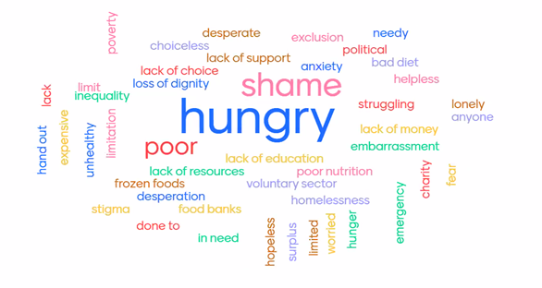
Sustain
‘Food poverty, food insecurity, food vulnerability, household food insecurity, food justice and hunger. These are just some of the terms used by organisations, businesses and individuals when talking about people being unable to afford, access or prepare a healthy meal.
All these terms have their uses but can we use them to reframe the narrative to drive positive change?’
'Name five ‘negative’ words you have heard that describe food poverty….
Notes:
Language matters, especially when it comes to achieving food justice | Sustain (sustainweb.org)
This was the fascinating question posed at the latest South West Food Power regional learning network which resulted in some equally fascinating discussion.
Clare Pettinger, the Food Power peer mentor for South West England, hosted the meeting and kicked off with this question to the group:
‘Name five ‘negative’ words you have heard that describe food poverty.' We’re sure readers have a few that spring to mind, but here’s what was shared on the day:

Slide 11
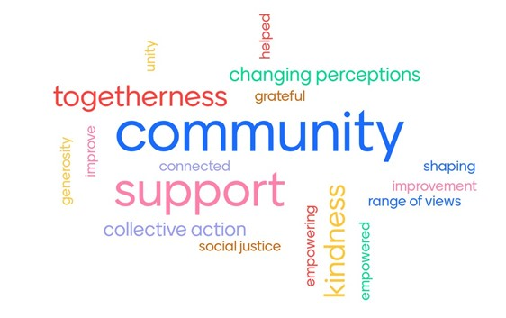
Name five positive words associated with food poverty
Notes:
In contrast to the negative words we started with, these offer a more hopeful vision of community that can be empowered to end food poverty and poverty overall. Language will be key in achieving that and that is what this conversation set out to explore. In doing so, the group have helped lay a path for more positive, solutions focused framing that can empower people to eliminate food poverty and push for food justice across the whole food system.
Feel free to share your own thoughts about language by emailing cecily@sustainweb.org and do have a read of some of the expert opinions and research on this topic below:
Megan Blake, Senior Lecturer at the University of Sheffield and creator of the Food Ladders concept.
The Frameworks Institute – Reframing Hunger in America

Slide 12
Language matters
Hunger
Food poverty
Food access
Food justice
Poverty
Household food insecurity
Household food insecurity
‘A lesser-known phrase in the public realm but increasingly popular amongst charities, academics and public sector organisations. The group agreed that this was the best term for capturing the fact that people fall into poverty because of a small change to their circumstances. This can tip people over the edge into food poverty at any point, as evidenced by the many individuals and families seeking food support for the first time ever as a result of the Covid-19 pandemic. This could therefore be a good alternative to food poverty in a policy context.
Verdict: A good option, perhaps best for a policy context
Leading academics we interviewed confirmed a similar sentiment.
Notes:
Sustain’s view and work:
Hunger
Some organisations felt that we need to go back to basics and use the word hunger because that is what people living in food poverty are - hungry. This term makes it more relatable to the public, but others felt it risked oversimplifying the issue. This is because it does not reflect the wider issue of poverty and can lead to a focus on more short-term solutions, like food banks, when what we need is to address the root causes.
Verdict: Too simple
Food poverty
This is the most common term, encompassing both a lack of food and the wider context of poverty. Though some felt it was a smokescreen that moved away from people’s experience of hunger and does not account for the temporary nature of food poverty, in most cases at least. The challenge though is that this term is best understood by the public and policy makers so if we’re to move away from this we need to bring them with us. One suggestion was to use this term for public engagement and use another all-encompassing term for policy work.
Verdict: Well understand but problematic long-term
Household food insecurity
A lesser-known phrase in the public realm but increasingly popular amongst charities, academics and public sector organisations. The group agreed that this was the best term for capturing the fact that people fall into poverty because of a small change to their circumstances. This can tip people over the edge into food poverty at any point, as evidenced by the many individuals and families seeking food support for the first time ever as a result of the Covid-19 pandemic. This could therefore be a good alternative to food poverty in a policy context.
Verdict: A good option, perhaps best for a policy context
Food access
It was felt that this had a number of different meanings ranging from money to access food or access to food in a geographical area e.g. food deserts which made it less suitable for public communications at the very least. It was also thought to compound the misleading belief of many that an individual is unable to access food due to their own circumstances rather than the system failing to provide it or support them effectively.
Verdict: Avoid due to multiple meanings and unhelpful framing
Food justice
This was the most popular choice amongst the group because, though it had multiple meanings, they all led to the same end point – good food for all. It offers a more positive, empowering narrative through focusing on justice which implies a failure of the system rather than the individual. It was also pointed out that the entire food system is impoverished, so to build a resilient food system fit for the future, food justice must be secured across the whole system. Recognising this, some organisations have already pivoted towards this language in their communications.
Verdict: The preferred option
Poverty
Finally and perhaps the simplest of them all - poverty. Anyone living in food poverty is living in poverty and this needs to be a key part of the narrative or we risk short-term sticking plasters, such as food banks and surplus food redistribution, becoming a long-term problem.
Verdict: Use wherever possible.
In addition to discussion on specific terms, a key take-home from this session was that all language should be developed with the input of people with lived experience of household food insecurity. This will help reach the communities that organisations are working to support, create a more empowering narrative for both public and policy engagement and relay the key issues more effectively.

Slide 13
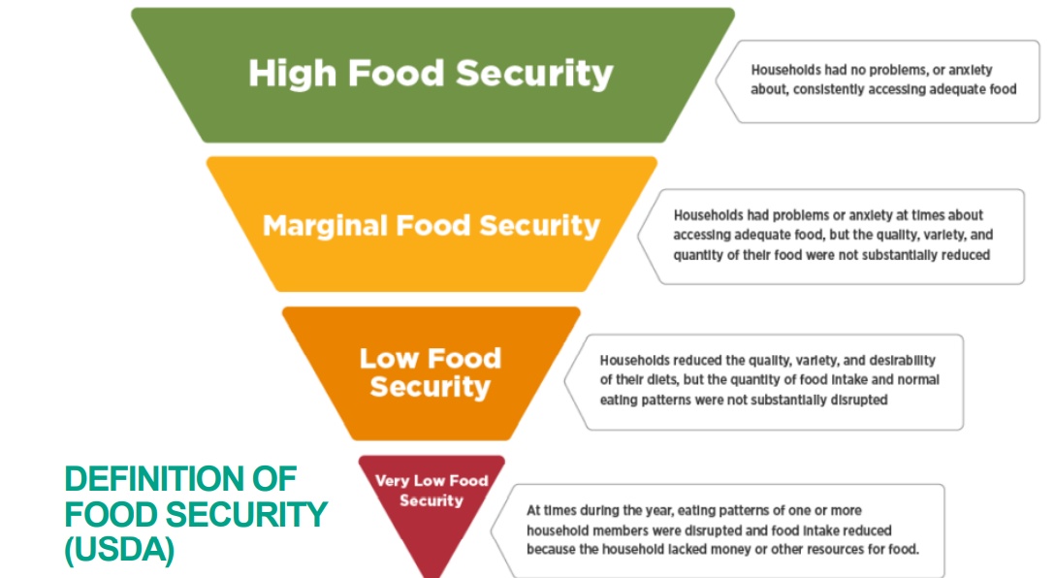
Source 1
Notes:
Source: adapted from the USDA Economic Research Service USDA ERS - Definitions of Food Security
Used by OHID (Office for Health Improvement and Disparities) in their Food Resilience Public Health webinar 7th July 2022 – referred to us by NYCC Public Health officers

Slide 14
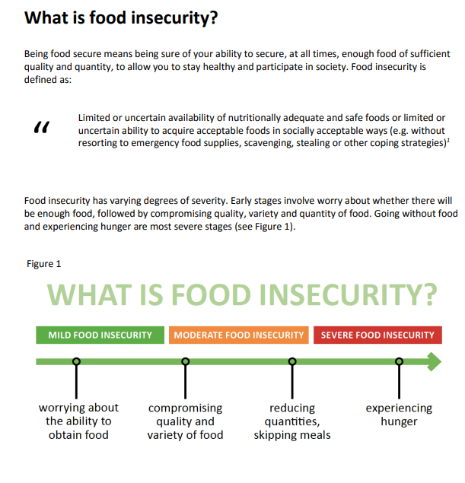
Food insecurity
Source 2
Too Poor to Eat Food insecurity in the UK By Anna Taylor and Rachel Loopstra
The Food Foundation May 2016
Source 3
What is household food insecurity?
Most simply, food insecurity is a lack of the financial resources needed to ensure reliable access to food to meet dietary, nutritional, and social needs. It can be acute, transitory, or chronic, and ranges in severity from worry about not being able to secure enough food to going whole days without eating.
What is household food insecurity? | ENUF
Source 4
‘Insufficient and insecure access to food.’ shorthand description used in recent bid to ESRC for the Partnership and Innovation Fund, September 2022, Loopstra, R (leading academic)
Notes:
Source 2:Microsoft Word - FoodInsecurityBriefing May 2016 FINAL.docx (nuffieldfoundation.org)
Too Poor to Eat Food insecurity in the UK By Anna Taylor and Rachel Loopstra
The Food Foundation May 2016
Source 3: ENUF is a hub for research and evidence on household food insecurity in the UK.
What is household food insecurity? | ENUF
There is enough food to feed everyone on the planet, but globally there are still 1 billion people experiencing food insecurity. Food supply and consumption are not evenly distributed.
The UK does have food security. Around 40% of the UK's food has been imported and much of it has been processed.
Case study - attempts to achieve food security in the UK - Supply and demand of natural resources - an unequal balance - OCR - GCSE Geography Revision - OCR - BBC Bitesize
When people do not have enough nutritious or affordable food to eat (BBC GCSE curriculum)

Slide 15
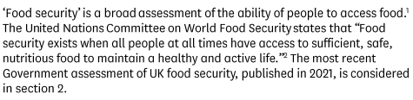
Source 5
This report uses the term ‘household food insecurity’ to mean: ‘the inability to acquire or consume an adequate quality or sufficient quantity of food in socially acceptable ways, or the uncertainty that one will be able to do so.’
HUNGRY FOR CHANGE The final report of the Fabian Commission on Food and Poverty 2015
Source 7
House of Commons Library, Food Security Briefing, March 2022
Source 6
Food insecurity is exactly what it sounds like: when a person is without reliable access to enough affordable, nutritious, healthy food. British Red Cross
Notes:
5 HUNGRY FOR CHANGE The final report of the Fabian Commission on Food and Poverty
6 What is food insecurity and why it is a threat? | British Red Cross
7: Food Security – House of Commons Library 30 March 2022
British Red Cross further insights:- (source 6)
How does food insecurity affect people?
A combination of all these factors is devastating people’s lives, families, health, and livelihoods in parts of Africa.
That could mean people are...
Losing their lives and their loved ones
Skipping meals, which can impact health
Selling their last remaining livestock (likely their sole way of earning money)
Being forced into prostitution, leaving them vulnerable to violence
Pushing young girls into early marriage, so that parents have one child less to pay for, and in the hope they might be safer somewhere else.
The people who find themselves having to make these desperate choices have already been through a lot, whether that's from climate-related extreme weather events like droughts and flooding, or the impacts of Covid-19.
Causes
The causes of food insecurity are complex but key factors include, isolation, poor physical or mental health, lack of employment, financial hardship and insecure accommodation, all of which have been exacerbated by the Covid-19 crisis.
Access to food in emergencies: learning from Covid-19 (redcross.org.uk)

Slide 16
Measuring household food insecurity
September 2022
COVID-19 Insights Research Project: ‘Food’ language, definitions and measurement

Slide 17


How is household food insecurity measured in national surveys?
Routine monitoring in a national household survey is important for quantifying the scale of food insecurity in the population, tracking how the problem changes over time, and identifying vulnerable groups.
Scales capturing self-reported experiences of food insecurity have been validated in different populations around the world. A commonly used scale, and variations of it, is the USDA Household Food Security Survey Module. This is used routinely in the U.S. and Canada and has also been used in population-based surveys in the UK, including the Low Income Diet and Nutrition Survey and the Food and You Survey.
Measurement of household insecurity | ENUF
Notes:
The USDA module has also been used in other research studies, such as the Southampton Women’s study, Born in Bradford cohort study, and studies of people using food banks in London and across the UK.
Box 1 details the questions included in this module.

Slide 18
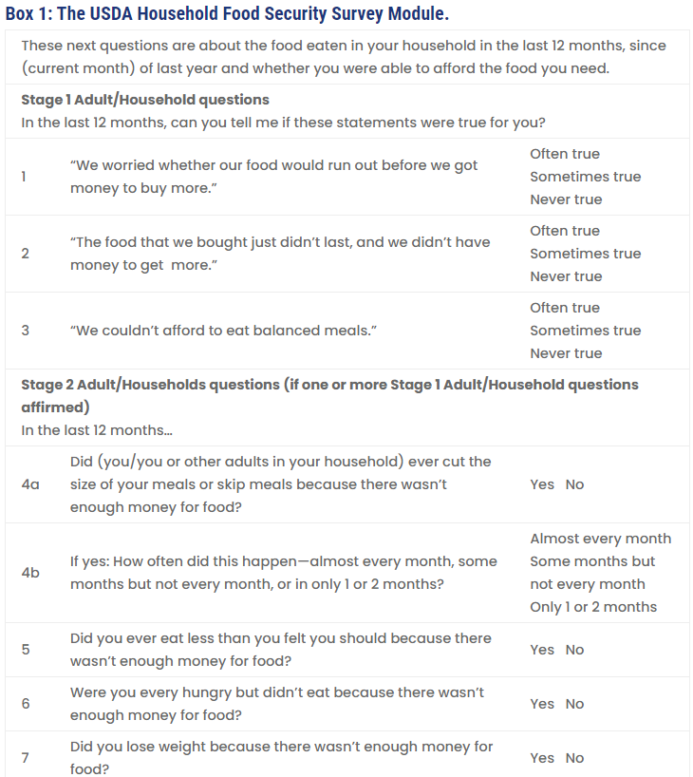
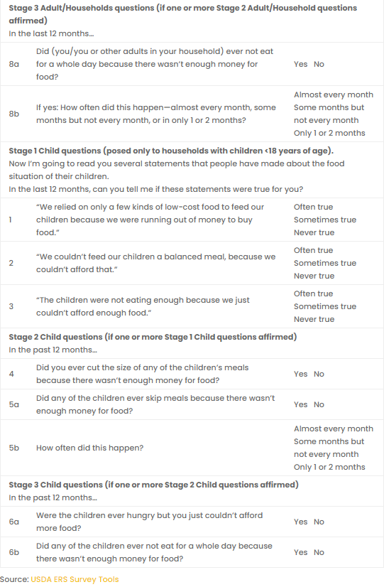
Notes:
The USDA module has also been used in other research studies, such as the Southampton Women’s study, Born in Bradford cohort study, and studies of people using food banks in London and across the UK.
Box 1 details the questions included in this module.
The Household Food Security Module can be shortened by only including questions that reference adults and household members, removing questions that reference children, or shortened to six questions rather than the 10 questions found in the Adult Food Security Module. The questions can be asked with reference to different time periods. In the US, questions are asked in reference to both 12 months and the past 30 days in their annual Current Population Survey, giving an indication of how transient food insecurity is in the population. In 2019, the USDA Adult Food Security Survey Module, with a 30-day reference period, was added to the Family Resources Survey in the UK.

Slide 19
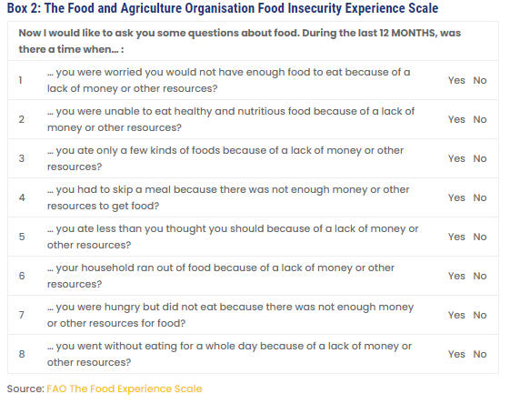
Notes:
In 2019, the Food and Agriculture Organisation launched a programme of research into household food insecurity around the world, exploring the use of an experience-based measure based on the USDA scale. It is simpler, consisting of only 8 questions with simple yes/no responses. It doesn’t ask parents/guardians about child experiences, and it doesn’t capture how frequently households had experiences over the past twelve months, but through its administration in the Gallup World Poll, comparable estimates for food insecurity are now available for countries around the world.
Measurement of household insecurity | ENUF

Slide 20
Measurement of household insecurity | ENUF
Why should we measure food insecurity and not just poverty?
Similar to the way that other measures of material hardship, covering housing conditions, bill and rent arrears, and the ability to heat one’s home are important part of measuring and tracking well-being in the population, so too is food insecurity. Lacking in basic essentials is a sign that income and other financial resources are not sufficient to meet basic needs.
Compared to income-based poverty measures based on annual income, household food insecurity is a more dynamic measure of poverty. Why is this?
Likely because spending on food is self-regulated, meaning that when households feel stretched financially, spending on food is often among the first essential items that are cut back on.
Compared to fixed contracts, payments that are automatically deducted from income, and the threat of eviction, research has shown household spending on food is often the most flexible.
Given the wider range of necessities to enable participation today (e.g. access to the Internet and a computer, mobile phones), updated research on how spending priorities are managed on low incomes is needed.
However, in 2012, research from the Poverty and Social Exclusion survey highlighted a gradient of what poor households were doing without.
Being unable to afford two meals a day was something experienced less often. Expenditure surveys suggest that when households are poor, multiple compromises are made, with reduced spending in all categories, including food, household bills, and social participation.
Notes:
Measurement of household insecurity | ENUF

Slide 21
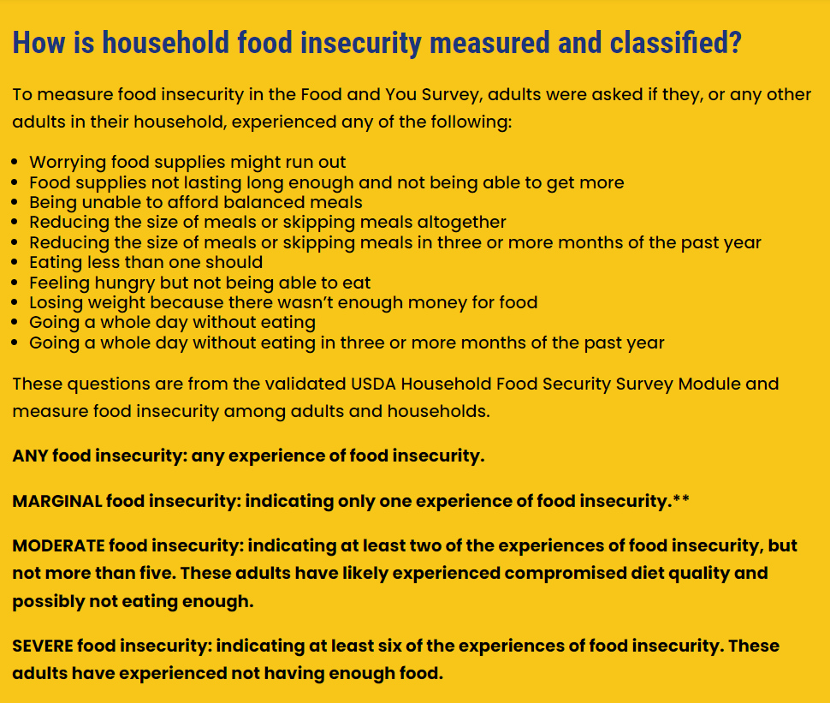
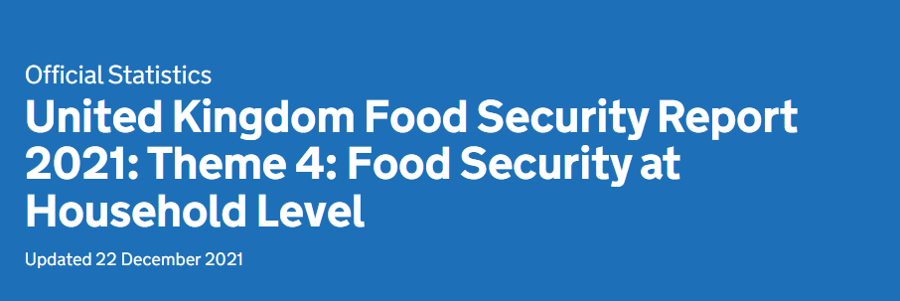
Understanding household food security
There are various complex factors that determine whether a household is food secure. At a high level, household food security can be broken down into affordability, access, utilisation, and stability. Affordability, access, and utilisation provide three key links in the chain, or tests, for households to get food on their plates. Simply, these are whether they can fill shopping bags, pay for them, and prepare nutritious meals. Stability is determined by the consistency with which the previous three tests are met.
Notes:
Vulnerability to food insecurity | ENUF
We have received data from Dr Megan Blake using Food and You Data enabling us to explore some of the levels of food insecurity as described. NB data limitations / date of data supplied
United Kingdom Food Security Report 2021: Theme 4: Food Security at Household Level - GOV.UK (www.gov.uk)
Food Security Report 2021: Theme 4: Food Security at Household Level
Updated 22 December 2021
Key messages
Data on household food security indicates that 92% of households regarded themselves as being food secure in the financial year 2019 to 2020.
In the last decade, food and non-alcoholic drinks have, on average, become cheaper compared to other goods and services. However, affordability needs to be understood in the wider context of overall household expenditure. Housing and transport make up the largest share of spend for the average UK household, and both categories have seen increases in their share in the last decade.
Access to food shops in England is for the most part adequate, with at least 84% of the population in every region able to reach a shop by public transport or walking within 15 minutes.

Slide 22



The Food and You consumer survey collects information about the public's reported behaviours, attitudes and knowledge relating to food safety and food issues. This involves food purchasing, storage, preparation, consumption and factors that may affect these.
The survey provides data for England, Wales and Northern Ireland. Since 2014, results from Food and You have been published as an Official Statistic, reflecting the robust methodology of the survey.

Slide 23
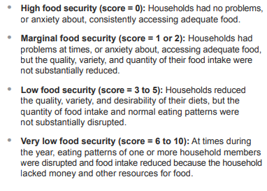
Food and You (Wave 5, 2019)
Definition:
Food security, as defined by the United Nations’ Committee on World Food Security, is the condition in which all people, at all times, have physical, social and economic access to sufficient safe and nutritious food that meets their dietary needs and preferences for an active and healthy life.
Measurement
In Food and You, household food security is measured using responses to ten different questions relating to experiences with accessing and consuming food
Households that report three or more conditions indicating food insecurity are classified as ‘food insecure’
Notes:
Source of definition: Chapter 2. Food security: concepts and measurement[21] (fao.org)
These ten questions asked within the Food and You survey are used by the United States Department of Agriculture Research Service. See www.ers.usda.gov/topics/ food-nutrition-assistance/food-security-in-the-us/measurement for further details.
Food and You - Wave Five | Food Standards Agency

Slide 24
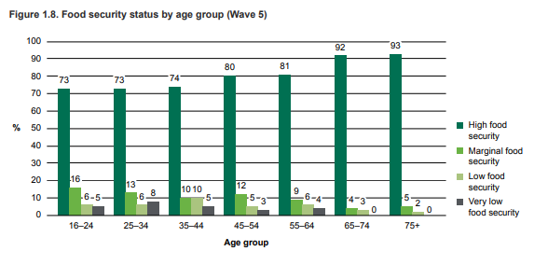
Overall levels of food security
Based on these scores 80% of respondents lived in households with high food security
10% in households classified as marginally food secure
10% reported living in household with low or very low food security.
These proportions are at similar levels to Wave 4 (2016).
Based on fieldwork with 2,241 interviews with adults aged over 16 between June and November 2018
Notes:
Page 39 Food and You Wave 5 results
The Food and You Survey - Wave 5
These findings are based on 2,241 interviews from a representative sample of adults aged 16 and over across England, Wales and Northern Ireland. Fieldwork was carried out between June and November 2018

Slide 25
The following differences were observed between groups of respondents
Age
Households with children
Working status
The proportions living in households with high food security increased broadly with age, from 73% of people aged 16 to 24 to 93% of over 75s.
Respondents who lived with children under the age of 16 were less likely than those with no children to have high levels of food security (70% compared with 84%), and there was a similar difference for those living with children aged under 6.
People in work were also more likely than those who were unemployed to report living in households with high food security (80% compared with 49%). Almost a quarter (23%) of unemployed people lived in households with very low food security, compared to 4% of those in work.

Slide 26
The following differences were observed between groups of respondents
Household income
Long term health conditions
Related analysis
59% of households in the lowest income group had high food security, increasing with income to 93% in the highest income households. Unsurprisingly 13% of households in the lowest income groups had very low food security (compared with less than 1% of those in the highest income households)
This insight was provided by Dr Megan Blake based on deep analysis of Wave 3 but also echoing similar results in Food Foundation data (January 2021)
The risk of food insecurity for those who have long-term health conditions are 2.56 times as likely to have very low food security regardless of IMD. In areas of least disadvantage, the risk is 2.3 times as likely
12% had felt that the food they bought didn’t last, and they didn’t have money to get more
11% had felt that they couldn’t afford to eat balanced meals.
There were again differences among age groups; 18% of 16 to 24 year olds agreed that the food they bought didn’t last, but this proportion decreased with age to 4% of over 65s. There was a similar pattern in the proportions who often or sometimes couldn’t afford to eat balanced meals (from 13% of 16 to 24 year olds to 3% of over 75s).

Slide 27
The majority of respondents (83%) said they had never worried about running out of food before there was money to buy more. 17% had worried about this at some time and there were variations across groups.
Age
Households with children
Household income
A quarter (25%) of respondents aged between 16 and 24 mentioned they had worried about running out of food before there was money to buy more, whereas only 5% of over 75s said the same.
The proportion of respondents living with a child under the age of 6 who had worried about running out of food (29%) was double the proportion of respondents also living with a child under the age of 6 who had not (15%), and there was a similar pattern for those in households with children aged under 16.
In the lowest income households 36% had worried about running out of food before there was money to buy more, and this proportion declined with increasing income to 5% of the highest income households.

Slide 28
Key messages from Food and You, Wave 5
The majority (80%) of respondents reported living in households with high levels of food security, 10% lived in households with marginal food security and 10% lived in households with low or very low food security (known as ‘food insecure’).
About one in six (17%) of respondents reported that their household worried in the last 12 months about running out of food before there was money to buy more.
Similar proportions said that in the last 12 months they had experienced food running out when they did not have money to get more (12%) or that their household had experienced not being able to afford to eat balanced meals (11%).
Just under half of all respondents (47%) reported making at least one change in their buying or eating arrangements in the last 12 months for financial reasons.
NB. Levels of household food insecurity are thought to have increased to c14% since this publication based on other survey data collected by the Food Foundation Food Insecurity Tracking | Food Foundation
Notes:
‘Food security’ means having access at all times to enough food that is both sufficiently varied and culturally appropriate to sustain an active and healthy life.

Slide 29
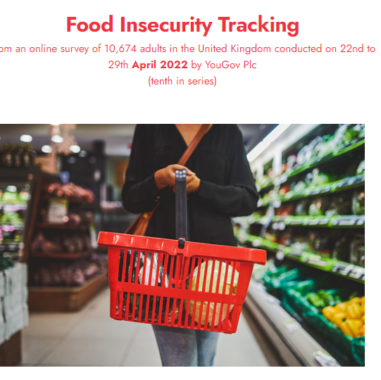
Did you/anyone else in your household
1. have smaller meals than usual or skip meals because you couldn't afford or get access to food?
2. ever been hungry but not eaten because you couldn't afford or get access to food?
3. not eaten for a whole day because you couldn't afford or get access to food?
Notes:
Measuring Food Insecurity
We asked three questions to assess whether people were food insecure.
If they answered yes to any of these three questions, they are classified as food insecure:
Did you/anyone else in your household:
1. have smaller meals than usual or skip meals because you couldn't afford or get access to food?
2. ever been hungry but not eaten because you couldn't afford or get access to food?
3. not eaten for a whole day because you couldn't afford or get access to food?
We asked them if they had experienced this in a) the last month and b) the last 6 months.
These questions are part of the United States Department of Agriculture's Food Security Survey module. This is a validated survey tool, used to measure and monitor household food insecurity in many high-income countries, including the UK. These questions capture moderate and severe experiences of food insecurity.

Slide 30
Analysis
Latest figures from the Food Foundation see a 57% jump in the proportion of households cutting back on food or missing meals in just three months.
7.3 million adults (13.8%) are food insecure in April 2022. They live in households that had gone without food in the past month .
This compares to 4.7 million adults in January 2022.
Notes:
This crisis cannot be blamed on one cause but instead is a culmination of the war in Ukraine causing uncertainty over oil supplies pushing up prices plus the impact of sanctions, global shipping costs increasing due to reduced capacity during the pandemic combined with increased cost of shipping containers. Combine this with the government support during the pandemic ending, staff shortages as a fall out of both the pandemic and Brexit and shortages of goods across the world and the UK’s inflation rate has risen to a 30-year high.

Slide 31
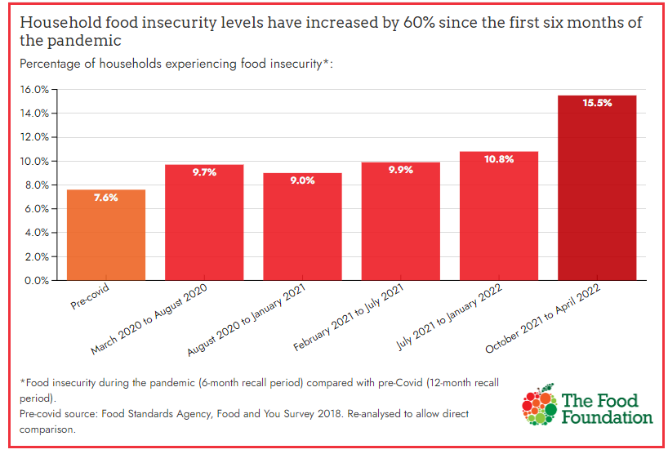
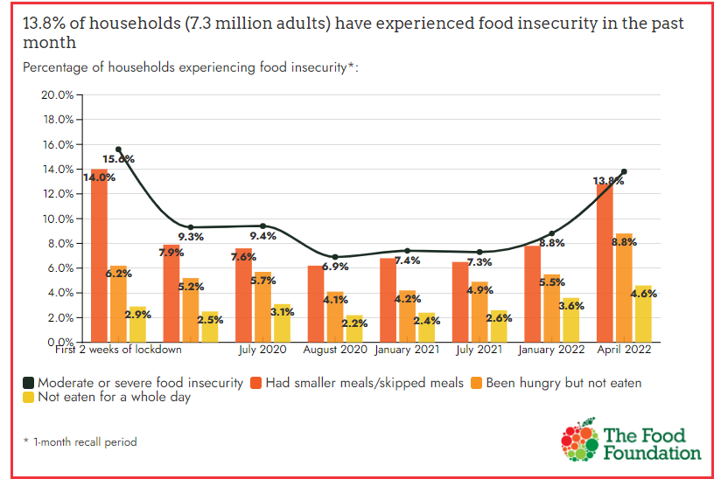
Food Foundation: Food Insecurity Tracker
Survey 10, April 2022

Slide 32
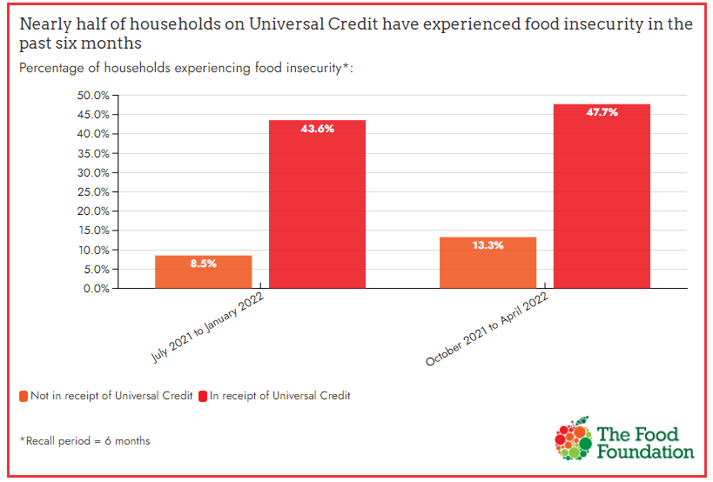
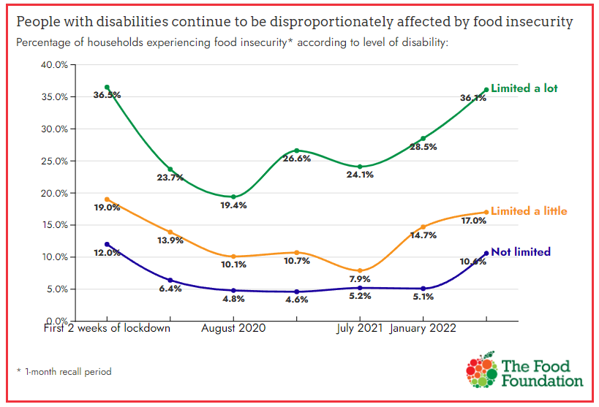
Food Foundation: Food Insecurity Tracker
Survey 10, April 2022

Slide 33
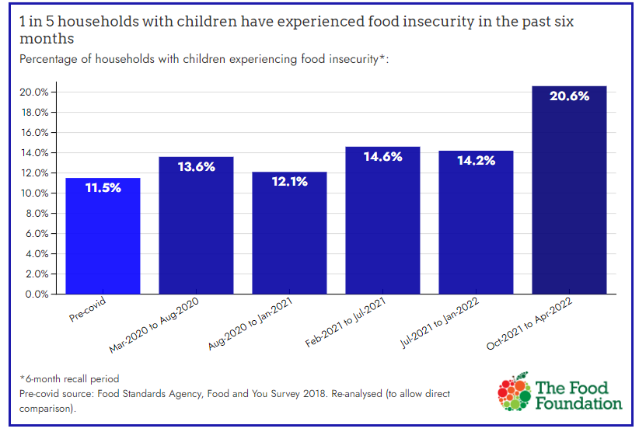
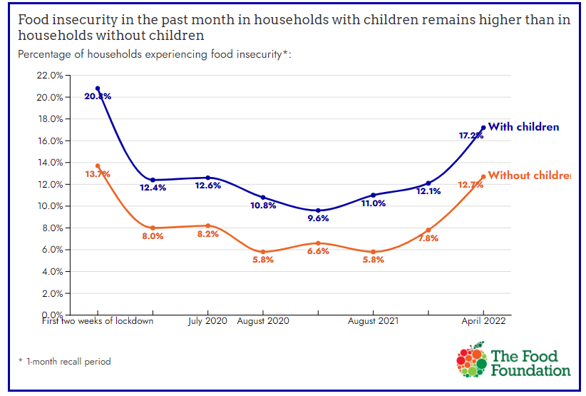
Food Foundation: Food Insecurity Tracker
Survey 10, April 2022

Slide 34
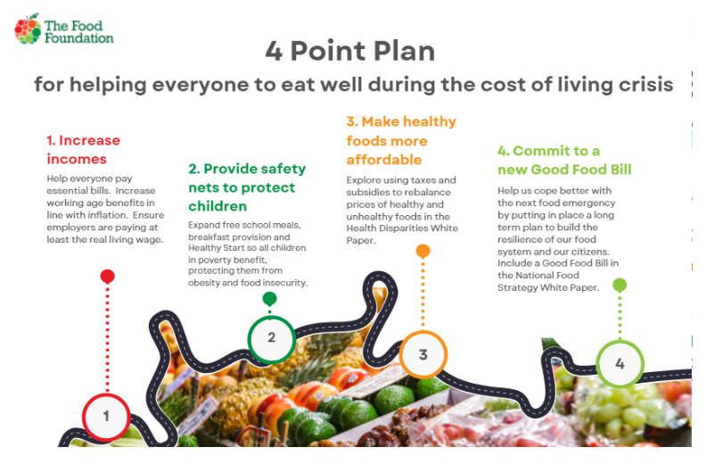
Food Foundation: 4 Point Plan

Slide 35
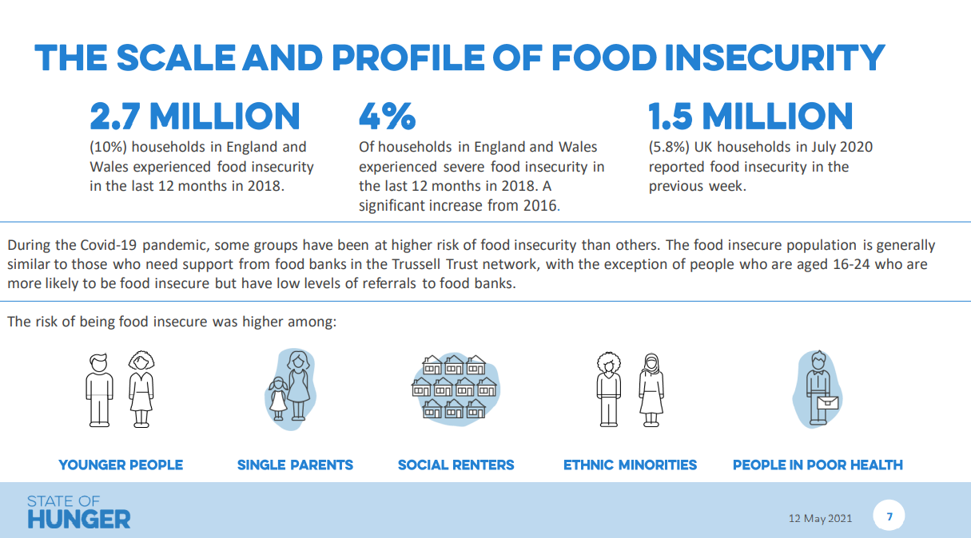
State of Hunger Report, 2018
Notes:
Alternative source of figures, 2018, Trussell Trust

Slide 36
Measurement in York & North Yorkshire
‘Hungry’, ‘Struggle’ and Worry’
Data Dashboard developments
 | Hungry | Struggle | Worried
Selby | 7.84 | 14.77 | 7.85
Craven | 6.07 | 10.08 | 7.27
Scarborough | 5.64 | 11.36 | 9.44
Richmondshire | 4.7 | 9.87 | 8.19
Ryedale | 4.29 | 9.71 | 8.17
Hambleton | 4.21 | 9.32 | 7.83
Harrogate | 3.3 | 8.59 | 7.62
York | 2.81 | 7.54 | 9.5
Access to new data thanks to Dr Megan Blake, Sheffield University - Adult Food insecurity at Local Authority Scale based on Food Foundation data January 2021
Notes:
This map provides UK-wide local authority estimates of 3 different measures of adult food insecurity. The estimates draw from a survey commissioned by the Food Foundation that was conducted in Jan 2021 by YouGov.
Hungry is defined as having skipped food for a whole day or more in the previous month or indicated they were hungry but not eaten because they could not afford or get access to food.
Struggle is defined as a positive response to at least one of the following:
Sought Help accessing food
Skipped or shrank meal
Gave a reason for not having enough food
Worry is defined as choosing very worried or fairly worried about getting food.
**Please note: these percentages are not additive across measures. You can add across places within a single measure.
The darker the colour the greater the percentage of insecurity in each measure. Measures and classes can be turned on and off via the buttons in the lower left-hand corner.
The estimates are produced by Dr Angelo Moretti (MMU), Dr Adam Whitworth (Univ Sheffield) and Dr Megan Blake (Univ Sheffield) using a regression-based multilevel small area estimation methodology.
The accompanying briefing report provides technical details on the methodology.
Estimates and confidence intervals may be downloaded here.
Further questions on the local estimates can be direct to m.blake@sheffield.ac.uk
For further information about the Food Foundation survey please contact office@foodfoundation.org.uk

Slide 37
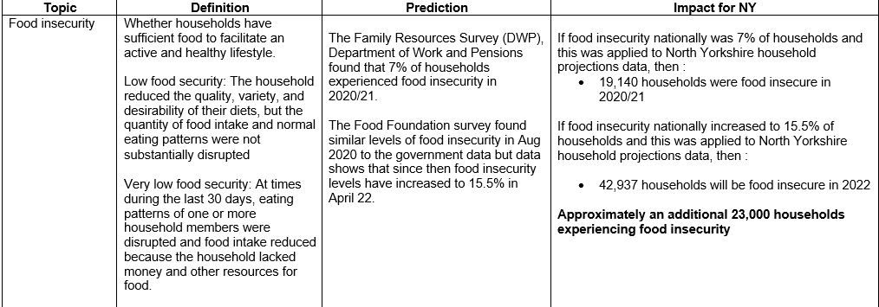
NYCC Management Board, May 2022 - CONFIDENTIAL

Slide 38
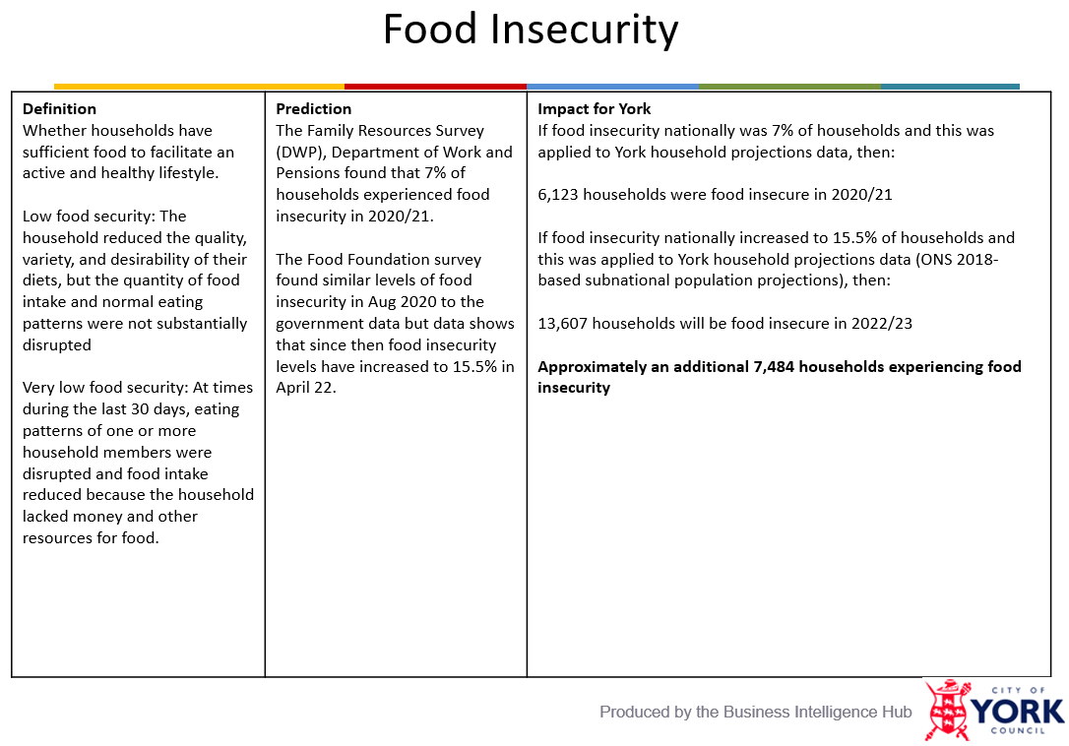
CYC Cost of Living Board Paper, July 2022 - CONFIDENTIAL

Slide 39
Thank you
Alan Graver, Skyblue Research Ltd
alan@skyblue.org.uk
www.skyblue.org.uk
0794 000 4560

