Slide 1
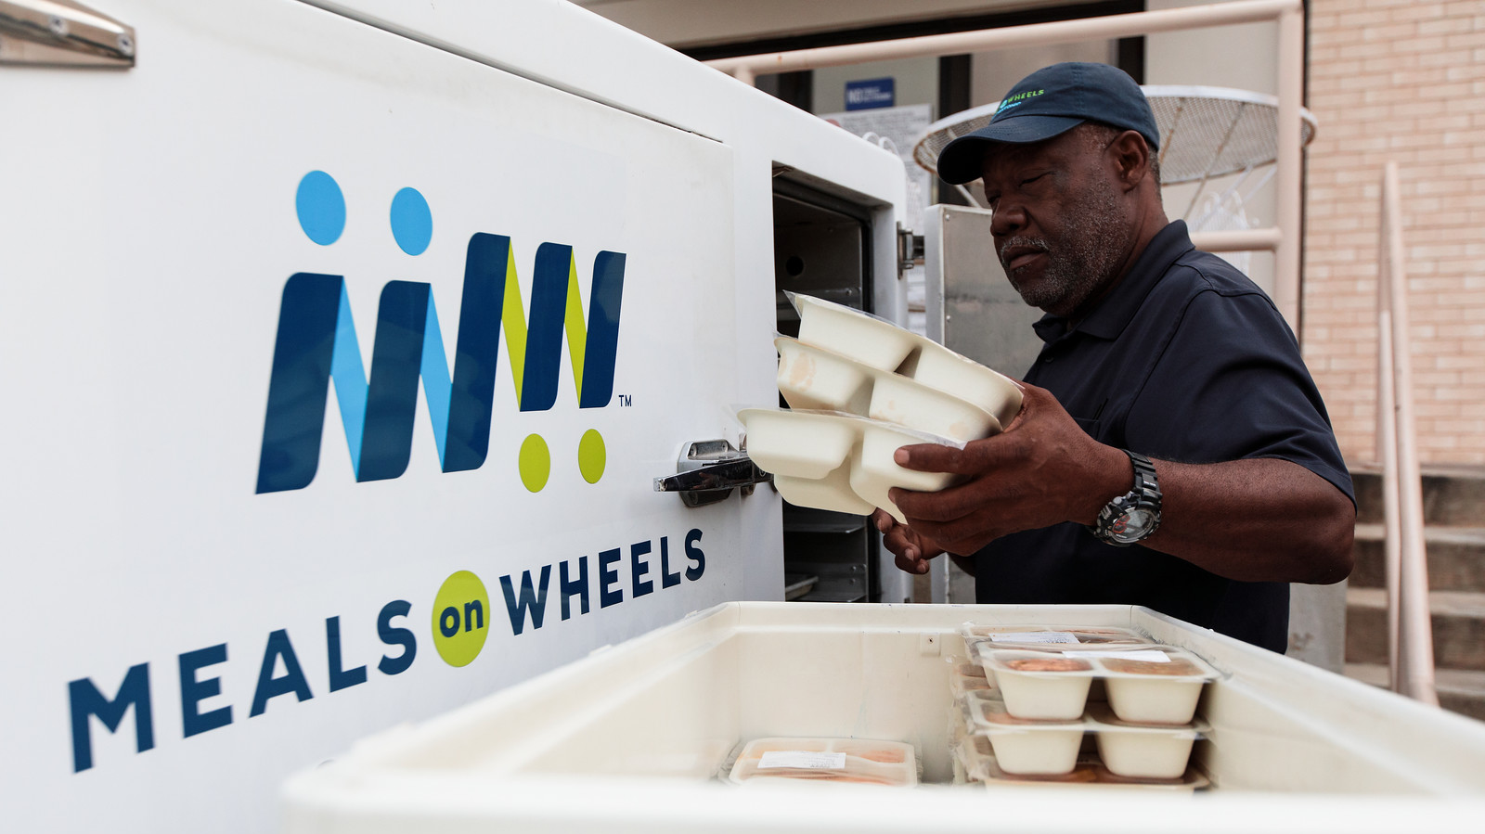

Covid Recovery Insight Project: Food Insecurity
Direct Food Provision
Notes:
Image: https://vantageaging.org/blog/volunteer-meals-on-wheels/
This presentation is based on a synthesis of evidence from 10 key sources:
A survey of food banks operating independently of The Trussell Trust food bank network. December 2019
‘Comparing local responses to household food insecurity during COVID-19 across the UK (March – August 2020)
Food vulnerability during COVID-19 End of project summary of key findings (2022)
Herefordshire Case Study, Mapping local responses: March to August 2020',
Meals on wheels for the 21st century. A report exploring meals on wheels services in London before, during and after Covid-19. Sustain. July 2020. The author is Morven Oliver-Larkin, who coordinates Sustain's London Food Poverty Campaign encouraging sustainable approaches to improving household food security, particularly where these address root causes.
More than Just Food: Food Insecurity and Resilient Place Making through Community Self-Organising, Published: 23 May 2019
Releasing social value from surplus food Evaluation Final Report FareShare-British Red Cross. Impact of British Red Cross funding on FareShare to tackle Loneliness and Isolation. February 2020
Shaping more resilient and just food systems: lessons from the COVID-19 pandemic. 2021
The nutritional quality of food parcels provided by food banks and the effectiveness of food banks at reducing food insecurity in developed countries: a mixed-method systematic review. 2022
Visiting Nurse Association. Meals on Wheels Analysis. Final Findings (2017

Slide 2
Definition
Bringing volunteer shopping, support, and free or paid-for meals to older and isolated adults – normally in their own homes
Direct food can also be offered as part of a ‘hot meals PLUS wrap around support ' approach, that might include welfare checks, and complementary social care services
This presentation examines food boxes / parcels and meals on wheels services
Notes:
Direct food provision plays an important part within the wider ‘food support landscape’. A satisfactory definition is hard to come by, but a key feature of this model is that it is ‘commensal’ that is supplying food to people who the provider does not have a family or close link with. This type of service can be delivered in people’s homes, but this is not a universal feature.
The COVID-19 pandemic accelerated the growth of this type of support, at a time when gathering together was not possible. In all four countries, national schemes were established to support people who were shielding and unable to access food. Many councils also began providing their own local government food parcels.
There was variability in the levels of support and how this support was provided across the four UK nations but third sector involvement in direct food aid was a commonality.
The model also diversified to include, for example, ‘pub meals on wheels’ or ‘school dinners on wheels’. However, this followed the austerity period when ‘meals on wheels’ type provision reduced significantly.
From ‘A commensal is an organism that uses food supplied in the internal or the external environment of the host, without establishing a close association with the host, for instance by feeding on its tissues’.
Source: https://www.sustainweb.org/foodpoverty/meals_on_wheels/
Meals on wheels services can be paid-for, subsidised or free-of-charge typically linked to addressing malnutrition, or the risk of malnutrition, amongst older people

Slide 3
Outcomes
Improved dietary intake, but not quality of diet
Social connectedness
Reduced extent of food insecurity
Increased engagement by local authorities on poverty, food and related issues
Increased partnership working across districts / boroughs
Saving time and better resource deployment for charities
Employment opportunities for volunteers
“Meals on wheels can provide a lifeline to people struggling to feed themselves in their own homes.”
For statutory services:
Presentative / mitigating effects – e.g. spotting falls earlier, or reducing hospital re-admissions
Delayed need for care
Cost savings to the health care system.
Notes:
From ‘A commensal is an organism that uses food supplied in the internal or the external environment of the host, without establishing a close association with the host, for instance by feeding on its tissues’.
Quote source: ‘Meals on wheels can be paid-for, subsidised or free-of-charge.’

Slide 4
Enabling and Limiting Factors
Enabling ingredients:
Delivered within a ‘rights based framework’ to promote choice and dignity.
Councils connecting and referring
Includes wider assistance support
Roles dedicated to maximising the potential of the system – e.g. to connect faith groups to food networks
Flexible models that can be free, subsidised or paid for by end users
Paying workers the living wage
Forming part of a well functioning wider food support ecosystem.
Barriers:
Lack of oversight and coordination
Questionable sustainability of ‘home grown’ direct food services
Variability
Healthy food not prioritised
Achieving economies of sale in sparsely populated rural areas
Families are rarely involved in the design of these services
Funding is often short term and insecure.
Demand varies significantly by area, making central planning difficult.

Slide 5
Good practice – worked example
Focus on healthy local food/importance of food
Early identification of where resources are and where to get them
The ability to pull community together and to lead and own what is needed locally.
Growing your own
Stronger community feel
Ability to adapt
Community support in rural areas
"Family focus"
Community food hubs and use of surplus food
Healthy food education projects
Looking for more sustainable long-term ways of meeting food needs local growing of food and connecting producers with those who need food locally.
The local authority working closer with charities and food supporting organisations, understanding the needs better.
Not good practice
National food box
Bringing food into the county from outside providers to meet local need when we could have enhanced local provision and supply over longer term.
Judgement on why people are asking for help
Duplication of services
Organisations ‘popping up’ to provide support that don't consult with others already doing this, leading to duplication in some cases
Herefordshire Case Study, Mapping local responses: March to August 2020', published July 2021.

Slide 6
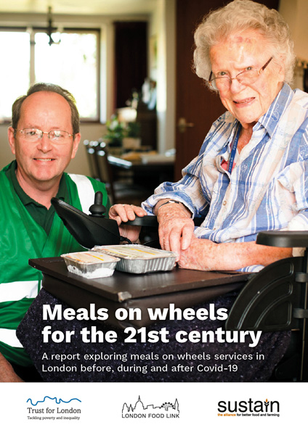
Meals on Wheels
Viable mixed models exist for making the service affordable for local authorities, especially where this involves social enterprise and integration with social services.
This form of direct food provision is essential for those who are least able to prepare or cook meals for themselves. Regular visits from delivery staff generate ‘social, relational and psychological value’.
“A meals on wheels service, delivered well, treats recipients with respect and dignity, offers choice and control over several aspects of the service, and supports and nourishes recipients.”
'Economies of scale' that make these services financially viable can be difficult within a single borough or if strict eligibility criteria are applied. Working in partnership across borough boundaries should provide opportunities to find workable economies of scale; depending on how these are assessed.
Notes:
Image: https://www.sustainweb.org/publications/meals_on_wheels_for_21st_century/
Meals on wheels for the 21st century. A report exploring meals on wheels services in London before, during and after Covid-19. Sustain. July 2020
Meals on wheels can be paid-for, subsidised or free-of-charge.
A US study modelled a 46% ROI on a meals on wheels service. – based on valuing both health and social benefits / mitigation (e.g. reduced isolation).

Slide 7
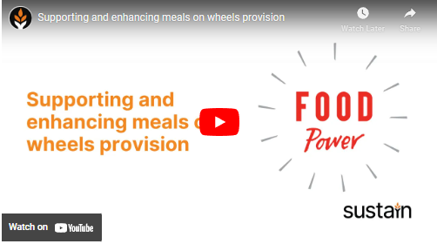
Sustain resources: meals on wheels
Please see Sustain’s dedicated website section and resources aimed at anyone seeking to support and enhance meals on wheels provision
Supporting and enhancing meals on wheels provision - YouTube

Slide 8
Questions arising
How is the nutritional quality of food parcels achieved / managed?
Should national or local government direct food insecurity interventions?
What is provision of meals on wheels in York and North Yorkshire? And if deemed insufficient, how is the case for investment best made to incorporate this as part of adult social care and / or public health in a pursuit of mitigating malnutrition in older people?

