Slide 1
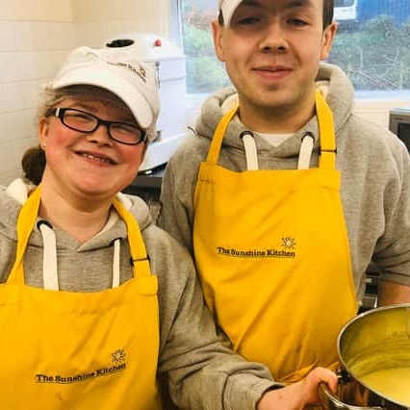

Food and Education Models
Covid Recovery Insight Project: Food Insecurity
Notes:
Image: https://www.fifetoday.co.uk/news/people/sunshine-kitchen-help-for-students-with-disabilities-3288620

Slide 2
Definition
This resource includes models that have a focus on food education or literacy. These can manifest in different ways but can include:
Community kitchens (where the evidence is greatest)
Community food programmes or projects with a specific ‘social making’ motivation e.g., cooking, learning and sometimes then easting together
Courses and demonstrations that are accessed at community hubs
At their heart, these food education / literacy approaches aim to reduce household food insecurity by teaching skills to people so they can make limited household / food budgets stretch further.
They can also provide access to places to grow food or provide cheaper access to food, through community shops, market voucher schemes or food box programmes.
In community kitchens participants prepare large amounts of food together and take home the meals prepared, and simultaneously often are taught budgeting and cooking skills.
Notes:
This presentation draws on 6 of the most relevant sources of evidence
In practice, there is often an overlap between food models and education, however, the community kitchen is a particular model of focus in this report based on the availability of evidence found in the review. Please also note that a range of funders provide grants to encourage community learning / skills / literacy of this nature
Evaluation of Fife's Community Kitchen (2012)
An independent evaluation of Food for Life cook and eat courses, Shoreditch Trust (2017)
Social policy and embedded evaluation: Assessing the impact of a food insecurity project in the United Kingdom
Interventions to address household food insecurity in high-income countries (2018)
A review of practical cooking skills activities which focus on promoting an affordable healthy balanced diet for adults, young people and their families within low-income communities in Scotland (2015)
Chopping and changing: Evidence and ideas to improve the impact of your cooking skills courses (2018)

Slide 3
Outcomes seen in the evidence base for these models
Increased awareness, knowledge, skills, experience and confidence around healthy eating through classes including:
  What constitutes a healthy diet
  The importance of eating healthily
  How easy it can be to prepare healthy food
  How to prepare affordable healthy food
Increased intake of nutritious foods/reduced barriers to healthy eating / significant improvements to participants’ diets e.g. in Fife Community Kitchen nearly two-thirds:
  eat more fruit and vegetables
  make more meals using fresh ingredients
  add less salt to food; and
  eat less food that is high in fat and/or sugar
Improved ability to plan, shop for and prepare healthy meals for self and families
Increased healthy food access
Improved knowledge of selection and preparation of more highly nutritious food
Improved eating habits and consequent health benefits
Improved social connectedness / socialising / meeting new people
Increased self-reliance and engagement with social services
Improved social skills and enhanced social support
Increased skills, confidence and enjoyment from cooking
Budgeting skills
Life and employability skills (where this forms part of the education model) e.g. in Fife, 31% said it had helped them get into education or training and 20% find a job
Introduction to college (depending on the model)
Sense of achievement
Increase in confidence
Choice and empowerment
Reduced isolation
Feeling valued
Having fun / a laugh / a sense of pleasure.

Slide 4
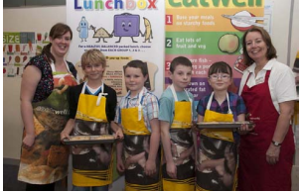
Fife Community Kitchen
Strengths / effective aspects
A domestic, homely environment
Well-equipped
Facilitates the delivery of healthy eating sessions
Staff who deliver courses at the Community Kitchen
The Community Kitchen has social benefits for participants
The management model of the Community Kitchen minimises on-going costs and overheads
The partnership approach behind the model and strong rationale for its creation (linked to NHS/local plans and ambitions)
Challenges
Residents finding it difficult to get to the Community Kitchen using public transport
increasing the capacity/opening hours to meet demand
Income generation
Barriers that hinder individuals' ability to eat healthily:
a lack of awareness of what constitutes a healthy diet
a lack of skills, confidence and knowledge to shop for and prepare healthy meals
a lack of available and affordable healthy produce, particularly among low income communities
cultural habits and traditions.
Notes:
Image - https://www.fifetoday.co.uk/news/people/new-courses-launched-in-community-kitchen-at-greener-kirkcaldy-3571230
(n.b. other models in the UK have succeeded by selling courses to the private sector and paying customers whilst subsidising use for local VCSEs and those struggling / in the area of deprivation).

Slide 5
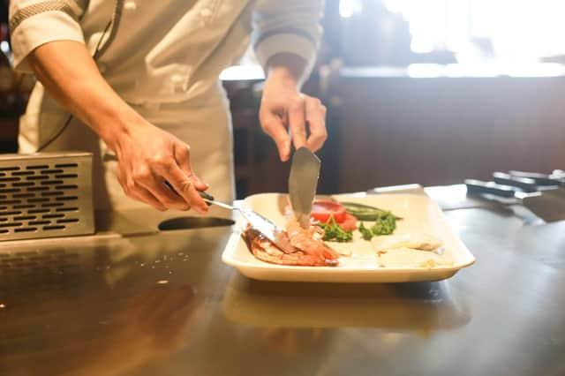
Hackney Cooking Classes – Food for Life
Challenges
Oversubscribed courses / meeting demand
Signing up residents who live locally and who have low socio-economic status
Requires skill, dedication and hard work over a long period of time to gain community trust
It was difficult to recruit people living within a short walk of the kitchens (in Hackney) for reasons including:-
  a lack of confidence to try something new,
  associating courses with school
  shift work
  chronic illness or
  an unwillingness to be out in the early evening.
May require 'extra' encouragement from GPs, nurses, voluntary organisations or housing officers.
Strengths
By listening to them, Food for Life staff have designed an initiative that meets their needs and wishes
Use of community connections
Staff have the confidence to show leadership by organising courses which extend knowledge
Key to the high quality provision and its success is the use of knowledgeable and committed sessional staff sensitive to working with those on a limited income and with an ability to incorporate those with disabilities and with long-term health issues
Opportunities for developing a more integrated system of commissioning
The courses were well run, participants learn, found them pleasurable and many enjoyed them socially – sense of belonging too.
Notes:
Image - https://www.fifetoday.co.uk/news/people/new-courses-launched-in-community-kitchen-at-greener-kirkcaldy-3571230

Slide 6
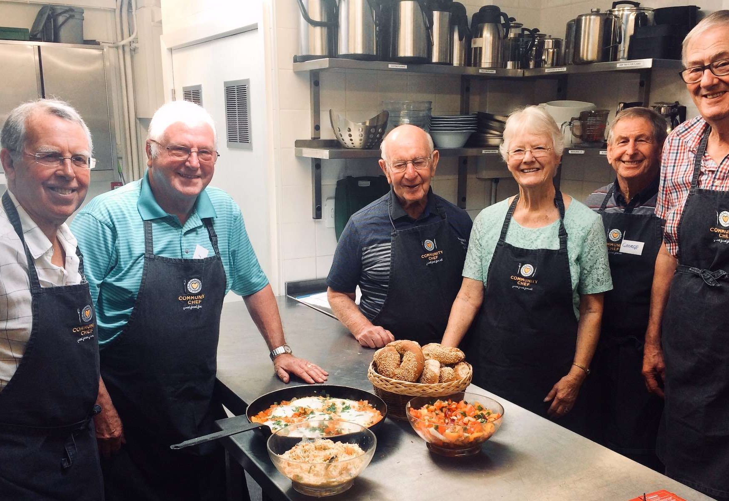
Community Cooking Courses
One model comprised a six-week cook and eat session called 'healthy, wealthy, and wise' where participants do five weeks of different recipes, mostly all done with basic equipment
Participants play icebreaker games and are given a choice of recipes – providing choice and a sense of empowerment
Participants sit together and eat, kids too.
The aim is to find a fun way for people to learn to cook healthy options within a tight budget.
By enabling new ways of cooking, these sessions reduced stress associated with trying to find low-cost food that families would eat that are also at the same time healthier options.
Notes:
Image - https://communitychef.org.uk/cookery-courses
Building on existing food skills participants began to be more confident and have more positive relationships with their food. This intervention also expanded the reach of their services to a wider range of age groups in the community thereby enhancing the communities capacity to build resilience.

Slide 7
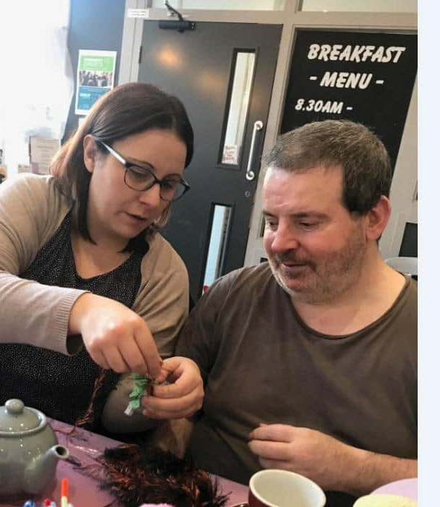
‘Crafternoons
Social learning with food
As a result of putting on a craft learning activity, which included a cup of tea and a snack, it was reported that the number of medical visits by older people in the village went down.
Crafternoon sessions facilitate social connections and a sense of purpose for older residents in the community, which has the outcome of enabling them to live longer and better lives but also makes them available as a motivated resource for community self-organisation.
Notes:
Image - https://www.northamptonchron.co.uk/news/people/crafternoons-be-held-accessible-northampton-town-centre-venue-help-promote-positive-mental-health-1372718

Slide 8
Making the case for food and education models
The case for community kitchens
The investment case for the Fife Community Kitchen was oriented around public health challenges, specifically data relating to obesity, being overweight, links to type 2 diabetes, hypertension, heart disease, some cancers and premature death.
Good alignment with national and local policies, strategies, priorities and ambitions – across public health, but also at a local level linked to its 2011-2020 Community Plan.
The case for food education / cooking classes
Evaluations suggest that attending cook (and eat) classes represents a moment in time when participants are motivated to improve their lifestyles.
This situation presents an opportunity to develop an integrated set of interventions alongside cook and eat sessions to support participants sustain these improvements such as exercise.
A range of health, wellbeing and wider social benefits are in evidence and they can be targeted and or inter-generational in their approach depending on the desired outcomes.
Notes:
Community Food and Health Scotland also identify the contribution of this work in reducing health inequalities and barriers to healthy and affordable food; explore new ideas for improving food and health work. CFHS is currently working with the Scottish Government, community food networks and our colleagues in Public Health Scotland to plan how the community food sector can be supported in the future.

Slide 9

Sustainability ideas?
Durham Community Kitchen runs a community cafe and plans to deliver training for hospitality businesses
Community Training Kitchen in Inverurie charges a fee to organisations using the Kitchen but ensure that the classes are free for the service users
London Community Kitchen has a mixed revenue model, offers learning, qualifications, training into employment and has obtained an independent community café
Some initiatives such as Knowle West Health Association Community Kitchen and Community Kitchens Northwest (USA) run classes for members of the public, for which there is a nominal charge, on various topics including: one pot meals; food on a budget; and diabetes and weight control

Slide 10
Questions Arising
1: Do we have any / enough community kitchens?
2: Are these interventions attractive for Public Health / Adult Learning / Community investment in York and North Yorkshire?
3: What opportunities are there for building on existing community assets to develop community kitchens and classes where they will help people that are struggling, stressed or having to stretch their budgets?
4: How viable are community kitchens in rural or sparse communities – income generation models?
5: What can we learn from the ongoing work of Community Food and Health Scotland with their innovative approach to evaluating the efficacy of these kinds of food and education models, as well as the new research and evaluation commissioned to build the evidence base on the nature and extent of community food activity in Scotland?
Notes:
Community Food and Health Scotland also identify the contribution of this work in reducing health inequalities and barriers to healthy and affordable food; explore new ideas for improving food and health work. CFHS is currently working with the Scottish Government, community food networks and our colleagues in Public Health Scotland to plan how the community food sector can be supported in the future.

