Slide 1


Food with Wrap Around Support
Covid Recovery Insight Project: Food Insecurity
Notes:
Image: https://leanderplantsupports.co.uk/rusted-iron.html
This presentation draws on 9 of the most relevant studies identified
Sheffield: Advice and Food Bank Pilot Evaluation (2015)
Hartford, USA: Self-efficacy is associated with increased food security in novel food pantry program (2016)
Lewisham Homes’ Community Food Stores Impact Evaluation (2022)
Community store/shop and food pantries reviews synthesised by Dr Megan Blake (2022)
The Bread and Butter Thing, impact evaluation (2022)
Learning from international experience on approaches to community power, participation and decision-making in health Case Study: Empowerment approaches to food poverty in NE Scotland
A survey of food banks operating independently of The Trussell Trust food bank network. December 2019
Local responses to household food insecurity across the UK during COVID-19 (September 2020 September 2021). An analysis of experiences from 14 local areas from around the UK and recommendations for future policy and practice.
Interventions to address household food insecurity in high-income countries. 2018

Slide 2

Definition
Wrap-around support models are found in settings where food is part of a wider person-centred approach to encourage them towards a more stable and secure situation.
It can include:
Food venues / settings where there is also access to money advice /other services on site
Food models where volunteers are skilled to signpost on to other services and / or have access to resources that detail other person-centred services e.g., Food Resilience Toolkit (created in Leeds)
Apps that empower the individual seeking food to also access other support and services e.g., Hope in Swansea app
Notes:
This wrap around support can often be found amongst models already described in this report such as community hubs and some food banks that have developed their services to include advice and / or signposting e.g., in Harrogate 4 food banks are collaborating on a pilot with a fully qualified Citizens Advice worker to provide wrap-around support for people using the banks.
The Trussell Trust's model for food banks is well-established, involving establishing relationships with third-party local social and health service agencies who provide referrals; requiring that people in need of assistance have a referral for use; collecting data through the referral system; and guiding their member food banks to follow-up with referral agencies if they provide more than three referrals to a single client in a 6-month period.’ Source: A survey of food banks operating independently of The Trussell Trust food bank network. December 2019

Slide 3
Typologies of wrap around support
Typologies of Wrap Around Support
Practical services
Educational
Health / wellbeing
Pastoral
Social support
Communal / social
In a survey of 114 IFAN Network independent food banks (2018/19), over 60% of them offered other services in addition to food parcel distribution. Almost all provided signposting to other services or assistance and 60% offered other services, in-house, as well.
Notes:
Source: additional types of support offered by independent food banks. From a survey of a simple random sample of 114 in the IFAN Network, conducted between September 2018 and May 2019,
In a survey of a simple random sample of 114 (from 558 possible invitees in the IFAN Network) independent food banks conducted between September 2018 and May 2019, over 60% of food banks offered other services in addition to food parcel distribution. Almost all food banks provided signposting to other services or assistance and 60% offered other services, in-house, as well.

Slide 4
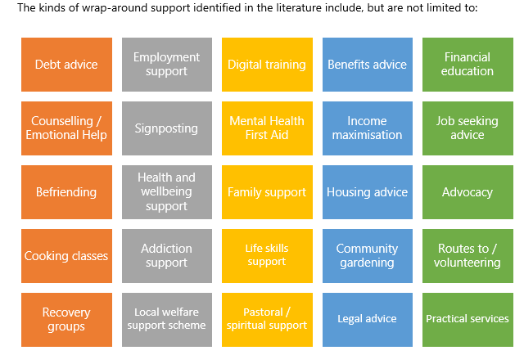

Slide 5
Outcomes seen in the evidence base for these models
Access to additional services, e.g., benefits, employment guidance, housing
Alleviation of stress of dealing with an acute income crisis
Saving money on travel by accessing in-situ/local advice worker at a food bank
Improved skills via training – some leading to qualifications
Increased confidence (to access the right support towards financial stability)
Increased social inclusion (where individual takes part in education/ classes/ groups)
Reduced stigmatisation for individuals / increased feelings of dignity
Feeling empowered / being able to make choices
Evidence is emergent around the preventative effects of these wrap-around services too and how their design is able to help individuals deal with the root causes of food insecurity
Notes:
The most notable outcomes in the literature based on evidence reviewed

Slide 6
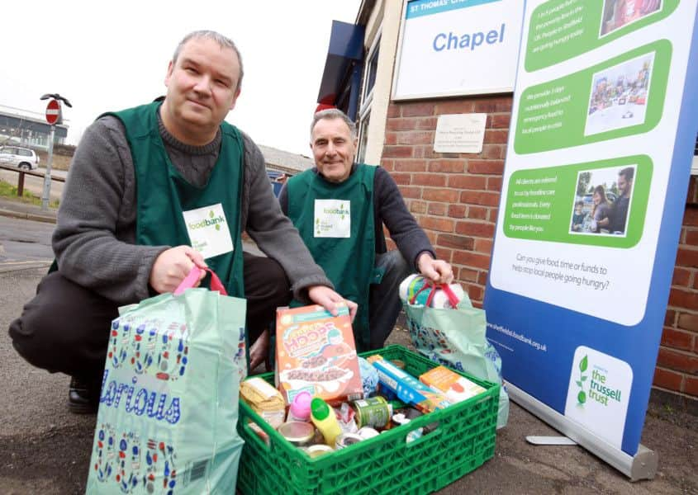
Example: Sheffield Advice and Food Banks Pilot
This pilot project in 2015 comprised a food bank and advice worker integrated model.
Specifically, it sought to work with clients to address their advice needs, including support in accessing their full benefit entitlement and dealing with benefit sanctions, as well as addressing the impact of other pressures such as debt, housing, employment and low pay.
The project had the additional aim of building capacity within the food bank volunteer community by equipping them with the knowledge, skills and confidence required to undertake a thorough initial assessment of social care need.
7 recommendations from the evaluation
1. Essential the intervention has clear aims / objectives.
2. Objectives should be used to inform more practical volunteer training to build confidence.
3. Sufficient lead-in time is required to work toward developing a joined-up approach.
4. Advice workers would benefit from an orientation period within the food bank.
5. Volunteers involved in client liaison have the opportunity to meet the advice worker.
6. Consider the positioning of the advice worker service.
7. Acknowledge that additional costs may be incurred in terms of room hire.
Notes:
Image - https://www.thestar.co.uk/news/sheffield-foodbank-teams-up-with-npower-to-give-out-fuel-vouchers-64087
It was funded by the City Council and implemented in four of Sheffield's food banks with an aim to help vulnerable food bank users who may be experiencing different types of acute income crises. There were important variations amongst the two food banks where evaluation took place. Food Bank 1 was approaching the end of its third financial year and was affiliated to the Trussell Trust while Food Bank 2, an independent, had only been operating for less than a year just received charitable status.

Slide 7
Examples in Scotland
Community Food Initiatives North East (CFINE)
Social Bites
CFINE both provide emergency food aid, develop employment capabilities and opportunities and provide education, skills development and training.
Evaluation concluded that CFINE’s work has been found to empower people and communities by promoting the consumption of healthy food, building financial capabilities and building confidence through supported volunteering and employment.
“Food can be an effective, accessible way to engage people in activities and develop capabilities that improve their quality of life, such as when food-related activities provide an entry point for health and social service referrals, for training, supported volunteering and employment. “
Social Bite’s work uses food as a lever to tackle a wider issue of homelessness. Their Aberdeen cafe is used as a social space where people in various stages of homelessness can come in for a sit-down meal after the shop has closed for the day. Termed 'social suppers', it offers counselling and other support for housing, healthcare in addition to food.
Suppers encourage conversations about politics, addiction, legal struggles, grief, racism, violence, boredom, frustrations with bureaucracy, family estrangement and job hunting.
Suppers link people with homeless charities and a multi-ethnic housing project, information from mental health services, financial advice and food security support groups, among others.
Notes:
https://www.cfine.org/
Image: https://www.cfine.org/get-involved/members
Case studies from Community Food Initiatives North East (CFINE) explore three key practices:
opening pathways to employment, financial capability and housing (Social Bite)
supporting poor households to move sustainably out of food poverty (CFINE)
making community grants in low-income urban areas through Participatory Budgeting.
See also Social Bite’s work around food and homelessness

Slide 8
Food pantry model with advice:
A random control study in Hartford (USA)
In this model clients were likely to experience very low confidence in their ability to become self-sufficient often dealing with unemployment, low levels of income and education with high housing and heating costs, lack of access to transport, poor mental health and low social capital. The model purposely adopted a goal based behaviour change approach with an aim to help residents acquire long-term food security and self-sufficiency.
Members attended monthly meetings with the Project Manager who oversaw the co-ordination of case management, motivational interviewing and wrap-around services. Dignity was improved by offering appointment times rather than anyone having to wait in lines; and individuals having a choice of shopping in the food banks.
The evaluation found increases in self-efficacy which included:-planning meals ahead of time; making food money last all month; making a shopping list before grocery store visit; comparing prices before buying food to get the best deal; making low-cost meals; buying foods that you think are healthy for your family.
The study is an example of how to programmatically design in the ambition NOT to create a cycle of dependency.
This study concluded that ‘a food pantry model with client-choice, motivational interviewing and targeted referral services can increase self-efficacy of clients.
Notes:
Prioritizing the self-efficacy of clients over the efficiency of pantry operations is required to increase food security among disadvantaged populations.’
Bandura’s social cognitive theory and determinants – stages of change model whereby the individual makes change by small achievable goals

Slide 9
Questions Arising
1: What is the most dignified way to offer wrap-around services to someone presenting at a food venue with very low or low food security?
2: Deploy qualified advice workers in situ as part of an integrated model? Does this work or is it off-putting and awkward for people? Would they see it as ‘authority’ leaning into their lives ‘knowing what’s best for them’ or welcomed support? What can we learn from ‘food & advice’ pilots in York & North Yorkshire and lived experience on this topic?
3: How important is that these qualified advice workers are also capable in motivational interviewing?
4: Would models to train up volunteers in food settings be more likely to succeed and / or how could they integrate with professionals in the advice sector to provide a dignified pathway for individuals towards a more secure situation in their lives?
Notes:
How could any mistrust of perceived or actual authority be overcome whereby an individual is more likely to agree to engage with an advice worker. In the ‘Next Stop Shop’ at FROG in Grangetown (Redcar) the volunteers work seamlessly with a qualified advice worker, dressed casually, and located in the social supermarket ready to support anyone presenting or referred in – but there are no conditions attached, no requirement to attend meetings.

