Slide 1
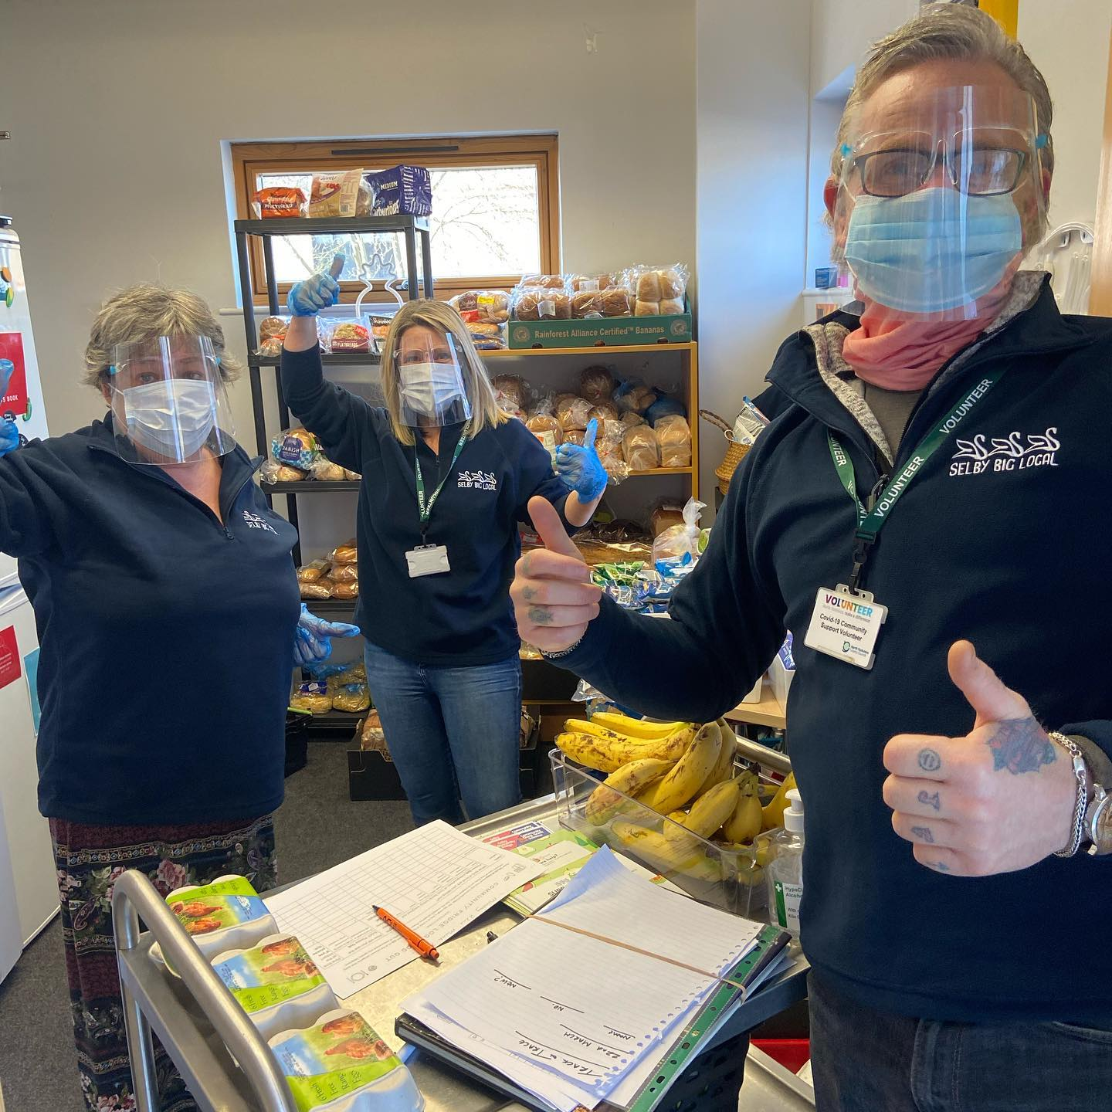


Covid Recovery Insight Project: Food Insecurity
Free Food Models
Notes:
Image: https://www.facebook.com/SelbyCommunityFridge/photos

Slide 2
Definition (Food Banks)
Food banks source food from public donation at local collection points, surplus food donated by businesses and redistribution community schemes, as well as procurement via their own funds. Food banks largely depend on philanthropy from individuals, local businesses, charitable trusts and foundations, but also raise monies through fundraising initiatives.
There are around 1,300 Trussell Trust food banks and 1,034 Independent Food Aid Network (IFAN) food banks in the UK. In 2020-21 the Trussell Trust supplied more than 2.5 million three-day emergency food parcels, an increase of 33% on the previous year. Around 40% of these went to children. IFAN, meantime, reported a 126% increase in the number of emergency food parcels distributed between February 2020 and May 2020.
The majority of food banks have some form of eligibility criteria to target those most in need (e.g ,proof of benefit entitlement), while Trussell Trust food banks usually ask referrals from a third party (a professional). Eligibility and application processes vary between foodbanks and discretion can be applied.
The term 'food bank' can refer to one of two types of service: here we use it to mean ‘a service that provides grocery items directly to clients’.
Notes:
This review is based on 18 of the most relevant studies.
Sources for this slide
Estimate of food banks (TT and IFAN): April 2021 estimates, House of Commons Briefing
Feeding the food insecure in Britain: learning from the 2020 COVID-19 crisis - May 2020
The role of food banks in addressing food insecurity: a systematic review. 2016
Holiday Hunger Project, a report on the holiday food and activity clubs monitored and supported by York Food Poverty Alliance June 2018-April 2019
‘Almost half (47%) of people referred to Trussell Trust food banks are in debt to the Department of Work and Pensions (DWP)’. Trussell Trust, Emergency food parcel distribution in the United Kingdom: April – September 2022
The main reasons for food bank use (in descending order), from the 2019 review of independent food banks cited: Awaiting outcome of a benefit application (i.e payment or decision), Benefit payment interrupted or reduced due to re-assessment, loan repayment, or other reason, High rates of debt meaning income insufficient to cover basic needs, Benefits currently stopped due to a sanction, Regular income insufficient to meet basic needs (e.g. food, housing, utilities), Inability to manage money due to issues such as gambling, addiction, or other problems, Unexpected outgoings (e.g. repairs, accident, funeral, relocation, help for family member), No recourse to public funds and ‘Other reasons’.

Slide 3
Definition (Community fridges)
Community fridges are independent community assets, set up, owned and managed by not for profit and community organisations.
Typically a publicly accessible fridge is for the use of the whole community.
The primary focus is on reducing food waste.
In practice, community fridges have become an important source of food, particularly fresh food, for those in need.
Notes:
This review is based on 18 of the most relevant studies.
Sources for this slide
Feeding the food insecure in Britain: learning from the 2020 COVID-19 crisis - May 2020
The role of food banks in addressing food insecurity: a systematic review. 2016
Holiday Hunger Project, a report on the holiday food and activity clubs monitored and supported by York Food Poverty Alliance June 2018-April 2019

Slide 4
Evidence
Most food bank users were facing an immediate, acute income crisis either a complete loss of income or a very significant reduction in their income - which had left them at crisis point, with little or no money to buy food. | 44% of independent food banks imposed no restriction on how often people could receive food. Over 60% of food banks offered other services in addition to food parcel distribution. 39.5% of food banks did not require referrals from third-party agencies (i.e. accepted self-referrals)
The language used to describe food bank users seems predominantly located in a discourse of blame | Community Fridge use increases stigma free access to food; and provided some solid volunteering experience for those at some distance from employment
Because of limited choice, and poor nutritional quality and quantity of donated food, there is some concern relating to the ability of food banks to prevent or remedy food insecurity and hunger | There was little evidence of these services effectively reducing food insecurity. Cash transfers and food subsidies were far more effective
Notes:
Sources:
1) Evaluation: Pilot Project. Advice and Food Banks making a difference to people in food poverty. 2015=
2) Hungry? Food Insecurity, Social Stigma and Embarrassment in the UK. 2015
3) The role of food banks in addressing food insecurity: a systematic review. 2016
4) A survey of food banks operating independently of The Trussell Trust food bank network. December 2019
5) Food Insecurity: Understanding local delivery, impact and innovation in the North East Riding (2021)
6) Food bank use surged during the pandemic but they can rarely provide all the help people need (2021)

Slide 5
Evidence
Cooking classes or events such as picnics for the whole community increase footfall and value/benefit | Emphasising the environmental angle was felt to normalise community fridge use
Key is the notion of enfranchisement, ensuring that everyone feels that they 'own' it as a part of the community. By existing in a public space and being open to public use, the fridge breaks down the clear-cut relation between 'business' and 'consumer’ | Investment needed to enable community-led change: evidence of success of community projects, yet instability in short-term project funding and an over reliance on volunteers and small VCSE organisations that struggle to access appropriate support when required
Notes:
Sources:
1) Evaluation: Pilot Project. Advice and Food Banks making a difference to people in food poverty. 2015=
2) Hungry? Food Insecurity, Social Stigma and Embarrassment in the UK. 2015
3) The role of food banks in addressing food insecurity: a systematic review. 2016
4) A survey of food banks operating independently of The Trussell Trust food bank network. December 2019
5) Food Insecurity: Understanding local delivery, impact and innovation in the North East Riding (2021)
6) Food bank use surged during the pandemic but they can rarely provide all the help people need (2021)

Slide 6
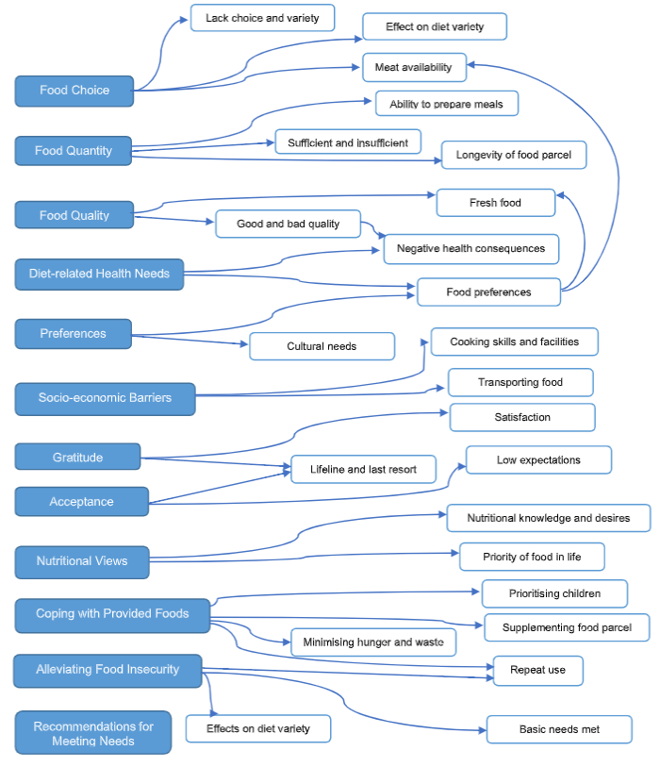
Measuring the effectiveness of food banks at reducing food insecurity
Food banks struggle to meet individual health, social, and cultural dietary needs in socially acceptable ways. Positive outcomes from diabetes-specific food parcels highlight the advantages of tailoring parcels to meet individual needs and preferences.
Food parcel quality and dietary quality were positively correlated and visiting food banks over once-per-month was associated with significantly higher dietary quality scores, compared with visiting less.
Mousa and Freeland-Graves (2019) found over 40% of nutrient and food group intake was attributed to food parcels. Improving the nutritional quality of food parcels by adding fruit and vegetables and removing nutrient-poor snacks significantly improved fruit and vegetables, vitamin C, and potassium intake.
Notes:
Source: https://onlinelibrary.wiley.com/doi/epdf/10.1111/jhn.12994
Page 18
FIGURE 2
The 12 descriptive themes (blue) and codes derived by line‐by‐line coding of the 10 qualitative studies included in the systematic review.
The themes and codes are reflective of the views of food bank clients regarding whether food banks meet their nutritional needs
EFFECTIVENESS OF FOOD BANKS AT REDUCING FOOD INSECURITY
Source for the diagram: The nutritional quality of food parcels provided by food banks and the effectiveness of food banks at reducing food insecurity in developed countries: a mixed‐method systematic review
Lucy Oldroyd1|Fatemeh Eskandari1,2|Charlotte Pratt1|Amelia A. Lake1,

Slide 7
Outcomes
Food banks
Food security at times of crisis
Improved diet
Improved physical health
Improved mental health
Increased awareness / connection to other types of support
Volunteers feel sense of purpose
Social benefits arise from interactions between users and with staff/volunteers
Reduced household expenditure
Reduced food waste to landfill
Reduced greenhouse gas emissions
Community fridges
Reduces stigmatisation by using community fridges
By providing access to fresh foods, community fridges may provide healthier options and opportunities to try new foods
Increased sense of community and enfranchisement
For supermarkets / food providers:
Improved CSR for supermarkets
Reduced cost of food disposal
Notes:
*The primacy of community fridges is to reduce food waste – with supermarkets the prime focus. Despite the huge quantities of food that passthrough community fridges it is useful to be aware that the level of food waste from retailers - which makes up most of the fridge's contents - only counts for 2% of the total food waste figure for the UK. The majority of food that is wasted in the UK (69%) is wasted by households, who make up only around 5% of fridge

Slide 8
Challenges and Enablers
Challenges
There is criticism that food banks can be stigmatising with the effect being that many who are very food insecure do not use them despite needing them most
Evidence on the value of UK food banks is judged to be ‘scarce’
Variability of approach and quality
Insufficient quality food, funding, adequate refrigeration and storage
Food banks are only used by a minority of low-income families
The use of eligibility criteria raises a number of questions, and can undermine the dignity of users and act as a barrier to take up.
Enablers
Located in areas of high deprivation with access to food distribution centres
Offer more than simply food ‘Everyone’s experience of poverty is different, and it’s vital that people receive tailored, dignified support.’
Partnership approach – e.g. Leeds Food Insecurity Taskforce
Entrepreneurial and ethical values
Over 6 in 10 independent foodbanks operate a ‘food plus’ model whereby other support is also available.
Some Trussell Trust food banks also offer this extended service.
Notes:
Source: https://www.trusselltrust.org/what-we-do/more-than-food/
No evidence was found in the literature to substantiate this. https://www.trusselltrust.org/get-involved/campaigns/
Leeds Food Insecurity Taskforce brought together Leeds City Council including Financial Inclusion Team, Catering Leeds, Children & Families and Adults and Health. Food Partnerships and wider food systems representatives such as Leeds Food Aid Network, Fareshare Yorkshire, Rethink Food, Trussell Trust, Foodwise, Foodcycle. Academic partners including University of Leeds Voluntary and community sector organisations including Voluntary Action Leeds City Council Food Champion Ad hoc members identified as relevant to the work programme or of interest to specific agenda items. Feeds into the Food Wise Leeds and the Financial Inclusion Steering Group, will support the work of the Leeds Food Aid Network
The Trussell Trust made headlines in 2022 thanks to a deal with Deliveroo. Customers were able to donate to the charity by rounding up their bills. However, due to Deliveroo’s own payment practices, the deal was controversial. https://www.heraldscotland.com/politics/20081956.trussell-trust-slammed-deal-deliveroo/
Pop group Squeeze also raised money and awareness by promoting food banks on their 2022 tour: https://www.squeezeofficial.com/2022/03/14/squeeze-food-for-thought-tour-2022/

Slide 9
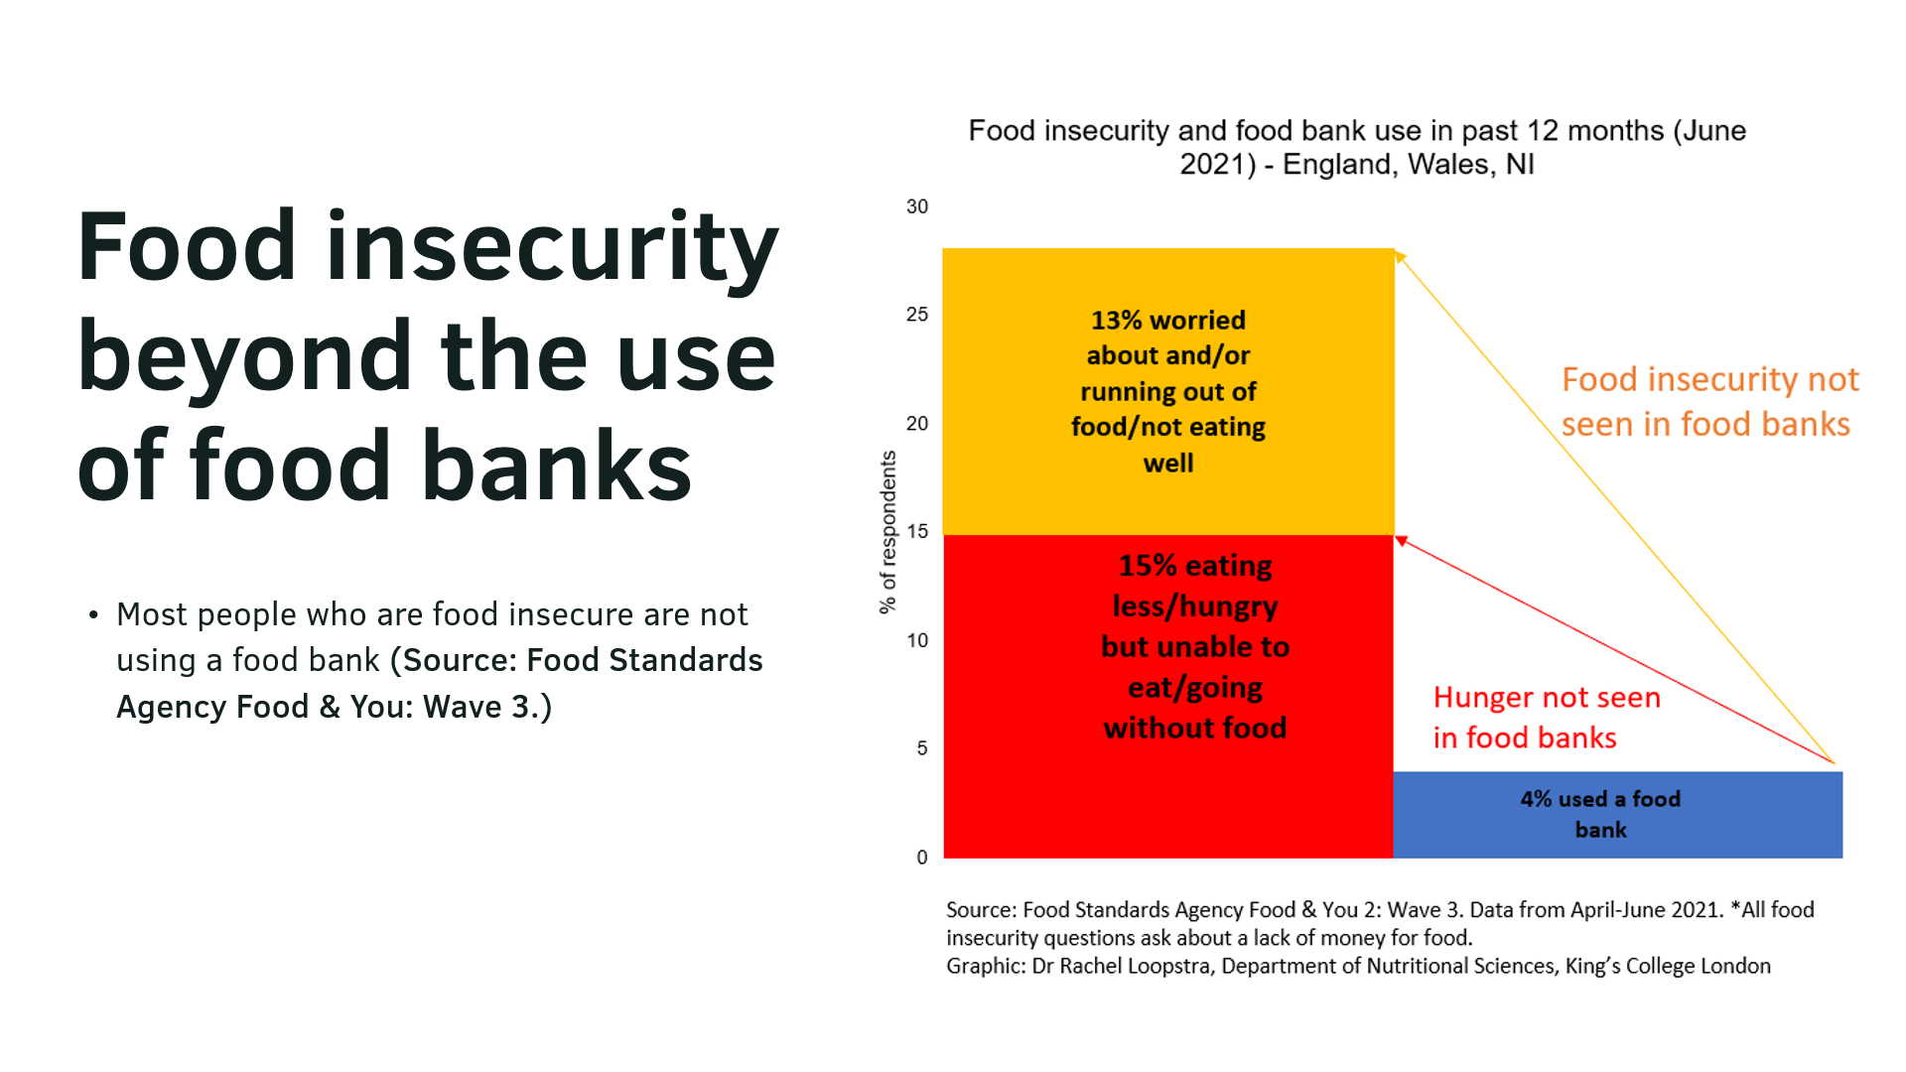
Notes:
IFAN, Isle of Wight Food Waste and Food Poverty Conference, 18th November 2022, The growing need for charitable food aid and a cash first approach to food insecurity

Slide 10

Selby Community Fridge Case study
Selby Community Fridge opened during the pandemic, and in its first 6 months , distributed 2435 bags (as of 18th June 2021) of surplus food to around 650 local people.
Developed by Selby Big Local with start-up funding from the Defra Food Projects Fund and support provided by Selby District AVS, Selby Community Fridge was conceptualised through consultations with residents
  “Despite COVID-19, the Community Fridge has been a resounding success, allowing those struggling with food insecurity to access free, fresh food, no questions asked.”
Day to day running is largely carried out by a group of c10 passionate volunteers. The Fridge’s social media presence is a vital part of the project’s continued success
Feedback from users of the Community Fridge has been overwhelmingly positive, highlighting the importance of the non-judgemental attitudes of our volunteers and just how critical the service provided by the Fridge is.
Notes:
Image: https://www.facebook.com/photo/?fbid=472501024911169&set=a.472501031577835
Source for case study
Food Insecurity: Understanding local delivery, impact and innovation in the North East Riding (2021)

Slide 11
Trussell Trust Yorkshire and Humber
Positive effects of foodbanks
Project Managers were previously foodbank users so in these instances their lives have been changed
The Trust’s model ‘pushes participation’ around food, mental health and suicide prevention
Some foodbanks – and / or the charities that operate them - are seen as cornerstones of their communities thus providing safe spaces to attend / visit
Volunteers and foodbank managers are in the front line collecting stories from people using the facilities providing valuable data and insights to help shape the Trust’s strategy
“The referral process is there to start an initial intervention to help. We encourage referrers to use their discretion. If they feel someone they know well, someone they have been working with long-term, who has a need, then the food is there for them. If that person has a need for multiple uses – such as 3 vouchers in a 6-month period – we would regard that as a point, a flag, of escalation and we’d be back in contact with the referrer to see why the person is still having these needs. We recognise that a food parcel doesn’t solve anything in of itself, its part of someone working with families. We want to be part of a holistic package of support. The referrers are so important as they are someone to go back to if an individual has been to a foodbank multiple times. We signpost people back to referral agencies.”

Slide 12
Foodbank Financial Inclusion Projects
In a recent development the Trussell Trust has been focusing on financial inclusion, and has made significant investment in three year Project available for any foodbank to access via its national strategy and funding.
This is enabling a local safety net of advice and support to be put in place at each foodbank.
More generally, the Trust advocates for a Cash-First approach to tackle the causes of food insecurity in preference to grants for food provision which can temporarily alleviate the symptoms.
All but 2 of the foodbanks in Yorkshire and Humber have a Financial Inclusion Project, mostly enabling them to buy in the time of qualified Citizens Advice staff or alternative local equivalents.
“This investment started in 2022 and data so far suggests that the model is empowering for those foodbanks taking advantage of the opportunity.”
Laura Chalmers, Trussell Trust Yorkshire and Humber Area Manager

Slide 13
Questions arising
Rather than reducing their role, to what extent can partners make better use of the expertise from the Trussell Trust and independent food banks to enhance provision, better still, to develop person-centred ways of tackling the root causes of food insecurity?
Partners may wish to commission further research to first identify, then consider in detail whether outcomes in areas without food banks are different from where this type of support is in place?
How to explore the efficacy of the Trussell Trust’s new Financial Inclusion Strategy approach which has seen national investment to enable advice work to be more formally connected to the food bank centres (i.e. evaluation of any pilots in York and North Yorkshire?)
How to understand, and support, any food bank to be connected into a wider system of support in York and North Yorkshire places, resulting in better preventative and wrap around interventions that help individuals towards a pathway of ‘good help’.
The extent to which the sponsorship model that the Trussell Trust uses, and which has both admirers and detractors, is one that other food models could include.
What is the role, if any, of local authorities in supporting any further expansion of community fridges in communities of York and North Yorkshire given Co-op’s planned investment with Hubbub - how can we identify what these plans mean for Y&NY?

