Slide 1
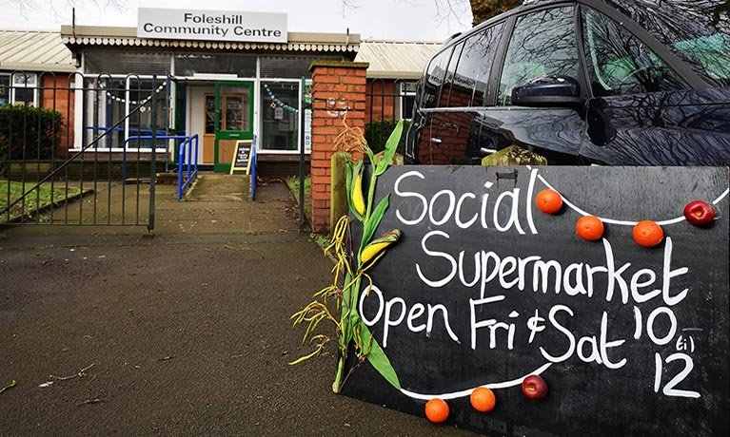

Covid Recovery Insight Project: Food Insecurity
Low Cost Community Food Retail

Slide 2
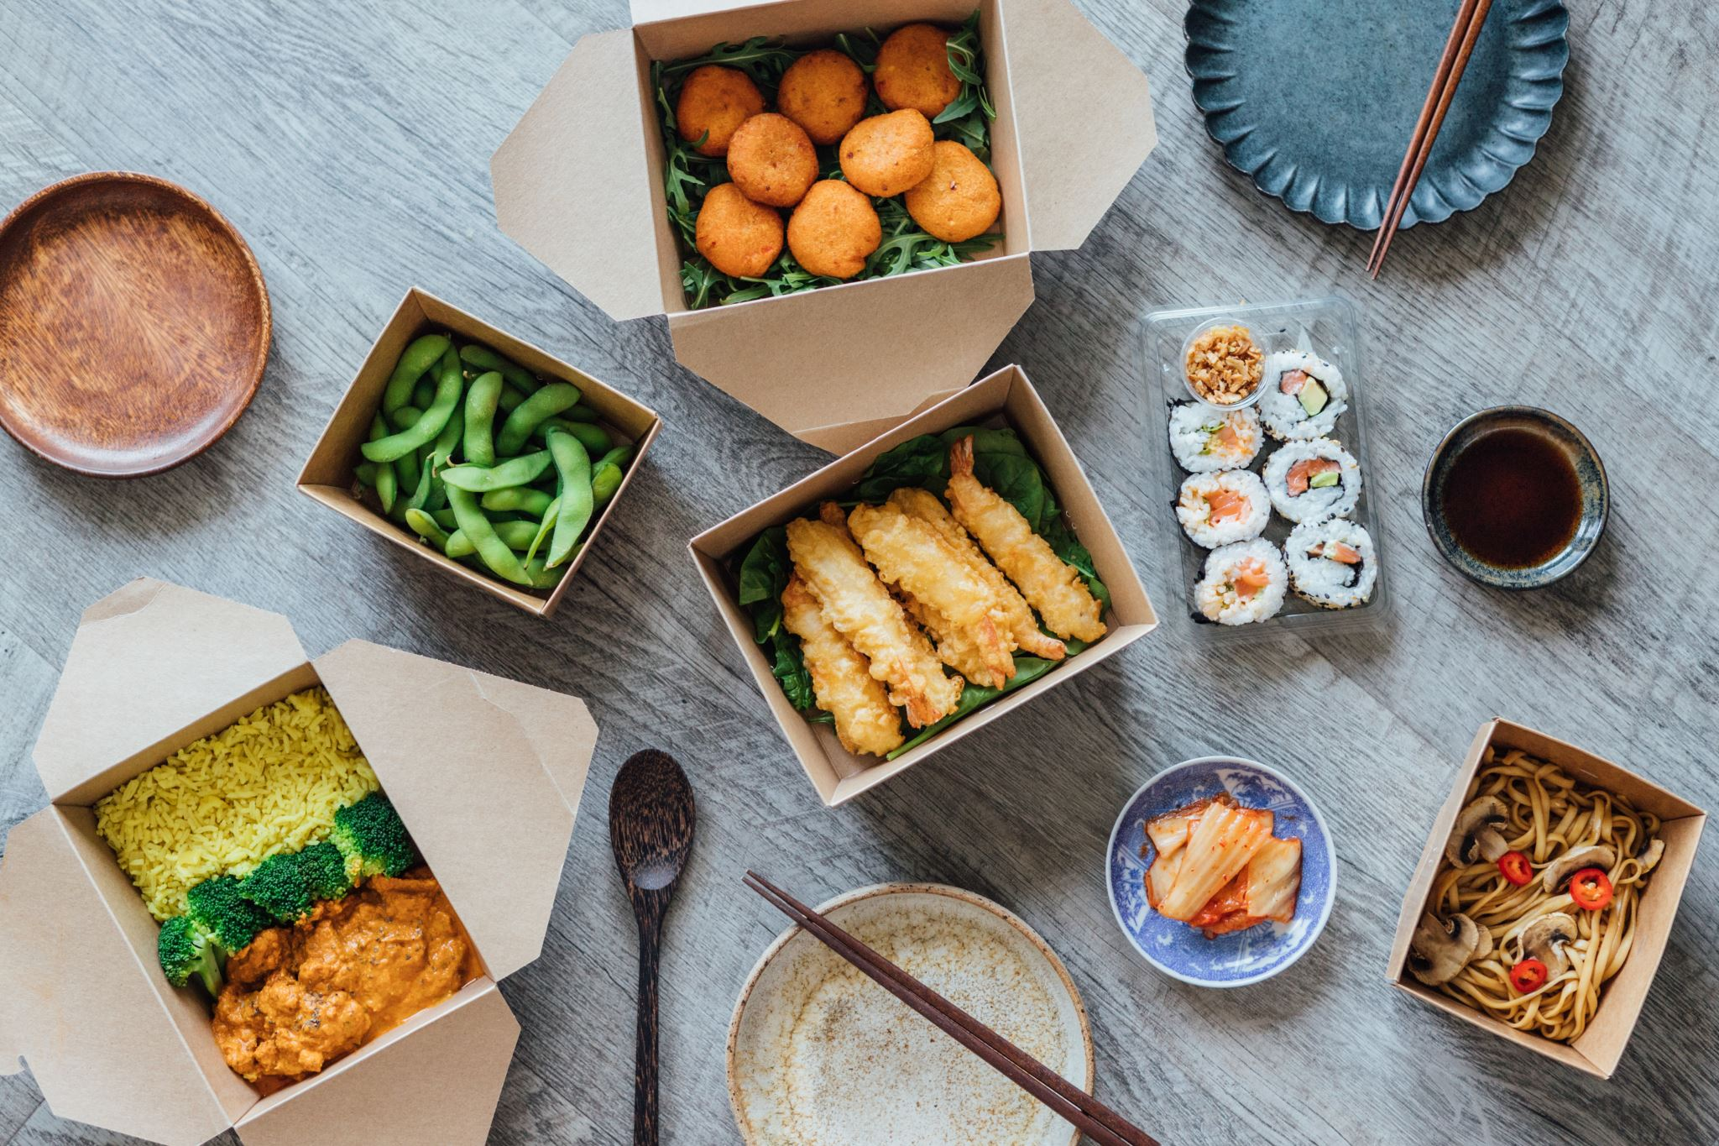
Definition: low cost community food retail
These are variously called local or community pantries, larders, or fridges, social supermarkets or food clubs. (Note however: larders and fridges are often ‘free food’)
Though they often also rely on redistributed surplus food, they differ from food banks because people usually pay a small amount either as a membership fee or on a per-use basis and then get to choose from the selection items available.
Making fresh foods available are also usually a feature of these models.’ .
Notes:
This presentation draws on 15 of the most relevant sources of evidence
We have included pantries, larders and social supermarkets (sometimes called Eco Shops or Next Step Shops in parts of the country)and community shops/stores in the definition. Fridges appear to be a free food access model whilst food clubs are found in the community food hubs and clubs report section.
Local responses to household food insecurity across the UK during COVID-19 (September 2020 September 2021). An analysis of experiences from 14 local areas from around the UK and recommendations for future policy and practice p17

Slide 3
Outcomes
Outcomes seen in the evidence base for these models
Community empowerment through a process of developing a local social supermarket
Increased resilience / less dependency e.g., not reliant on food banks as much as before
Less worry and stress by being able to stretch budget; less spent on food = more on other bills
Improved sense of belonging, dignity / reduced stigma by accessing a model that is open to the whole community
Choice / individual empowerment
Access to healthier, fresh food options not typically available in food banks
Opportunities to volunteer build skills and confidence, and these roles are often taken by people who are/were struggling themselves and seek to give back
Reciprocity
Self-efficacy – planning the cooking of food with greater confidence (especially where the model includes an education / cooking together element).
THERE ARE MANY OTHER OUTCOMES FOR INDIVIDUALS, COMMUNITIES AND ORGANISATIONS ASSOCIATED WITH THESE DIFFERETN MODELS – PLEASE REFER TO THE MAIN REPORT FOR DETAILS – FURTHER EXAMPLES FOLLOW.

Slide 4
Food pantry / social supermarket benefits
Benefits for Communities
Community resilience and social infrastructure: Members feel more connected to their local community.
Investing in community
Connecting with community services / strengthening communities: pantries act as food hub by offering additional support, taken as a whole therefore able to help members to deal with the root causes of food poverty.
Benefits to members (individuals and households)
Improves food and nutrition security: Pantries provide availability, access, and stability of wide variety of healthy and nutritious food to members.
Improves Wellbeing: Being able to buy good quality food at reduce prices improve self-worth. No stigma attached to using the service.
Health outcomes: Being a member /user of the pantry/social supermarket improves mental health and reduces anxiety – reduces financial worries.
Improves household income: For a household visiting a local pantry once a week could save £780 a year– savings are used to settle debts and pay other household bills, or buy more quality food.
Reciprocity: Food pantries/social supermarkets operate often by asking for something in return. In this model, for a small fee.

Slide 5
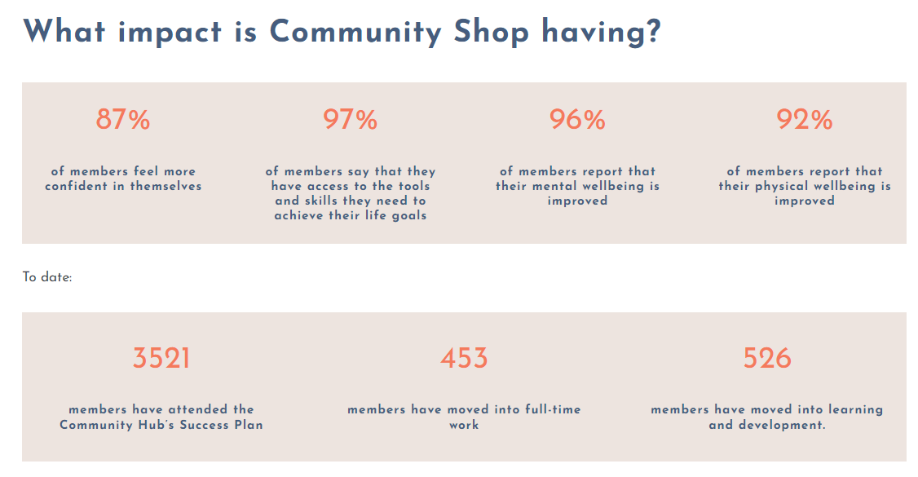
Outcomes associated with Community Shops / Stores
The Relationships Project has developed a case study detailing the following kinds of outcomes for people using the Community Shop/Stores model.
Notes:
Community Shop - Relationships Project

Slide 6

Challenges
High dependence on establishing and sustaining relationships
Logistic and distribution challenges
Unreliability of surplus food
Availability and coordination of volunteers
Financial challenges
Pantries can have excess produce that it struggles to eat or sell in certain seasons.
Notes:
Image: https://www.inventium.com.au/why-you-need-to-challenge-the-status-quo/
High dependence on establishing and sustaining relationships with food industry suppliers to ensure continuous provision of food. Issues of trust, cooperation and reliability are seen as critical when working with multiple stakeholders.
Logistic and distribution challenges – investments in infrastructural – transportation, storage facilities (storage space and storage infrastructure (i.e., shelving), and having enough volunteers to deal with coordinating activities. The short of shelf life of the products requires timely sharing of information, especially dealing with diverse supply sources. While sourcing food from national redistributor like Fareshare improves logistical challenges, it can result in ‘organisational food losses and waste’ due to short shelf life. Direct donations by supermarkets to pantries will reduce losses and waste
Unreliability of surplus food – pantries dependent on food surplus except for a small amount of fresh produce which is donated by food growers. The unpredictability of volume and nature of products of food surplus on one hand and control over stock to meet demand is a challenge, especially for pantries sourcing diverse sources.
Availability and coordination of volunteers – unavailability of core volunteers particularly during summer holidays and lack of expertise of volunteers provide challenge for organisations
Financial challenges – pantries generate income mainly through membership fees to cover cost of personnel, rent and operating cost as well as the services provided; there is high dependence on private and public donations and funds/grants to meet overheads costs - rent and/or infrastructure are considered as the major costs in the running of the pantries.
Pantries can have excess produce that it struggles to eat or sell in certain seasons; and needs transport options to be able to deliver or offer food to other organisations to use.

Slide 7

Innovation: SHORES Community Pantry
(East Holderness)
Very strong relationships with other food banks in the region and helped advise them with developing a similar model
Developed an emergency response fund as a safety net for the future – reinvesting income into the social purpose from the takings
Trading opportunity to generate income
Educational tools and community inclusion with recipe idea cards
Relevant in size to the community that they are serving, and they have let it organically grow
‘Steps to Food’ Security model
“How can we develop something that has a local impact for individuals, deal with future emergencies and be sustainable?”
Notes:
Southern Holderness Resource Centre, (more commonly known as the Shores Centre) is recognised a key community hub throughout the South East Holderness community. As a charity serving the area for over 15 years, they have extensive experience of supporting disadvantaged and vulnerable individuals by providing a wide range services, resources and facilities that positively contribute to health, economic development, enterprise, employment, financial and social inclusion.

Slide 8
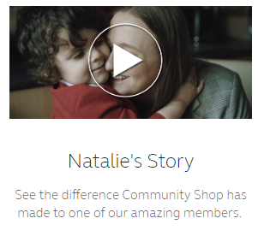
Community Shop Example
One member, Jenny, tells the story of Community Shop helping her find a job.
“I was buzzing as I came back to tell everyone that I had got a job, to start the following Monday, but then panic hit again as I realised I couldn’t afford new work clothes and safety footwear. The Community Leaders rallied round and sorted me out quickly.”
Natalie’s story, starting with food, has led to her doing some Kickstart classes and a decision and pathway to college in a very short period of time. “A fresh start that I never thought I would have.”
The Relationships Project case study asserts that ‘Community Shop is more sustainable than many other social supermarkets, largely because of its commercial arm, Company Shop, and overall Group heritage and structure which helps avoid supply-chain and staffing issues.
Notes:
More insight about the model and how it works is found here About Us | The Company Shop Group

Slide 9
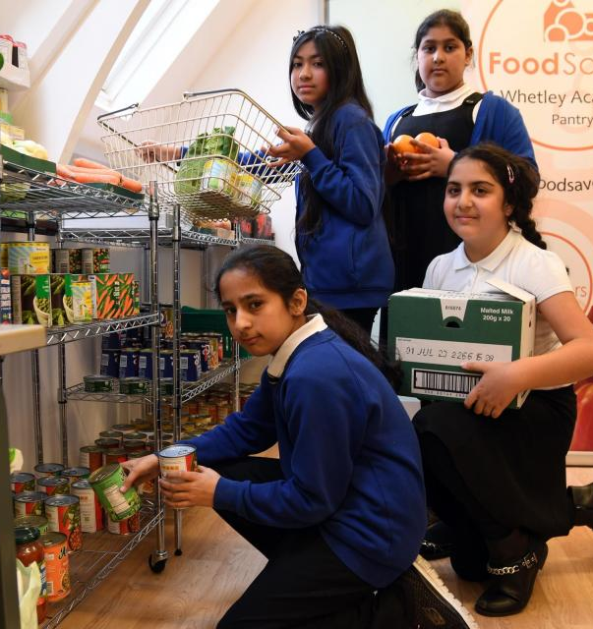
Community Pantry Example
Bradford: Inn Churches, a third sector organisation that provides practical support to people in Bradford including a Food Hub, established the ‘Food Savers’ scheme with the rationale that they did not want the legacy of COVID-19 to be an overdependence on free food.
Members of the scheme access the low-cost food markets whilst also establishing a savings account through the Credit Union:
“In addition to the pantry model, one thing that’s developing in Bradford, and it's beginning to spread as well, is our FoodSavers Network, where the local Credit Union has got on board. That has actually really turned lots of people's lives around that they’ve actually started saving a few pounds. They're purchasing their food at low cost and they're putting a pound a week aside or something. Then, for some people, that has really shifted their thinking.
  We’ve found that lots of people have been really positive. Some people have really found that a positive thing and actually have started to take charge of their life in a way they never had before, which is really, really positive.”
Notes:
https://innchurches.co.uk/foodsavers/
Image: https://www.thetelegraphandargus.co.uk/news/23102671.bradford-school-opens-pantry-help-struggling-families/

Slide 10
Making the case for low cost community food retail models
The models offer affordable, accessible and typically more nutritious options that could be regarded as a next step from needing to use a food bank.
The model encourages more dignity because a contribution is made and there is more choice.
Models can often be mixed which gives rise to wider individual and community benefits aligned with their social purpose.
The models enable revenues to flow that can then be re-invested into the wider social purpose in that community.
Notes:
/

Slide 11
Questions Arising
Can the evidence be strengthened to the point where a food pantry / social supermarket / community shop is knowingly able to address the root causes of food insecurity, and help clients achieve long-term food security and self-sufficiency?
How could the reciprocity aspect of low cost community food retail be embedded across all or more of the food models made available in communities, as this seems to amplify feelings of dignity, reduce stigma and encourage use without people feeling different.
How could these models operate / be adapted for rural or sparse communities?
Notes:
/

