Slide 1

‘Activities supporting food access’
Food alliances & partnerships
Free Food
Low-Cost community food retail
Direct food provision
Community Hubs
Collaborative models
Tailored / targeted food aid provision
Cash-based approaches
Other resources for food response
Wrap-around support
Food and education
Community food initiatives / projects
Local Councils
COMBINATIONS
FOOD RECOVERY
EVOLUTION – MORE THAN FOOD
‘There was also evidence of an increasing interest in, and use of, low-cost community food retail models.’
Third Sector Food Aid Providers
Other partnerships
Notes:
Alan Graver: adapted from REA 6: Local Responses to household food insecurity across the UK during COVID-19 (September 2020-September 2021), Katy Gordon, Hannah Lambie-Mumford, Simon Shaw and Rachel Loopstra
Free food
Food banks
Community fridges
Community larders
Low-cost community food retail
Social supermarkets
Food pantries
Cash-based approaches
Cash grants
Financial inclusion / income maximisation activity
Vouchers (for comparative purposes)
Direct food provision
Food parcels
Direct meal provision e.g., meals on wheels
Tailored / targeted food aid provision
Aimed at specific population groups
Collaborative models
Partnerships
Networks
Taskforce
Alliances
Community Hubs, Food Hubs and Clubs
Resources for food response
Funding (e.g., into VCSE sector)
Food
Human resources/capacity
Other ‘infrastructure’ (equipment/transport)
Wrap-around support
Money advice / debt counselling / other services
Signposting
Food and Education
Community kitchens
Community food programmes or projects with a specific ‘social making’ motivation e.g., cooking, learning and sometimes then eating together
Courses and demonstrations that are accessed at community hubs
Community food initiatives / projects
Initiatives that run food activities as part of their wider work or whose core work is about food (multiple models)
Projects about ‘growing’, ‘enterprise’, ‘sharing’ and or ‘celebrating’ food
REA6
Page 9: Table 1 Local council activities to support food access
- School food
- Support for households experiencing physical barriers to accessing food
- Support for households experiencing financial barriers to accessing food
- Supporting the third sector
- Strengthening partnerships
Page 10: Table 2 Food alliances, food partnerships and other partnerships
- Direct food provision e.g. meals on wheels services, community pantries, community larders, emergency food parcels and community hubs to distribute food to households requiring support
- Collecting and sharing data
- Supporting activity to address the root causes of food insecurity e.g. supporting member organisations to think beyond crisis support, ensuring members were aware of financial support available to households
- Supporting new responses such as ‘affordable food’ models
- Supporting ongoing communication and networking across actors
- Engagement with wider efforts to tackle systems change e.g. developing and contributing to local food plans, facilitating and promoting local supply chains
Page 11: Table 3 Third sector food aid providers
Direct food provision – emergency parcels, food larders, meal delivery (takeaway and delivery, free, pay what you can, hot and cold), food aid support for priority groups (homeless), food hampers over Christmas
School food e.g. breakfast club provision at local school, vouchers for FSM eligible families self-isolating
Support for households self-isolating
Cash first approaches e.g. local welfare provision payments, vouchers for supermarkets / local shops, provision of grants for clients to attend pay what you can meal provision, providing advice remotely
Other food activities e.g. in person community and family cooking sessions, online cooking classes, food growing
Food recovery, i.e. using surplus food to reduce food waste
Signposting e.g. to increase awareness of local council support
Contribute to wider efforts to tackle food insecurity e.g. involvement in initiatives such as moving beyond food banks, COVID-19 inquiry, COP26
Changes to form of support over time e.g. vouchers for community larders and supermarkets rather than food parcels, transition from food larder (free food) to pantries (membership based)
Changes to referral routes
Additional services e.g. money advice services including face to face interviews, provision of children’s clothing
Increased availability of food banks and opening hours
Means of delivery – resuming face to face collection of food parcels, option to choose food items for emergency food parcels resumed rather than pre-packed parcels
Models evolved too:
p13 Leeds - structures for leadership evolved from public health and financial inclusion initially but evolved to leadership from / around the hubs infrastructure now and into the future Food Resilience Toolkit launched by Leeds partners in July 2021 - wrap around support / signpost to other services p22 Bradford Food Savers Network / scheme designed in order to avoid over dependence on free food as a legacy of COVID-19. Involves credit union and food pantry so payment for food and £1-2 saved each week changing behaviours and 'lives' says this report Hope for Swansea app making easier for food bank users to signpost residents to wrap around support Herefordshire independent food bank starting to offer money advice service
Food recovery definition: using surplus to reduce food waste

Slide 2
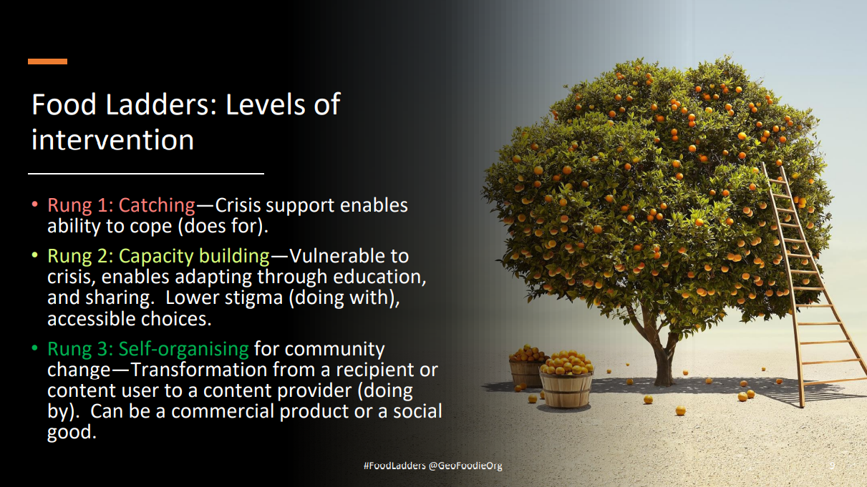
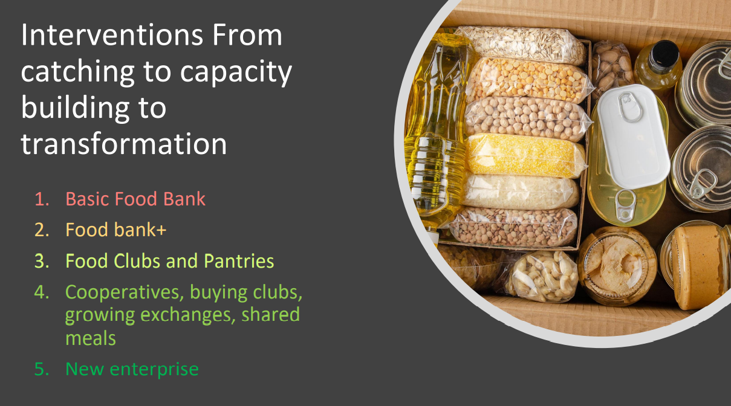
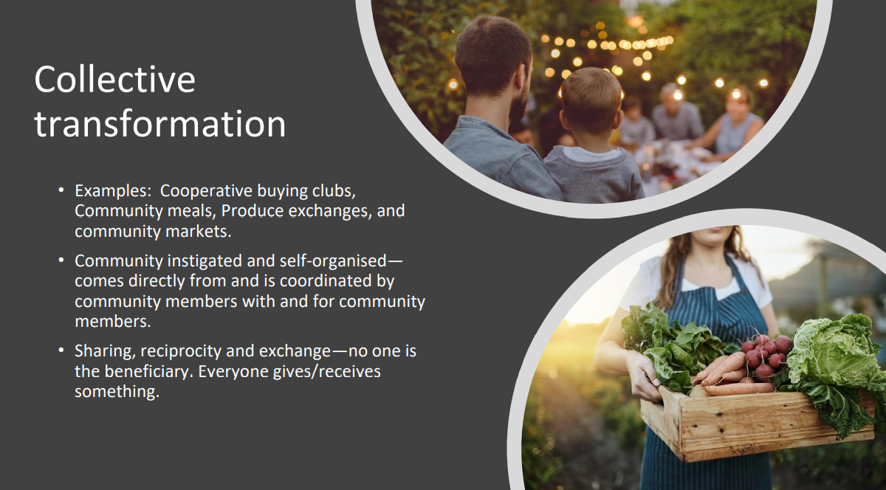
‘Strategic Place-Based interventions’
MIXED MODELS * LIVED EXPERIENCE * MORE THAN FOOD

Slide 3

Outcomes / Benefits of Food Security Interventions
Individuals
That are accessing the food
That are volunteering
This can impact households too.
Organisations / Groups
Food support / aid providers / VCSFEs
Partnerships, networks, alliances
‘The state’
The environment
Reduced food waste to landfill
Reduced greenhouse gas emissions
Communities
Notes:
VCSFEs = voluntary, community, faith and social enterprises

Slide 4
Outcomes / Benefits of Food Security Interventions for Individuals
⬆ Improved physical health through healthy eating
⬆ Improved mental health e.g., through reduced feelings of anxiety and better managing situations of ‘stress, struggle and stretch’
Reduction of risk factors associated with chronic diseases as a result of accessing healthy, nutritious food and diet behavioural change
Contribution to prevention outcomes e.g. reduced admission to hospital, delayed need for care
⬆ Improved food and nutrition security
Access to address immediate short term need
Alleviation of hunger
⬆ Availability, access and stability of wide variety of healthy and nutritious food
⬆ Enables choice of healthier food / improved diets / cook healthier at home
⬆ Enables individuals to try new nutritious food not previously tried or afforded
⬆ Improved sense of empowerment wherever choice is built into the model
⬆ Food knowledge and literacy
Some mixed models claim to contribute to ⬆ stability for members to improve their food security long-term
⬆ Behavioural change e.g. ⬆ increased intake of fruit and vegetables as an ⬆ % of household budget and / or as a snack choice displacing less healthy options
⬆ Changes in the way recipients buy, shop, and cook
⬆ Changes in householders’ food preparation patterns
⬆ Improves feelings of self-worth
⬇ Reduces feelings of stigma
⬆ Improved feelings of social inclusion
⬇ Reduces anxiety and stress to feed self / others
⬇ Reduces financial worries improving mental health
⬆ Improved sense of dignity
⬆ Self-confidence
⬆ Improved life skills
Improved self-efficacy
Sense of control
Feelings of independence
Safe spaces that encourage belonging
Health outcomes
Wellbeing outcomes
Improves household income
Some evaluations highlight benefits of some models for families / households not just individuals
Volunteer outcomes
⬆ Financial savings used to settle debts, pay other bills or buy more quality food elsewhere
⬆ Avoided spend through use of no / low cost / PAYF (pay as you feel) models
⬆ Helps stretch household / family budgets further
⬆ Improved financial wellbeing
⬆ Food resilience e.g., avoided use of food banks
⬆ Enables people to feed their families and have money left over from their food budget
⬆ Increase your/household/family food spending budget
⬆ Valuable (employablility / life) skills
⬆ Confidence around food / cooking skills / food literacy
⬆ Feelings of being needed, not needy (reciprocity through contribution)
⬆ Improved sense of purpose, meaning, ‘ownership’, enfranchisement and ‘doing good in a simple way’, supporting instinct for mutual aid
⬇ Reduced isolation and /or feelings of loneliness
Notes:
Visual created September 2022, Skyblue Research Ltd, synthesis of rapid evidence review process, base: 72 reports/studies
Addendum March 2023: Alan Graver
Specific models claim to contribute to prevention outcomes such as reduced admission to hospital, the delayed need for care, reduced hospital stays, reduced risk of hospital admission, suicide. Some encourage independence and, when evaluated at an aggregate level, support the reduction in health inequalities and disparities.

Slide 5
Outcomes / Benefits of Food Security Interventions for Communities
A reliable / stable response in times of crisis
Where additional support and/or signposting is offered to services or community-based activity by the model additional direct and indirect benefits can accrue e.g.,
⬆ Improved skills and personal development through training such as cookery classes / demonstrations / home budgeting / interview skills / community leadership training / business courses helping you / families to learn how to cook simple and nutritious meals with confidence / within a budget
⬆ Connection to other social and service providers - debt service recovery groups, local welfare support scheme, pastoral, and spiritual support; benefits and legal advice, help for self / families deal with the root causes of food insecurity
⬆ Members who participate in a wider community hub model’s activities are connected to other support organisations in the communities thereby providing them with opportunity to ‘build back their life’
⬆ Co-ordination / local support and involvement
⬆ Members buying the food packages in their community spaces often provides an informal opportunity for them to engage with other support services that they wouldn’t necessarily have done before, in turn supporting them to rebuild their resilience
Depending on the nature of the individual’s journey before or after accessing the model:
⬆ Improved employability
⬆ Access to education
⬆ Opportunity to address food insecurity longer term through person-centred support
⬆ Reinvestment of income (e.g., membership fees) to purchase stock from local firms where possible (n.b., this is a hallmark of community wealth building)
⬆ Some models disproportionately invest in local people who have struggled to access the labour market for whatever reason
⬆ Some multi-faceted models e.g., community food hubs can often emerge from opportunities to regenerate a space through a community asset transfer
⬆ Place based voucher schemes can be redeemed at local (fruit/vegetables/other) markets / stalls increasing income for participating stalls, co-operatives and FV producers and increase spending in local markets
Connecting with community services /strengthening communities
Strengthening local economy and investing in community
⬆ More connected to your local community e.g. membership models
⬆ Enables building of social networks, socialising, meeting new friends
⬆ Improves feelings of value and sometimes, enjoyment
⬆ Catalyst for community / sharing / developing new perspectives
⬆ Increased sense of community and enfranchisement
⬆ Where partnership models are established there is the potential to deliver more co-ordinated responses to deliver greater impact through needs identification, resource deployment and sharing information
⬆ Where models use lived experience to inform the local solutions the benefits to all involved are thought to be more effective and enduring
⬆ Working with community partners to establish community / food hubs creates community resilience, a sense of ownership / enfranchisement and social infrastructure for members/community
⬆ Social cohesion / ‘build a community within a community’
Community resilience and social infrastructure
Some food models can contribute to place-based self-organising, strengthened referral pathways for people navigating different ‘systems’ as well as encourage local co-ordination of person-centred support. ‘Communities within a community’ can be built and the involvement of experts by experience is thought to significantly enhance outcomes.
Notes:
Visual created September 2022, Skyblue Research Ltd, synthesis of rapid evidence review process, base: 72 reports/studies

