Slide 1


Covid Recovery Insight Project: Food Insecurity
Targeted Food Provision
Notes:
Image: Tang Hall Big Picnics (2019)
https://www.facebook.com/TangHallBigLocal/photos/gm.254193228650778/1318875168256830

Slide 2
Definition
Targeted food aid is aimed particular communities with different diets and food requirements and preferences, or to combat a particular challenge such as ‘holiday hunger’.
A meta review of COVID responses identified examples of tailored provision being made available to families with school aged children, Black, Asian and minority ethnic groups, and asylum seekers and refugees made available during March to August 2020. There was also some concern that there may still have been population groups who were missed by the support then, or indeed since COVID.
Targeted food aid provision is an example of attended programmes. These can be devised in ways where children access support in spaces and places that they already attend (e.g. school) as universal provision which reduces the risk of children being further stigmatised.
Holiday food clubs mainly focus on household strategies to mitigate food insecurity especially as it relates to school holidays and lack of access to free school meals
Holiday hunger has been defined as: "a situation that occurs when economically disadvantaged households with school-aged children experience food insecurity during the school holidays”**
Notes:
Lambie-Mumford, H., Gordon, K., Loopstra, R. and Shaw, S. (2021) ‘Comparing local responses to household food insecurity during COVID-19 across the UK (March – August 2020).
A Systematic Review of the Evaluation of Interventions to Tackle Children's Food Insecurity Published online: 14 February 2019
** Food Insecurity: A Constant Factor in the Lives of Low-Income Families in Scotland and England. 2021
*** Working in collaboration - Leeds Food Insecurity Taskforce
As part of the pandemic response (March September 2020) an estimated 64,000 food bags (equivalent 34,000 food parcels) were distributed from the food warehouse Breakfast and lunch bags for up to 230 homeless people daily (over 68,000 meals) Catering Leeds also worked with schools to provide a total of 95,826 daily grab bags and 170,910 daily hampers (34,182 weekly hampers)
During COVID-19, targeted food support played an important role in feeding people who were vulnerable, unwell or shielding.***

Slide 3
Outcomes
Improved variety and quality of diet
Willingness to try new things
Reduced risk of obesity*
New skills for young people
Social connectedness
Parents can work
Reduced household expenditure
Increase engagement from minority / under-represented groups
Reduced food insecurity
Improved budgeting
Changed shopping behaviours
Reduced takeaways/ fast food
Improved attention
Fewer skipped classes
For supermarkets / food providers:
Improved CSR for supermarkets
Reduced cost of food disposal
* For girls not boys, based on 1 US study

Slide 4
Enabling and Limiting Factors
Enabling ingredients:
‘Contextualised’ – tailored to local needs
Mix of approaches to meet different needs – through local partnerships
Regular routines
Skilful support teams
More than FSM, for example, FSM+15%.
Open to all - equality of opportunity
Communication with parents or involving them (‘Parents can eat too’, or unused food can be taken home)
Opportunities for participants and volunteers to build relationships
Food vouchers reduce the risk of trying new food / wasting money
Deliverers include voices of lived experience
Communicated and promoted through multiple channels – “requires more direct and relentless promotion.”
Barriers:
Variability of approach and quality
Evidence is often based on a narrow set of desired outcomes – for example attainment rather than social outcomes
Families are rarely involved in the design of these services
Funding is often short term and insecure, whereas the cycle of food insecurity is entrenched around the school year.

Slide 5
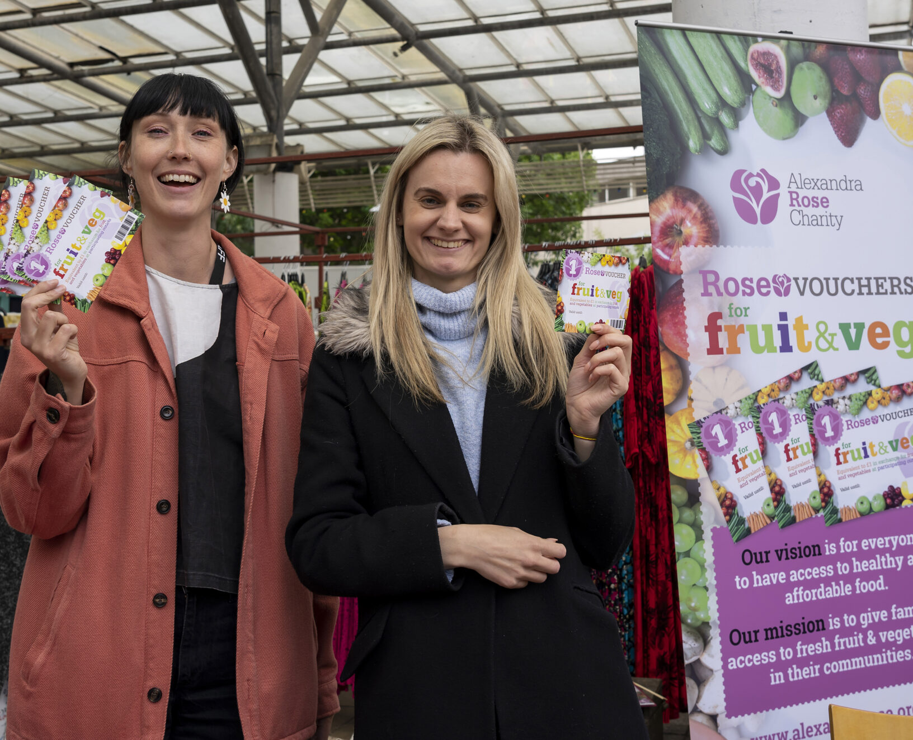
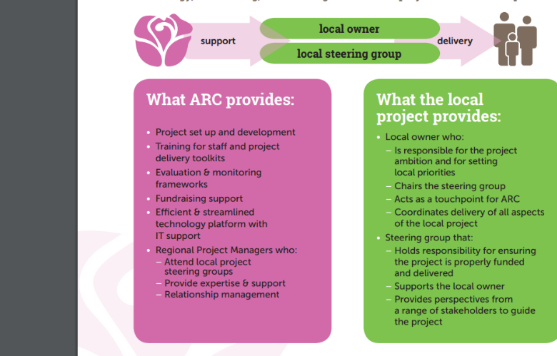
Rose Vouchers for Fruit and Veg
Projects provide vouchers for fruit and vegetables to low-income families who have children aged 4 and under. Vouchers are collected at Children’s Centres and redeemed at independent retailers in the local community, supporting the local economy
The nearest location is Barnsley, where Rose Vouchers report market traders make on average £150‑£250 a week more because of the vouchers.
The ambition of the charity is to increase the scale of their offer five-fold by 2025 – using a locally owned (franchise) model.
Improved access to fresh produce alongside advice, guidance and support from the Children's Centres has encouraged and facilitated positive diet-related behaviour change
Notes:
Image
https://www.alexandrarose.org.uk/rose-vouchers/impact/
Evaluation results from Lambeth showed.
90% of adults and 95% of children are eating more fresh vegetables
92% of families say they are feeling healthier 95% felt happier
87% of families say they are eating more home cooked meals.
Source: Evaluation Strategy 2020/2021 – 2024-2025. https://www.alexandrarose.org.uk/rose-vouchers/impact/

Slide 6
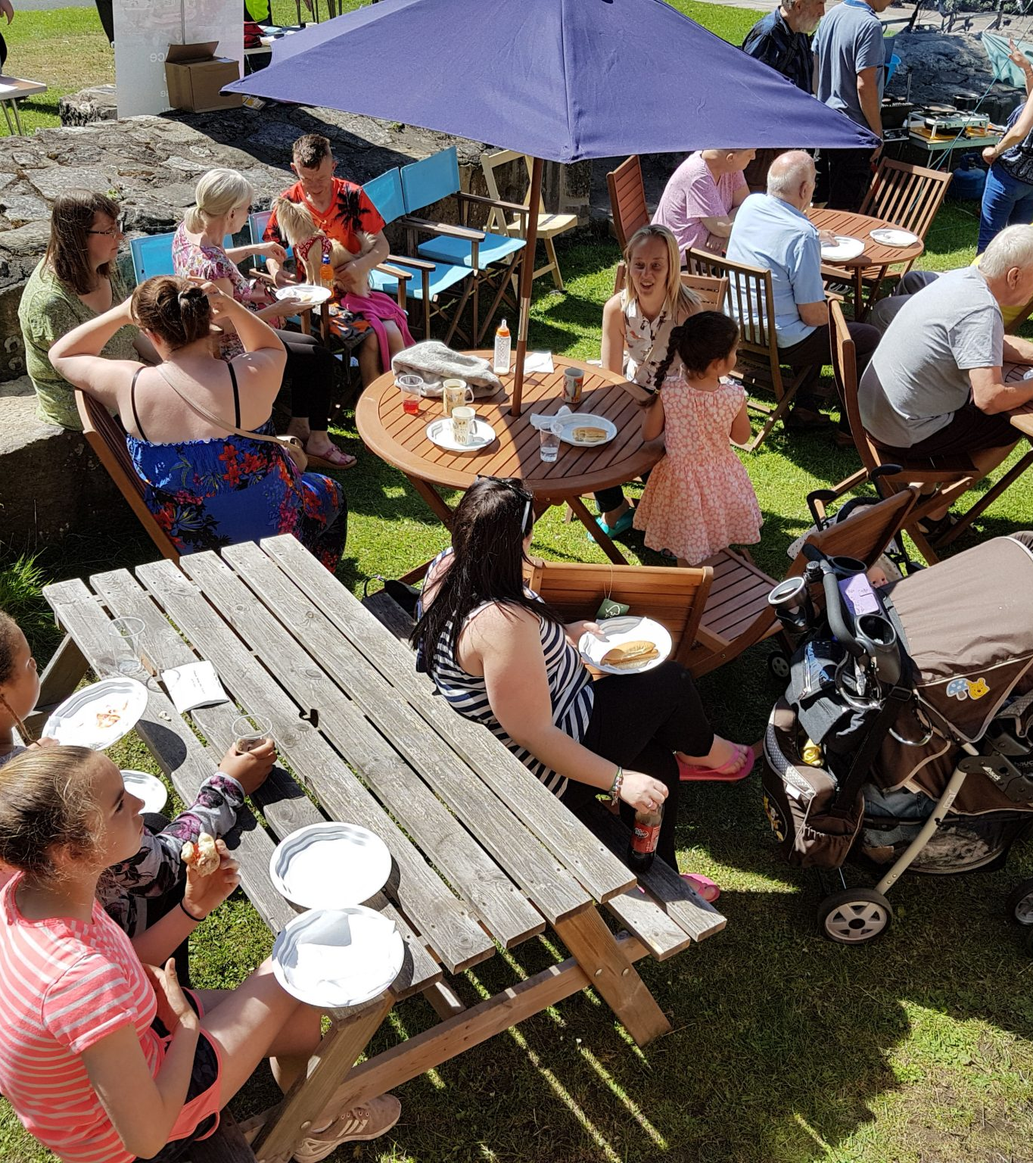
Red Tower CIC, York – helping to tackle holiday hunger
The model comprised: 1 project manager with volunteers and a cafe (open every Monday for 7 weeks) with fresh food / lunches for every child and baked goods donated with advice on healthy amounts, plus teas/coffees/juices and a Pay As You feel PAYF signs / donations box (takings used to cover overheads).
There was also a Food 4u Shop operated upstairs (produce that couldn't be made into lunches) for people to take a bag of groceries home (£1 suggested donation per bag)
Research identified these aspects of this holiday support programme to be effective.
Outdoor well-being: The garden was enjoyed by customers young and old every week; children literally dancing in the rain.
Inclusion: Elder neighbours enjoyed a sit-down, neighbours who had not been keen on the project to begin with, came to eat at the cafe by the end; People of minority ethnic origin also came.
Alleviating hunger: There was enough tasty, varied food for everyone, volunteers included, every week.
Zero-Waste: In total approx. 785kg of food was intercepted before being sent to landfill and waste collected for proper disposal by a local compost expert.
Volunteer experience: 1 intern, 1 coordinator, 2 staff from the CIC and 13 other volunteers repeatedly contributed their time, resources and enthusiasm. They appeared to benefit, get along well and enjoy it.
Notes:
Please note, not an impact evaluation per se.
Image : Red Tower York CIC http://redtoweryork.org.uk/the-power-of-food/
Based on sampled feedback from 2,500 users. Source https://static1.squarespace.com/static/5f452e5078bf4f32c97a8045/t/6241963f9ec2b51a579a08b5/1648465485739/TBBT+Impact+Report+2021+FINAL.pdf

Slide 7

Questions arising
How to resource the coordination, quality assurance and requirement to scale up and down in response to need?
The challenges in implementing holiday food schemes that have wider eligibility than Free School Meals. Where then to place thresholds?
How best to work with the VCSE sector that may not have food-related expertise but have the trust of people in groups where targeted food support might be most beneficial?
How best to build on all the learning from HAF in the past and over the next 3 years, somehow creating conditions for resilience rather than long-term dependency?
How to redress the evidence finding that families experiencing food insecurity were not sufficiently influencing the design of the interventions intended for them.
Notes:
Lambie-Mumford, H., Gordon, K., Loopstra, R. and Shaw, S. (2021) ‘Comparing local responses to household food insecurity during COVID-19 across the UK (March – August 2020).
A Systematic Review of the Evaluation of Interventions to Tackle Children's Food Insecurity Published online: 14 February 2019
** Food Insecurity: A Constant Factor in the Lives of Low-Income Families in Scotland and England. 2021
*** Working in collaboration - Leeds Food Insecurity Taskforce
As part of the pandemic response (March September 2020) an estimated 64,000 food bags (equivalent 34,000 food parcels) were distributed from the food warehouse Breakfast and lunch bags for up to 230 homeless people daily (over 68,000 meals) Catering Leeds also worked with schools to provide a total of 95,826 daily grab bags and 170,910 daily hampers (34,182 weekly hampers)
During COVID-19, targeted food support played an important role in feeding people who were vulnerable, unwell or shielding.***

