Slide 1
Food insecurity

Slide 2
Measure of food insecurity
Research has found that food insecurity is higher in the following groups:
People with low incomes, particular those on benefits
Working age people (older people are less likely to report food insecurity)
People in rented homes
Families with children
Minority ethnic groups and LGBTQ+
Disabled people and unpaid carers
Research has found that food insecurity is impacted by:
Access to food (related to area they live in, personal circumstances or external factors)
Ability to prepare food

Slide 3
Factors impacting on food insecurity
Food inflation March 2023 was 19.1%, the highest since 1977. In July 2023, food inflation was 14.8%.
In July and August 2023, 56% of adults reported an increase in their cost of living compared with the month before (ONS). Of these, 47% had started spending less on essentials including food.
In 2021/22, 4.7 million people in the UK (7%) were in food insecure households in the UK, according to the DWP. This included 12% of children, 7% of working-age adults, and 1% of pensioners.
The Food Foundation found that in June 2023, 17.0% of households in the UK were ‘food insecure’ (ate less or went a day without eating because they couldn’t access or afford food), up from 8.8% in January 2022 and 7.4% in January 2021.
More than 760,000 people used a Trussell Trust food bank for the first time in 2022/23, a 38% increase from 2021/22.
In January 2023, around 23.8% of state school pupils were eligible for Free School Meals. This rate has increased sharply since 2018 and is the highest rate recorded since the current time series began in 2006.
Source: House of Commons Library, Food poverty: Households, food banks and free school meals

Slide 4
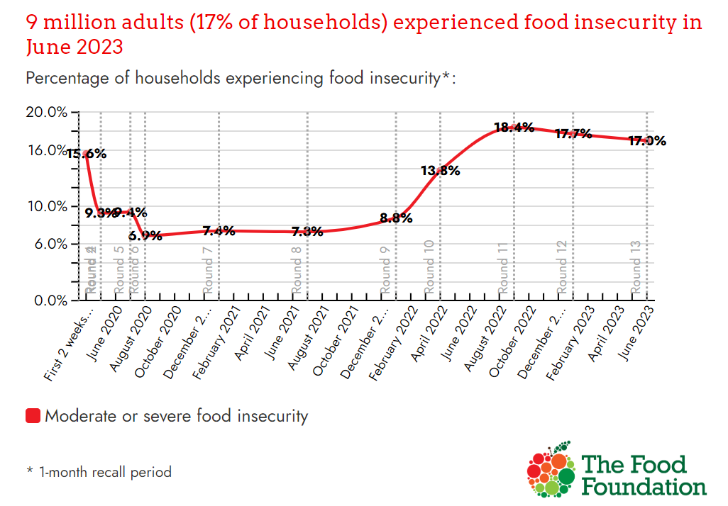
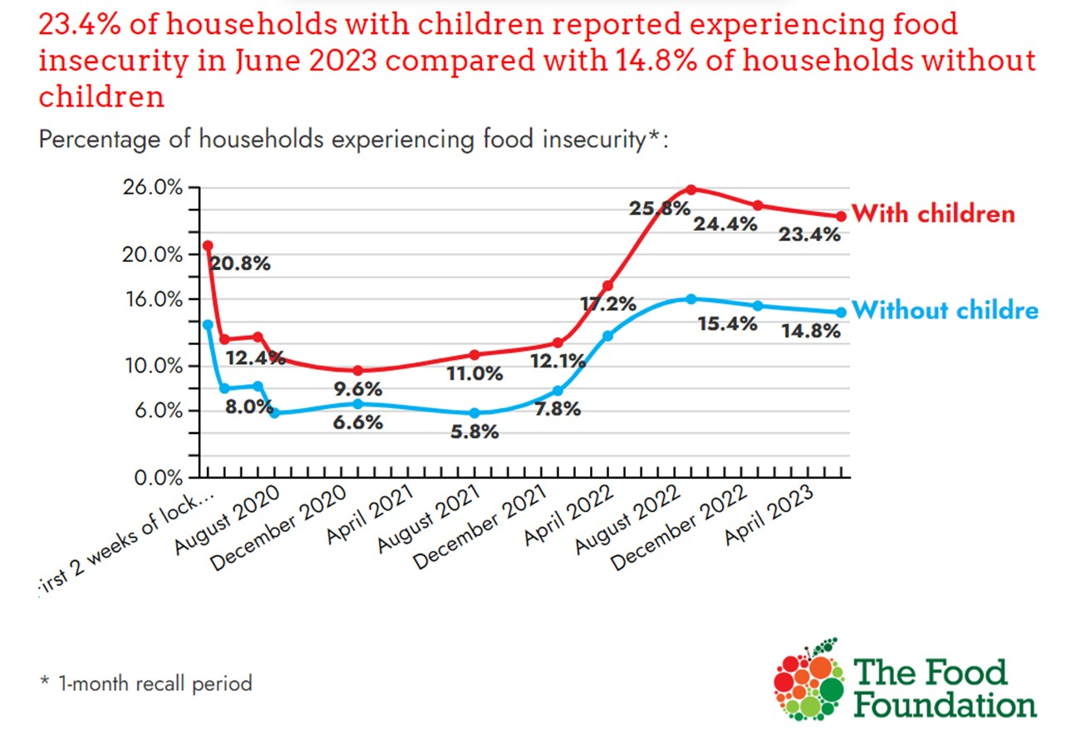
Food Insecurity Tracker

Slide 5
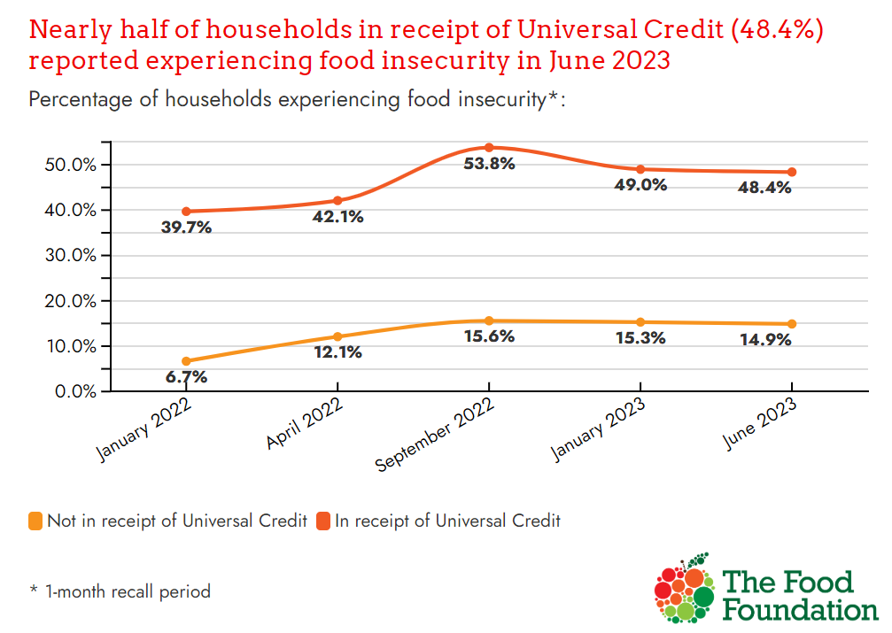
Food Insecurity Tracker

Slide 6
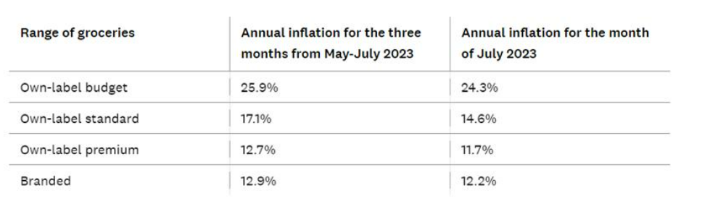
Which Food inflation tracker
The Which? Food inflation tracker shows that while supermarket own-label budget items remain the cheapest overall, prices rose most highly.

Slide 7
UK local food insecurity of adults 2021
The estimates are produced by Dr Angelo Moretti (MMU), Dr Adam Whitworth (Univ Sheffield) and Dr Megan Blake (Univ Sheffield).
 |  | York |  | North Yorkshire
 |  | % | Number | % | Number
Households experiencing hunger | Estimate | 2.81 | 2,458 | 5.00 | 13,692
 | 95% lower bound | 0.00 | 0 | 0.00 | 0
 | 95% upper bound | 13.27 | 11,620 | 14.60 | 40,164
Households experiencing struggle with food insecurity | Estimate | 7.54 | 6,601 | 10.40 | 28,681
 | 95% lower bound | 0.00 | 0 | 0.50 | 1,356
 | 95% upper bound | 16.16 | 14,150 | 20.80 | 57,221
Households worried about their food security | Estimate | 9.50 | 8,315 | 8.10 | 22,240
 | 95% lower bound | 2.54 | 2,228 | 1.80 | 4,943
 | 95% upper bound | 16.45 | 14,402 | 14.40 | 39,537
**Hungry is defined as having skipped food for a whole day or more in the previous month or indicated they were hungry but not eaten because they could not afford or get access to food.
Struggle is defined as a positive response to at least one of the following:
* Sought Help accessing food
* Skipped or shrank meal
* Gave a reason for not having enough food
Worry is defined as choosing very worried or fairly worried about getting food
Highest areas (local authority level):
Hunger: Selby (7.84%), Craven (6.07%), Scarborough (5.64%)
Struggle: Selby (14.7%), Scarborough (11.36%), Craven (10.08%)
Worried: York (9.50%), Scarborough (9.44%)
**Please note: these percentages are not additive across measures. You can add across places within a single measure. ).

Slide 8
Free school meals
Number of pupils eligible for Free School Meals
 | 2017/18 Spring | 2018/19 Spring | 2019/20 Spring | 2020/21 Autumn
North Yorkshire | 6,728 | 8,162 | 9,441 | 10,796
York | 1,942 | 2,317 | 2,728 | 3,133
Can we get a map of this and more up to date data from CYPS?

Slide 9
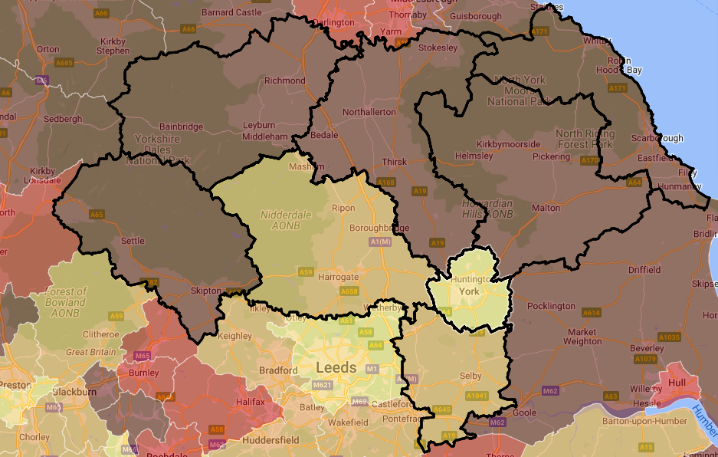
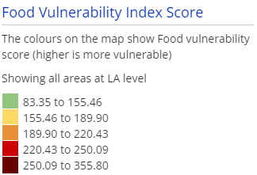
Food vulnerability index
Get lower level map from Colin
Food Vulnerability Index (June 2020)
Food vulnerability index combines: Frailty, Living alone, Distance to services, Digital exclusion, Income deprivation, Income Support families, Income-based Jobseeker's Allowance families, Income-based Employment and Support Allowance families, Pension Credit (Guarantee) families, Working Tax Credit and Child Tax Credit families not already counted, Universal Credit families where no adult is in 'Working - no requirements' conditionality regime, Asylum seekers in England in receipt of subsistence support, accommodation support, or both.
Higher the score, the higher the need.
Source: British Red Cross
Areas with highest indices:
North Yorkshire: Filey (465.57), Weaponness & Ramshill (404.1), Falsgrave & Stepney (392.5), Northallerton South (389.18), Woodlands (386.65), Upper Dales (351.88), Northallerton North & Brompton (347.88), Romanby (345.67), Sowerby & Topcliffe (342.23), Pickering (342.09), Leyburn & Middleham (338.45)
York: Westfield, Chapelfields and Foxwood (283.36)

Slide 10
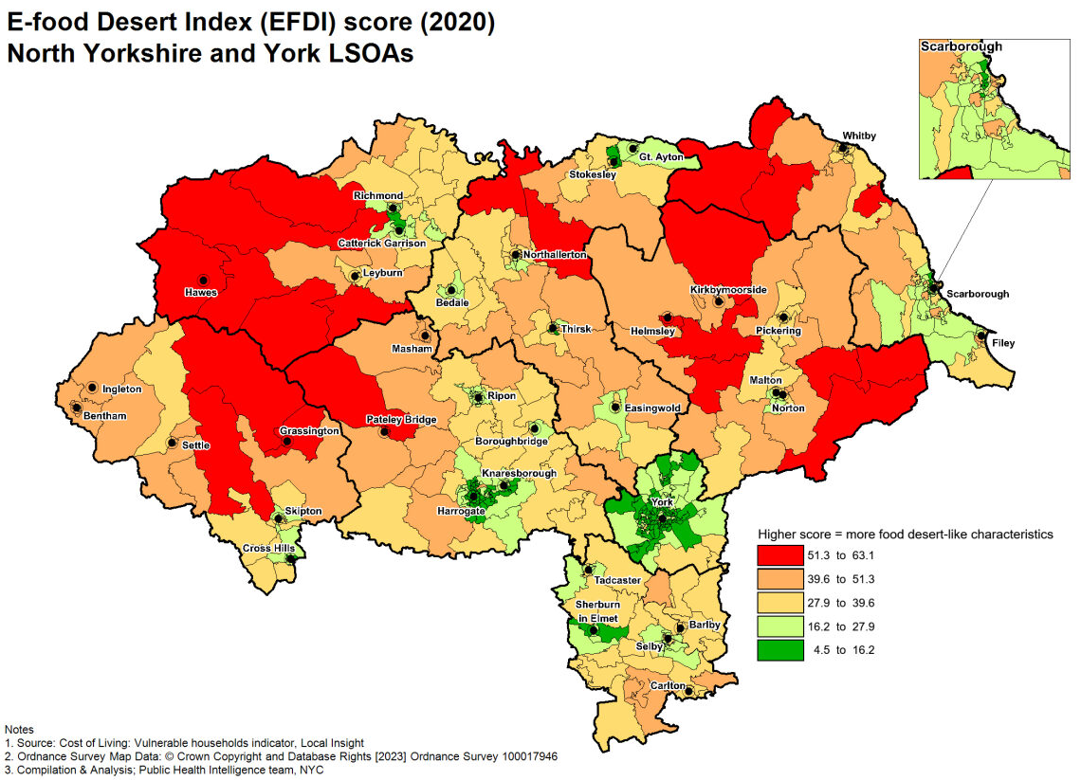
E-food dessert index
E-food Desert Index score
The e-food deserts index measures the extent to which neighbourhoods exhibit characteristics associated with food deserts across four key drivers of groceries accessibility:
Proximity and density of grocery retail facilities,
Transport and accessibility,
Neighbourhood socio-economic and demographic characteristics and
E-commerce availability and propensity.
A higher score denotes more evidence of food desert-like characteristics.
Areas with highest indices:
North Yorkshire: Upper Dales (59.54), Hunmanby & Sherburn (54.0), Helmsley & Sinnington (52.5), Wharfedale (51.76)
York: Westfield, Chapelfields and Foxwood (29.63)

Slide 11
Poverty
Poverty higher in the following circumstances:
Social rented and private rented housing
Disability
Informal carers
Three or more children than smaller families
Ethnicity
This affects
life expectancy
Mental health
Heath status (poor health)
Parental income, impact on young people educational attain
UK Poverty 2023: The essential guide to understanding poverty in the UK | JRF

Slide 12
How to measure food insecurity
Food banks
Cuts to Central welfare, higher rates of unemployment, higher rates of benefits sanctions leads to more food banks opening.
However, cannot measure based on food location to food banks based on community resources and social networks not based on population need
Not all people who are insecure use food banks.
Household food insecurity in the UK: 4. Introduction | Food Standards Agency
Prevalence of food security in the UK measured by the Food Insecurity Experience Scale | Journal of Public Health | Oxford Academic (oup.com)
Identifying populations and areas at greatest risk of household food insecurity in England - ScienceDirect

Slide 13
Fuel Poverty
Ryedale has the lowest percentage of dwellings with EPC Band ‘C’ or above. Lower than EPC band C in households indicates more likely to have fuel poverty.
Energy efficiency of Housing, England and Wales, middle layer super output area - Office for National Statistics (ons.gov.uk)
Energy efficiency of Housing, England and Wales, local authority districts - Office for National Statistics (ons.gov.uk)
Annual Fuel Poverty Statistics LILEE Report 2023 (2022 data) (publishing.service.gov.uk)

Slide 14
Craven has the lowest percentage all dwellings with EPC band ‘C’ or above. Terrached houses are more likely to have lowest than EPC band ‘C’ and so likely to be fuel poor.

Slide 15
Economic activity (low-level) status those aged 16 years and above, by local authority (Census 2021)
Selby has more inactive than the rest of North Yorkshire
Employment in local authorities, England and Wales - Office for National Statistics (ons.gov.uk)

Slide 16
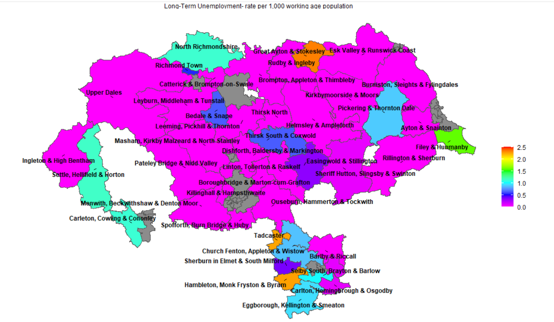
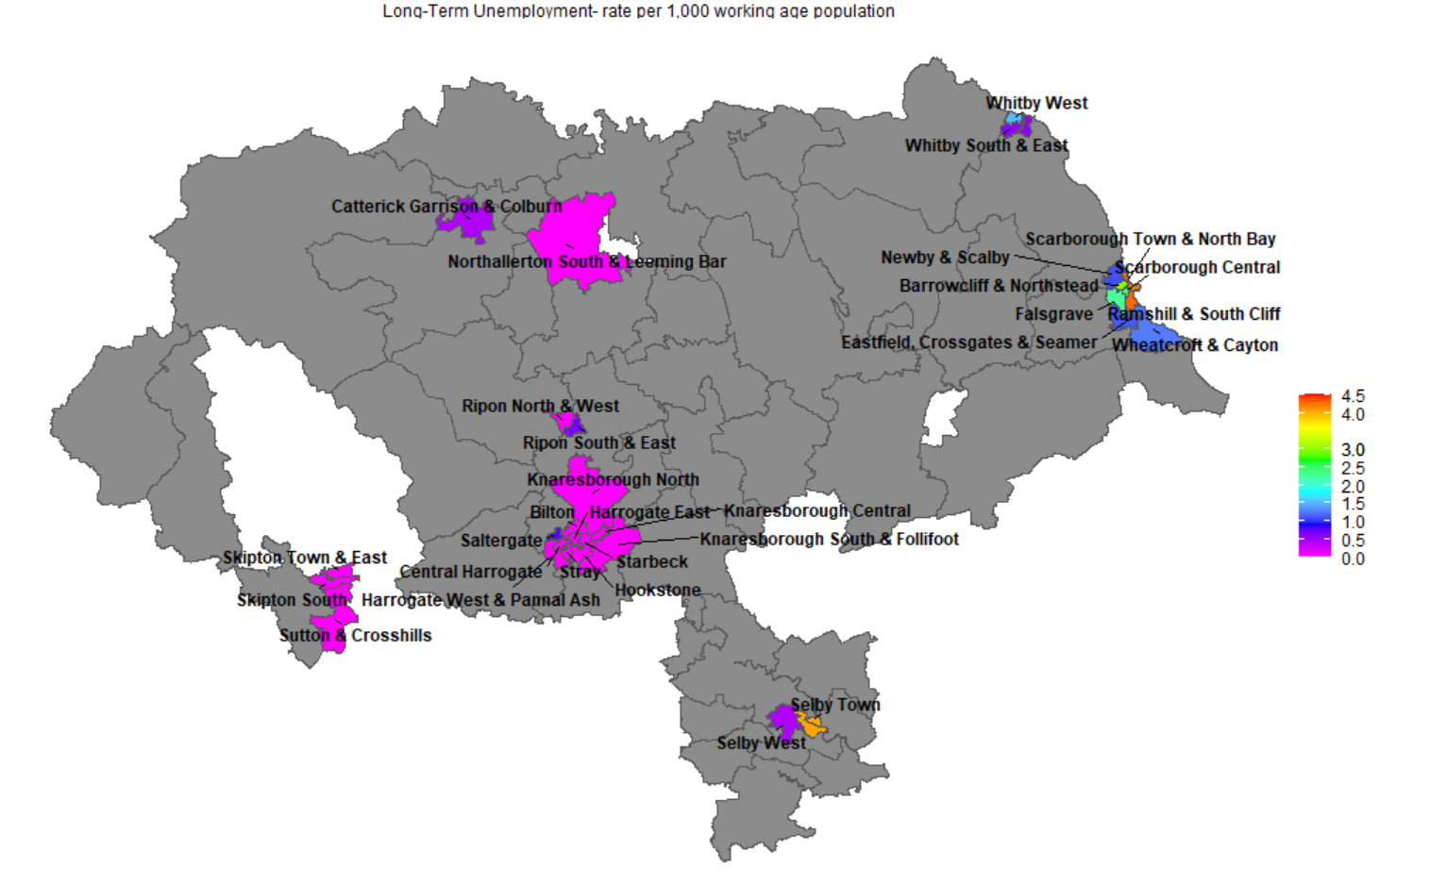
Long-term employment rate per 1,000 working age population (2021 data). Rural versus Urban. In Rural areas, Tadcaster, Hambleton, Monk Fryston and Byram, Great Ayton and Stokesley have the highest long-term unemployment rate per 1,000 working age population. Whereas, in Urban areas Selby and Scarbough Central have the highest long term unemployment rate per 1,000 working age population.

