Slide 1

Our vision is for a UK without the need for food banks.
We say this because it’s not right that anyone cannot afford their own food. That’s why we are working towards a just, compassionate future, where no one should have to use a food bank to get by.
Notes:
We are working towards one clear aim: to end the need for food banks in the UK. We work with food banks in our network, their communities and in partnership with other organisation to challenge the causes of poverty and call for change.

Slide 2
Busiest ever period
Notes:
Food banks in the Trussell Trust network distributed almost 3 million food parcels between April 2022 and March 2023.
This is the most parcels that the network has ever distributed in a financial year and represents a 37% increase from the same period last year (in 2021/22).
This is the first time food banks in the Trussell Trust network have distributed over a million parcels for children, with record levels of need seen for both children and adults this year.
The need seen this year is even higher than the first year of the covid-19 pandemic, where food banks in the TT network previously saw record levels of need – the increases seen this year represent a 16% increase on this turbulent year.
We are highlighting in our messaging about the statistics that the levels of need seen this year are part of a longer-term trend which pre-dates the cost-of-living crisis, and even the COVID-19 pandemic. While these two events have had a major impact on food bank need, they are not the main cause. Rather, they have exposed and exacerbated a longer-term crisis: that of a weakened social security system that is unable to protect people from the most severe forms of hardship, thereby forcing more people to the doors of food banks.

Slide 3
Cost of living payments correlate with a reduction in need
NOV 2022
Notes:
In July and November 2022 the governments Cost of Living payment - £326 to people in receipt of means tested benefits owing to low income – was distributed.
Our data shows that at the time each cost-of-living payment went out there was a short-term reduction in need, however, very shortly afterwards that need increased again.
The first cost of living payment was distributed in July 2022 – can see from the graph a slight dip need in July 2022, and is different to the trend seen in 2021/22 (180,136 parcels distributed, and still 12% increase on July 21)
The second cost of living payment was given in November 2022. Winter months are generally when the highest level of need is seen at our network of food banks. In the last five years we have seen a month by month rise from October to December, when the number of parcel’s distributed peaks, but levels remain high throughout January. Analysing the data, we can see that whilst the cost of living payment has not managed to entirely change this trend there was less of a rise in November than we would normally expect. Only 0.2% increase from October to November.
However, as in July when need dipped and then surged in August, the same pattern was seen in the winter with need rising after the payments in November and peaking in December.
What this does show us how is that when people have adequate amounts of money back in their pockets they no longer need to come to the food bank.
The fact that these periods of respite from the Cost-of-Living payments were short-lived shows that one-off payments are unable to make a lasting difference when people’s regular income (from social security and from work) is just too low to enable people to afford the essentials.

Slide 4
UK government
We need a long-term commitment that benefit rates will always be enough to afford the essentials.
The Trussell Trust is calling on the UK Government to enshrine in law the principle that at a minimum, Universal Credit should protect people from going without essentials.
Effective local crisis support also has a part to play. The UK Government should set out a long-term strategy for local crisis support and commit to a multi-year settlement of funding.

Slide 5

What’s a ‘cash first’ approach to food insecurity?
Notes:
About a Cash First Approach….
I support food banks across the Yorkshire and Humberside. Help them operationally to do what they need to distribute emergency food, as well as possible for as long as they are needed, but also to think strategically and work towards a future where food banks and other charitable food aid organisations are not needed.
We know that charitable food aid is a sticking plaster and not a solution to the poverty driving someone to need help from a Foodbank.

Slide 6
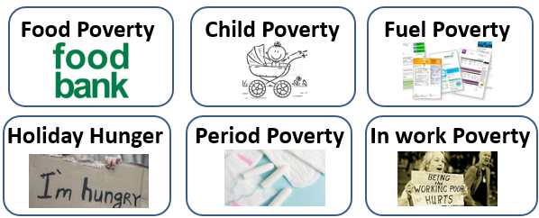
Types of poverty
But poverty is still poverty…
Notes:
We hear about quite a lot of different types of poverty
I talk about food banks a lot, but I try to avoid talking about food poverty
People need food banks because they don’t have enough money for food, in the same way that people unable to afford tampons or heating are struggling because there isn’t enough money coming in. When we talk about ‘food poverty’, ‘period poverty’, or ‘energy poverty’ we risk downplaying that these are all symptoms of not having enough money.
There is sometimes a big emphasis on child poverty but in order for a child to be in poverty, the adult that cares for them must be in poverty. It can be helpful to think of different types of poverty to recognise the depth and breadth of the problem but we need to tackle it as a whole.
The danger is people may think the solution is giving out food or tampons or energy vouchers when none of these things will address the structural issues that leave people without enough money.
Which is the central approach of TT.
So instead of talking about food poverty I talk about poverty and advocate for ‘cash first’ solutions, things that put cash into people’s pockets and bank accounts – wherever possible.

Slide 7
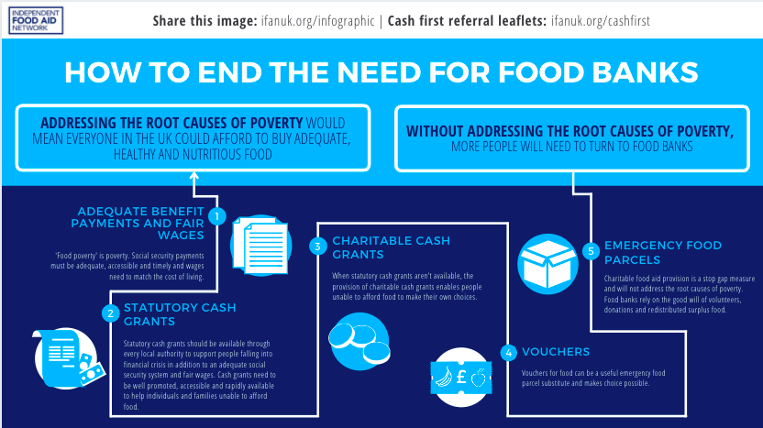
Notes:
As we attempt to reverse the trend to the increasing number of people coming to food banks and emergency food aid providers, both IFAN and ourselves are focusing our efforts on strengthening some of the other responses to food insecurity.
This infographic helps to highlight some of these things:
Ideal situation. Everyone has adequate income to choose their own food. Most dignified situation.
Through LA (Leeds Welfare Support scheme). Pilot.
You may be aware of where these exist locally
Shopping vouchers could be considered a step up from a food aid parcel by empowering people with more choice.
However dignified a service, we know it cannot address the root of the problem of poverty.
Our social security system needs changing to that benefit payments match the cost of living.
Adequate locally safety net.
A real living wage paid across the board.
We need to reverse the normalisation of emergency food aid and promote income based solutions and wrap around support.
We believe that improving the local safety net by the means of a local welfare assistance scheme that offers cash to people in a crisis, that is fully accessible and is offered hand in hand with wrap around support. We hope that these steps will be the first options for people facing financial crisis, and charitable food aid would become a last resort, and hopefully in the future will no longer be relied upon for the mass distribution of food aid on the scale we are currently seeing.

Slide 8
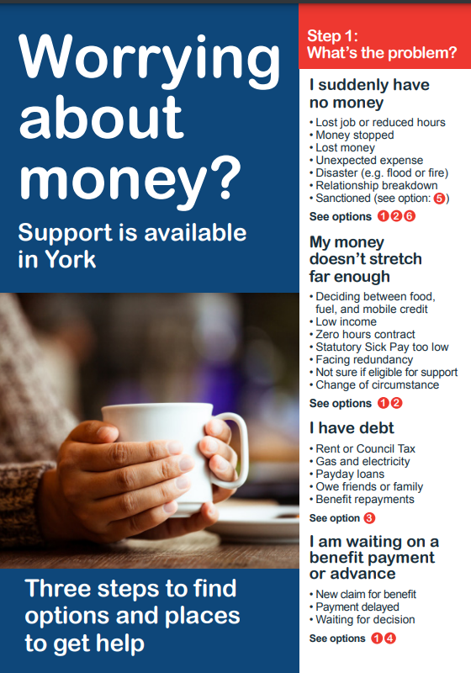
Notes:
The leaflet helps individuals identify what the problem is at Step 1:
● suddenly have no money
● awaiting a benefit/payment decision
● money doesn’t stretch
● I have debt
So lets use the first problem as our example. I suddenly have no money – options are numbers 1, 2, 6

Slide 9
Headlines from the leeds cash first pilot evaluation

Slide 10
What DID THE PILOT INVOLVE?
Leeds City Council (LCC), three food banks in Leeds, LFAN and the Trussell Trust came together to set up a pilot cash first approach as part of LCC’s Local Welfare Support Scheme (LWSS)
Cash first approaches support people in financial crisis with dignity, flexibility, choice, speed, convenience, and administrative efficiency.
The pilot scheme provided cash grants to people in financial crisis in Leeds, running from 1 October 2021 to 1 April 2022, and distributed £45,450 between 187 grants, supporting 283 individuals.
The scheme ran during a period of significant financial upheaval for families on the lowest incomes. The £20 uplift was cut in October at the start of the scheme, followed by significant and ongoing increases in the cost of living due to inflation.
Notes:
The aim of applying this approach was to support individuals by providing cash to allow immediate support at a time of crisis. The principle is that this support will better enable the individual to manage the effects of a life change or crisis and improve their ability to address the root cause of the crisis situation. As such it is a particularly useful approach for addressing short-term shocks to an individual’s financial situation. The approach was also designed to replace the need for provision of food parcels for these individuals. The key benefits to designing a cash-first pilot scheme are that it offers people: flexibility, choice, speed and convenience; preservation of dignity; and administrative efficiency.

Slide 11
What did the scheme aim to achieve?
The cash grant aimed to:
Increase the emotional wellbeing of people receiving the grant
Negate the need for further use of food banks within the next 12 months
Enable people to afford the essentials
Enable them to better manage their financial situation

Slide 12
What did the evaluation aim to understand?
The Trussell Trust and Leeds City Council commissioned Vantage Point Research to undertake an independent evaluation of the scheme.
Our 6 research questions were:
What are the success factors and barriers to effective implementation of the cash grant scheme?
What are the experiences and outcomes for people who receive a cash grant and how does this compare with going to a food bank?
Are the people who receive a cash grant less likely to need to use a food bank again in the medium-term, compared to other food banks?
What are the wider outcomes for people who receive the grants, including wellbeing?
Poverty and destitution: can a cash grant pull people out of need? Are they able to afford the essentials?
What have grant recipients spent their money on?
Notes:
Really important that the evaluation was done by someone who was neither TT or the Council.

Slide 13
What was the impact on grant recipients?
Affording the essentials and preventing the need for food parcels
Dignity, agency and wellbeing
Some impact on financial resilience
Cash grants can only provide short term respite without a sufficient social security system

Slide 14
Affording the essentials and preventing the need for food parcels
  94% prefer cash grant to a food parcel.
  The vast majority (90%) experienced improvement of overall finances during the grant period
  The majority (86%) did not use a food bank whilst in receipt of the grant (from DCS analysis).
  Most commonly spent on food, followed by paying for gas and electricity. Other items frequently bought were toiletries, clothes, transport, other bills and paying off debt/arrears.
  There is no evidence of misuse, though grant recipients were themselves anxious that others would misuse the grant. Evaluation recommends no restrictions on spending in future schemes.

Slide 15
Dignity agency and wellbeing
“I'd say it had a good impact on [my] mental health because knowing that you've got extra money to buy your essentials and make sure that you've got what you need for that week or for that month helps.” – Grant recipient, female from the second round of interviews
Recipients valued the agency and freedom of choice to buy food to suit the households likes and dietary requirements, and to be able to stock up on supplies and frozen food.
For some the grant enabled them to think about or apply for new jobs, and for others it helped them get out to reconnect with friends.
Notes:
Final point is good segue into next slide

Slide 16
Some impact on financial resilience
The majority (71%) of surveyed cash grant recipients reported that the cash grant improved their confidence in managing their household finances.
One in ten (10%) reported that they repaid a loan from a friend / family member and a small number of recipients reported paying off government debt or a pay day loan / doorstep lender.
The survey of grant recipients found that one in five (20%) had been able to save some money since receiving the cash grant. This is a significant.
Notes:
The impact is largely felt during the period that people received the grant, but it did have significant impact on their mental health as well as some being able to pay off debts or even save, which of course would have a longer-term impact.
Still an emergency response and cannot replace a properly resources and secure social security system that is fit for purpose.

Slide 17
Cash grants can only provide short term respite without a sufficient social security system
Half (50%) of grant recipients matched to the Trussell Trust data collection system needed support from a food bank after their final payment. This was accurate at the end of May 2022.
The majority (81%) said they were fairly or very likely to need to use a food bank again.
Notes:
Note that improving the advice and support at the point of the referral, in the future, would hopefully minimise the need for future support.

Slide 18
CASE STUDY: EVA
When the £20 uplift to UC was cut, Eva had to sell her car because she could no longer afford the MOT.
Eva has health conditions which require her to go to regular hospital appointments, but she was starting to cancel those appointments because she couldn’t afford the taxi ride.
The cash grant has enabled her to go to her hospital appointments and to buy medicines she needs.
Notes:
People who go to food banks are not just struggling with food, they are struggling with so much more. This shows that a cash response can help but further than food.

Slide 19
What’s next for Leeds city council?
  Continue to embed the cash first approach.
  Range of payment methods.
  Launch of online referral form – for public and partners.
  Wide range of referral partners.
  Person centred support offer.
Notes:
Issues with finding cash point and travelling to the cash point, and admin issues.
Long term wrap around support would be essential, clearly more than cash is needed

Slide 20
Questions?
  You can find the recording of the Leeds Cash First webinar in full here:
  How we’re working with local government - The Trussell Trust
  You can find the full research evaluation by Vantage Point here:
  Microsoft Word - Vantage-Point-Research-Leeds-Cash-First-evaluation.docx (trusselltrust.org)
  You can find our literature review of cash first as an approach here:
  Microsoft Word - Cash-first-literature-review.docx (trusselltrust.org)
  Contact: laura.chalmers@trusselltrust.org

Slide 21
Thank you
Questions?
Laura.chalmers@trusselltrust.org
Notes:
We are working towards one clear aim: to end the need for food banks in the UK. We work with food banks in our network, their communities and in partnership with other organisation to challenge the causes of poverty and call for change.

