Slide 1

Covid Recovery Insight Project: Food Insecurity
Community Food Initiatives / Projects
Notes:
Image - https://www.bbc.com/news/uk-scotland-north-east-orkney-shetland-51474866
IMAGE REMOVED 2ND JUNE 2025

Slide 2
Definition
Community food initiatives (CFIs) aim to ensure that people have access to affordable, acceptable and adequate food.’
CFIs have a variety of aims and may work within a geographical community or a community of interest. Public Health Scotland’s community food work has focused on supporting CFIs that aim to address or mitigate health inequalities. CFIs have supported organisations that aim to tackle access, affordability, acceptability, availability and/or the adequacy of good food within their communities.
CFIs come in a range of shapes and sizes, but fall into three main groups:
Initiatives that run food activities as part of their wider work.
Initiatives whose core work is about food, e.g., lunch clubs, community cafes, community allotments, community shops, food or meal delivery, food-based-social enterprises.
A third type of food organisation are organisations that support community food activities locally by supplying food, outreach activities or providing facilities for other organisations and agencies (e.g., cooking classes, training, training kitchens).
Notes:
This review is based on 10 of the most relevant studies.
Source: A snapshot of Covid-19, food insecurity and community food initiatives | Community Food and Health (Scotland, 2020)

Slide 3
Community Food Projects – Typologies
Eden Field Guide to Community Food Projects
Community food projects take different forms in response to their context. Types of activities include:
1: Growing food | 2: Be enterprising | 3: Make something | 4: Sharing and celebrating
Community food garden Allotments Community orchards Community growing on farmland Home growing and shared gardens Guerrilla gardening Wild food and foraging Community-supported agriculture (CSA) Livestock and bees | Food co-ops and buying groups Box schemes Community shops / retailing Community cafes Pop-ups Food hubs Farmers markets | Using up food that’s being wasted Making and selling your own produce Sharing your skills Community composting | Sharing food in your community Supper/ lunch clubs Food Swaps
Notes:
This review is based on 11 of the most relevant studies.
Source: Eden Field Guide to Community Food Projects

Slide 4
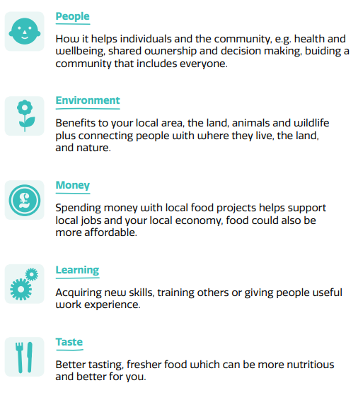
Outcomes
Outcomes from community food projects can be tracked in these ways too
Improved diet/food access: fruit and veg barras, community shops, shopping or meal service.
Mitigate social isolation and/or promote good nutrition: lunch clubs, community cafés, social meals.
Develop individual skills and/or promote community development / environmental aims: food growing, cooking skills, community-led research.
Easier to get involved compared to higher commitment alternatives e.g., community gardening.
Wellbeing, optimism and resilience.
New friendships, camaraderie, reducing stigma e.g., if there is a sharing, celebrating, growing or eating together element
Reduced social isolation, “A place to go”
Increased self-awareness / understanding of situation
Shopping locally
Reduced food supply chain and cost of food disposal.
Notes:
Sources
Shaping more resilient and just food systems: lessons from the COVID-19 pandemic (2021)
The Food Ladders Project - Mapping the Geographies of Food Provision in Sheffield. 2022
Navigating Storms: Learning from Covid-19 food experiences 'Food Vulnerability During Covid-19' Participatory Panel. October 2021Navigating Storms: Learning from Covid-19 food experiences 'Food Vulnerability During Covid-19' Participatory Panel. 2021
Community and Health Scotland Strengthening the future for community retailers (2018)

Slide 5
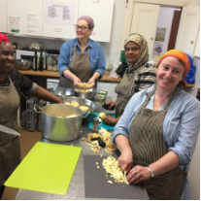
Granton Community Gardeners – community development in action (North Edinburgh in a locality recognised as an area of deprivation)
This is a case study about how a community gardening project started in 2010 from a conversation between neighbours about a small piece of unused land and has grown into a local charity hosting regular community meals and events, group gardening sessions and tuition, and a number of thriving connected projects including a bakery, a chicken co-operative, and a free-shop.
The project has found that for a lot of people, the diminished individual responsibility, and increased sociability and mutual learning of shared work makes it easier to get involved, compared with other higher commitment alternatives (e.g., allotments).
“It has also been interesting to observe over time, community connections and mutual understanding, gradually strengthening simply as a result of 30-50 neighbours from a wide range of age groups and cultural backgrounds, eating together around large tables each week.”
Notes:
Source: Granton Community Gardeners – community development in action | Community Food and Health (Scotland)
Further community gardening case studies are found here Community gardening | Community Food and Health (Scotland)

Slide 6
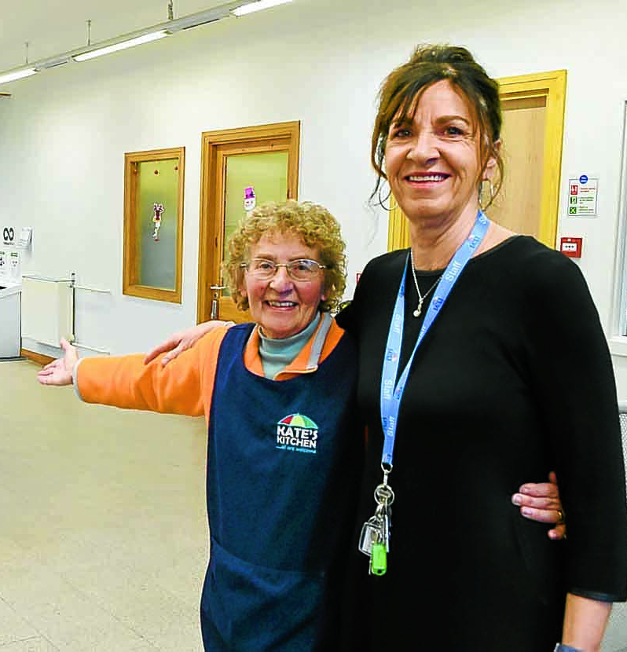
Kate’s Kitchen – community cafe
Kate’s Kitchen (KK) is based in Annan in Dumfries and Galloway. The organisation’s aim is to make life better for everyone that comes through the door. It runs a ‘pay what you can’ café which is open to anyone. It is funded through the Scottish Government’s Fair Food Transformation Fund.
The café offers full lunches twice a week, and light lunches another two days when group activities are running
Evaluation findings showed that for most, but not all, the services had been life-changing, and had given their life a purpose.
Outcomes reported included more confidence, building new friendships and having somewhere to go.
Transport costs and difficulties have encouraged KK to apply for funding for an outreach service too.
Notes:
Image: https://www.dng24.co.uk/new-home-for-kates-kitchen/

Slide 7
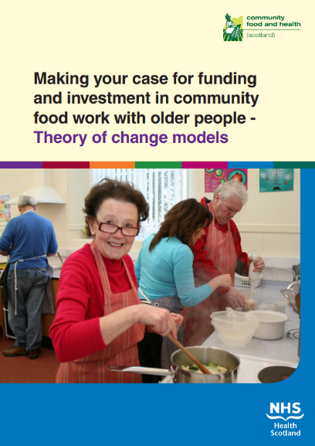
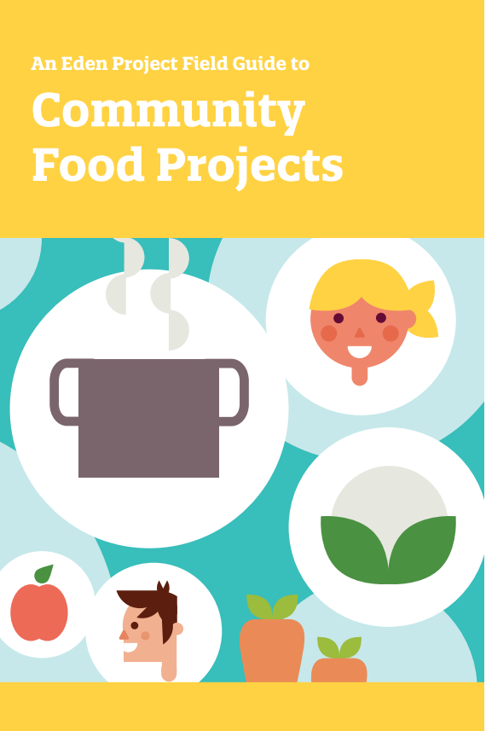
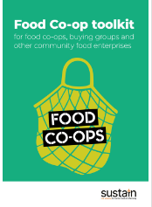
Useful resources
Notes:
Making the case | Community Food and Health (Scotland)
community_food_projects_e-book_0.pdf (edenprojectcommunities.com)
Community Food Projects: A directory of projects on the Food Poverty Database | Sustain (sustainweb.org)
Food Co-ops Toolkit - a simple and comprehensive guide to setting up food co-ops | Sustain (sustainweb.org)

Slide 8
Questions arising
What is our map of provision in York and North Yorkshire like when compared to the 4 community food project framework typologies derived by the Eden Project?
What has been, or is, the current appetite from local residents to develop their own community food initiative / project and if they wanted to, how would they get practical advice and tips beyond the resources identified in this paper?
Has any local self-evaluation been tried by those running the community food projects to understand the benefits they deliver / their local efficacy?
Is there any evidence of York and North Yorkshire landowners being incentivised / encouraged to give over pockets of their land for communities to grow food on?
Notes:
Community café self-evaluation programme | Community Food and Health (Scotland)

